Slide 1
+
Fashion

Slide 3
Fabric for Fashion / Clive Hallett and
Amanda Johnston
Section 2
Plant fibres: Alternative plant fibres

Slide 4
Objectives
Identify alternative plant groups
Describe the key bast fibres
Identify the key properties of bamboo
Summarize the different leaf fibres

Slide 5
Alternative plant fibres
Some have long been part of Asian cultural identity
Others require modern processing techniques to make them viable
Categorized as bast, stem or leaf fibres
All images in this presentation are subject to copyright. Copyright owners are listed in the book.
By downloading these presentations you agree that they are for classroom use only.

Slide 6
Alternative plant fibres
Key alternative bast fibres are jute, ramie and hemp
Additional alternative bast fibres include kenaf, nettle and banana
Bamboo is a stem fibre
Leaf fibres are abacá, piña and raffia

Slide 7
Bast fibres
Bast fibres are ‘soft’ fibres obtained from the phloem or inner skin of the plant
Jute (burlap)
Second to cotton in global consumption
Good tensile and ductile strength
Excellent environmental credentials
Mostly used in furnishing textile industries

Slide 8
Bast fibres
Ramie
China largest producer
Inexpensive linen look-a-like
Stronger than linen and cotton
Blends well with cotton and wool
Sustainable plant with long fibre-producing lifespan

Slide 9
Bast fibres
Hemp
Hemp is the generic name for the Cannabis family of plants
Industrial hemp refers to variety grown for fibre and non-drug purposes
China and Japan have long tradition of cultivating hemp
All images in this presentation are subject to copyright. Copyright owners are listed in the book.
By downloading these presentations you agree that they are for classroom use only.

Slide 10
Bast fibres
Hemp cultivated throughout medieval Europe
By 19th century 80% of global fabric made from hemp
Marijuana Tax Act (U.S. 1937) caused prices to crash – fibre lost favour
Strong, durable fibres with good thermal value offering protection against UV light

Slide 11
Bast fibres
Hemp production
Industrial hemp has been selectively bred to offer poor levels of THC
Finer fibres produced if plant is harvested before flowering
Retting achieved by mechanical pulping or through bacterial action

Slide 12
Bast fibres
Hemp can be ‘cottonized’ by process similar to that used for flax (linen)
Fibres can be made into fabrics from finest lace to heavyweight industrial canvas
Ukraine leads in developing new varieties with improved fibre content and increased yield
Ecologically and sustainable plant – fast growing and does not need pesticides

Slide 13
Bast fibres
Kenaf
China and India major producers
Minimal use of pesticides and fertilizers needed
Emerging uses include engineering applications, insulation paper and clothing-grade fabric
Nettle
Fine long staple fibre that is stronger than cotton
Ecologically sustainable plant
Produces good quality fabric

Slide 14
Bast fibres
Banana
Strong and versatile bast fibre
History of a quality textile in Japan and Nepal
Good absorption and drying properties
Can be processed with chemicals or enzyme retting
All images in this presentation are subject to copyright. Copyright owners are listed in the book.
By downloading these presentations you agree that they are for classroom use only.

Slide 15
Bamboo
Bamboo is a stem fibre of the grass family
Great cultural significance in many East Asian countries
Prolific and fast growing
The variety used for the textile industry is moso bamboo
China is the primary producer

Slide 16
Bamboo
Bamboo fibre
Durable fibre with high tensile strength, smooth next to skin
Wicks away perspiration/moisture quickly
Keeps wearer several degrees cooler in summer than other fibres
Antistatic properties, ideal fabric for active sportswear
All images in this presentation are subject to copyright. Copyright owners are listed in the book.
By downloading these presentations you agree that they are for classroom use only.

Slide 17
Bamboo
Bamboo production
Bamboo for commercial use is plantation-grown
Unlike bast fibres the entire stem (culm) is used
All images in this presentation are subject to copyright. Copyright owners are listed in the book.
By downloading these presentations you agree that they are for classroom use only.

Slide 18
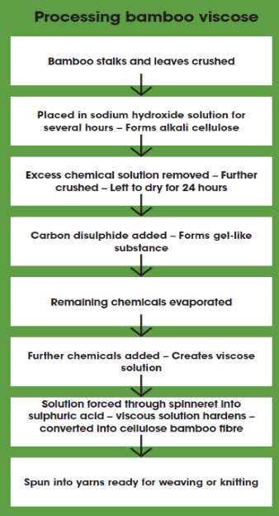

Slide 19
Bamboo
Processing bamboo fibre
Three principal ways to process bamboo into fibre
Bamboo rayon/viscose:
Processed with chemicals as with other wood pulp celluloses
Closed-loop processes used to capture and reprocess solvents, however bamboo’s antibacterial properties and UV protection is lost

Slide 20
Bamboo
Bamboo linen:
Processed through mechanical crushing, high-pressure steam and natural enzyme retting
Lyocell bamboo:
Technique where cellulose is obtained through an organic solvent process
Popular in U.S. where labelling is closely monitored

Slide 21
Bamboo
Ecological sustainability
Sustainable resource that does not require pesticides or chemicals
Naturally bio degrades
Improves and replenishes soil
Generates more oxygen than same acreage of trees
Garments completely biodegradable at end of life cycle

Slide 22
Leaf fibres
Leaf fibres are ‘hard’ fibres produced from strands that run through the leaf
Abacá
The fibre/fabric is known as manila hemp
Currently not used commercially
All images in this presentation are subject to copyright. Copyright owners are listed in the book.
By downloading these presentations you agree that they are for classroom use only.

Slide 23
Leaf fibres
Piña
Piña cloth is a ceremonial fabric used in the Philippines
Made from the leaves of the pineapple plant
Soft, lightweight, easy-care fibres with good translucent lustre in white or ivory

Slide 24
Leaf fibres
Raffia
Generally used for accessories
Fibres dye well
Natural springy quality of weave allows creation of ‘moulded’ garments
All images in this presentation are subject to copyright. Copyright owners are listed in the book.
By downloading these presentations you agree that they are for classroom use only.

Slide 25
Key points
Fibres are categorized as bast, stem or leaf
Bast fibres are ‘soft’ fibres obtained from the inner skin of a plant; include jute, ramie, hemp, kenaf, nettle and banana
Bamboo is a durable stem fibre with high tensile strength; wicks away perspiration and has antistatic properties
Leaf fibres are ‘hard’ fibres produced from strands that run through the leaf; include abacá, piña and raffia

