Slide 1
+
Fashion

Slide 3
Fabric for Fashion / Clive Hallett and
Amanda Johnston
Section 2
Plant fibres: Linen

Slide 4
Objectives
Describe the history of linen
Summarize the development of European linen
Identify the key fibre properties of linen
Outline the ecological and sustainable advantages of linen
Explain the process of linen production

Slide 5
The history of linen
The meaning of linen
The Latin Linum usitatissimum translates literally as ‘useful linen’
‘Lining’ and ‘lingerie’ are words derived from the same origin
‘Linen’ is still used generically to denote household textiles
All images in this presentation are subject to copyright. Copyright owners are listed in the book. By downloading these presentations you agree that they are for classroom use only.

Slide 6
The history of linen
Linen oldest textile in the world
Flax cultivated by early Middle Eastern civilizations
In Egypt, linen used as display of wealth for the afterlife
Symbolic of purity, linen used for Jewish and Christian vestments

Slide 7
The history of linen
Renaissance and Baroque courts passed laws to curtail excessive use of linen
19th-century gentlemen judged by the quantity and quality of their linen
Coarse flax was a fabric of everyday village life in 1800s

Slide 8
The history of linen
Flax vital supply during WWI for tents, ropes and canvas for aeroplanes
In common with other natural fibres, fell out of fashion after World War II
Technological innovations in 1980s and 1990s led to wrinkle-free and shrink-resistant fabric
Unique appeal is once more appreciated

Slide 9
The development of European linen
Northern Ireland and Flanders of great historical importance in production and manufacturing of linen
Italy largest converter of flax fibre into yarn and fabric for both export and domestic markets
The U.S., Italy, Germany, Japan, France and Great Britain all key end markets for linen

Slide 10
Linen fibre
Properties of linen
Strongest vegetable fibre
Natural colour ranges between ivory, tan and grey
Hygroscopic (absorbs moisture)
Not insulative
Thermo-regulating
Fast drying
No give or stretch
All images in this presentation are subject to copyright. Copyright owners are listed in the book. By downloading these presentations you agree that they are for classroom use only.

Slide 11
Ecological considerations
Ideal for organic cultivation
Sustainable crop
Crop production does not strip soil of nutrients
Little irrigation needed
Little energy needed to process
Fully biodegradable
No chemical fertilizers or pesticides required
Can be sun bleached
All images in this presentation are subject to copyright. Copyright owners are listed in the book. By downloading these presentations you agree that they are for classroom use only.

Slide 12
Linen production
Cultivation
Canada and China produce just over 50% of total global production of flax between them
India and U.S. also key producers
Egypt and Ethopia are Africa’s main cultivators
Russia, Ukraine, Belarus and Baltic countries are expanding their flax production
Northern France, Belgium and Netherlands produce the finest premium flax (long-line fibres)

Slide 13
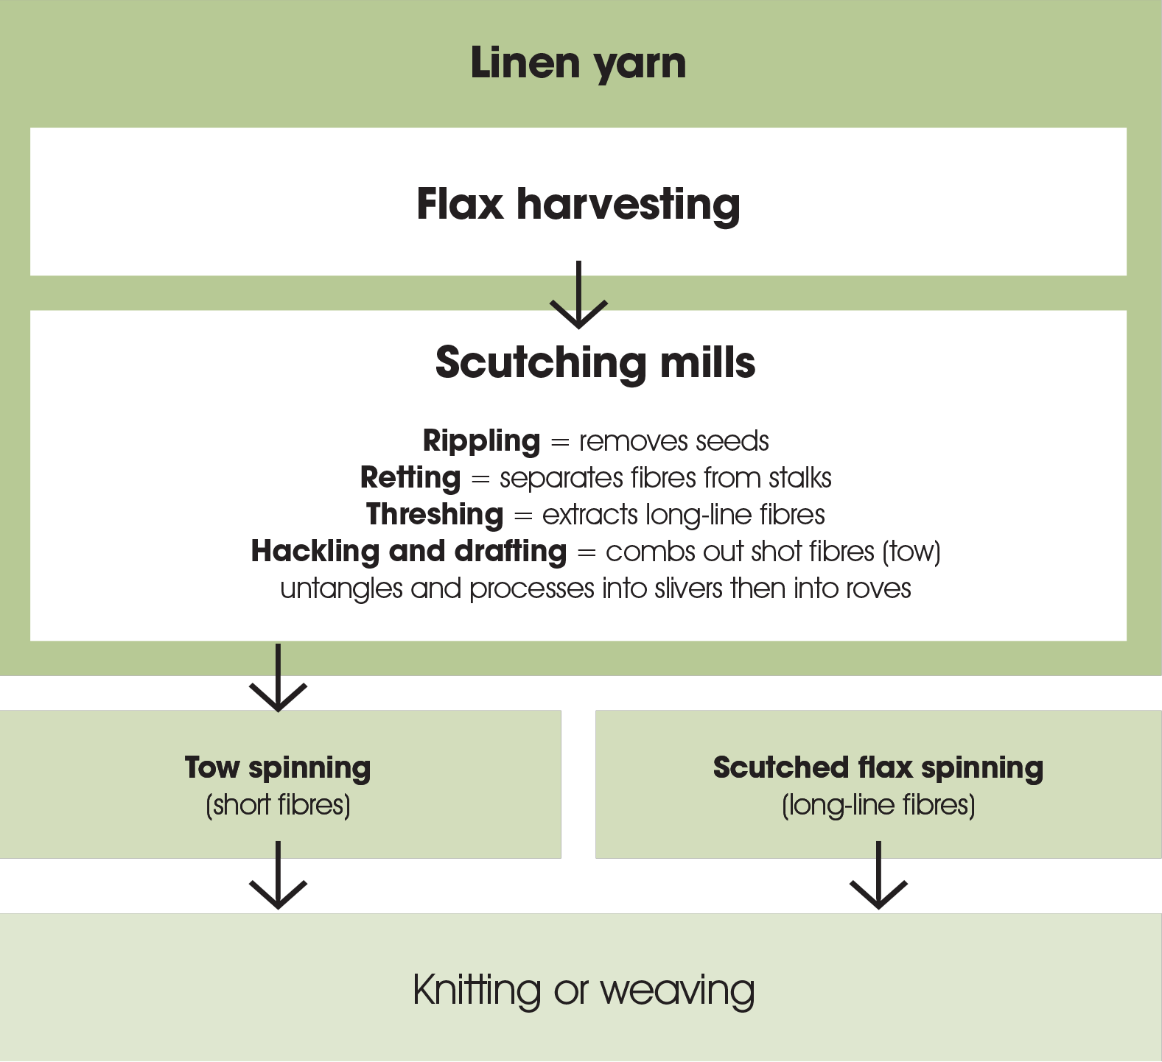
All images in this presentation are subject to copyright. Copyright owners are listed in the book. By downloading these presentations you agree that they are for classroom use only.

Slide 14
Key points
Linen oldest textile in world; popularity has risen and fallen as clothing textile; often associated with wealth
Northern Ireland and Flanders of great historical importance in production and manufacturing of linen; Italy largest converter of flax fibre into yarn and fabric
Hygroscopic, thermo-regulating and fast drying fabric
Flax sustainable crop that can be processed in a fully eco-friendly manner
Linen is produced from flax that is harvested, scutched and spun

