Slide 1
+
Fashion

Slide 3
Fabric for Fashion / Clive Hallett and
Amanda Johnston
Section 3
Man-made fibres: Synthetic fibres

Slide 4
Objectives
Differentiate between synthetic and artificial fibres
Identify the main synthetic fibres produced
Describe the history of synthetic fibres
Explain how polymers are formed
Summarize sustainability issues with synthetic fibre production
Identify the main characteristics of synthetic fibres and metallic yarn

Slide 5
Man-made fibres
Man-made fibres can be categorized as synthetic or artificial
Synthetic fibres are made from chemicals derived from fossil fuels
Artificial fibres are either plant cellulose or bio-engineered
Man-made fibres represent over 70% of all global fibre production

Slide 6
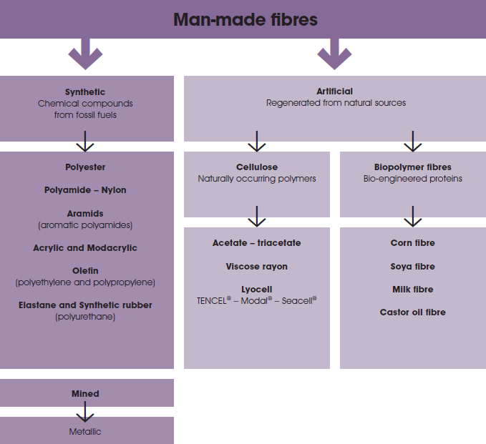

Slide 7
Synthetic fibres
Group of man-made fibres where synthesis has been chemically carried out
Fibres are composed of chains of small unit hydrocarbons synthesized as polymers; mainly sourced from petroleum processed from crude oil
Fibres that dominate market are polyester, nylon, acrylic and polyolefin
Additional fibres include aramids, polyurethanes and synthetic rubber

Slide 8
The history of synthetic fibres
Cellulose acetate and artificial silk in 19th century predate synthetics
Nylon first commercial synthetic; developed as alternative to silk
The U.S., Britain and Germany were at forefront of research into synthetics
Stockings were the first nylon product in 1930s

Slide 9
Polymers and polymerization
Chemicals used derive from oil, coal and natural gas (fossil fuels)
Produced from synthesized polymers; many are not biodegradable
All images in this presentation are subject to copyright. Copyright owners are listed in the book.
By downloading these presentations you agree that they are for classroom use only.

Slide 10
Polymers and polymerization
Polymers are formed by polymerization of monomers (molecules of repeating units bonded together)
Synthesis process combines units into a longer polymer chain
A mix of different chemicals will produce a range of synthetic fibres

Slide 11
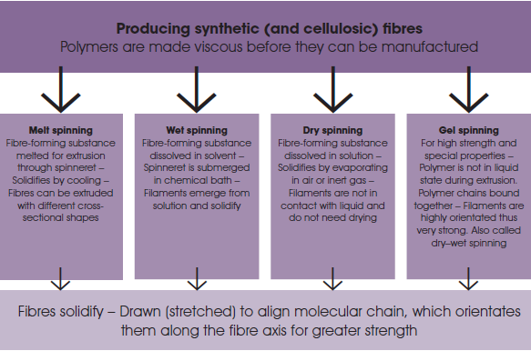

Slide 12
Ecological sustainability
Non-cellulose synthetics are not biodegradable
Synthetics ease strain on agricultural land usage; similar volume of wool fibre requires 60 hectares of sheep grazing land
Under 1% of petroleum is used for global production of synthetic fibres
Production of synthetic fibres requires little water; similar weight of cotton requires 20,000 cubic tonnes of water

Slide 13
Polyester
Most used man-made synthetic fibre; in production since mid 1950s
DACRON® was the trade name for early polyester
Blended with cotton or wool, polyester contributes strength, stability and serviceability
Most commonly used microfibre is made from polyester
Does not biodegrade but can be recycled to almost its virgin state

Slide 14
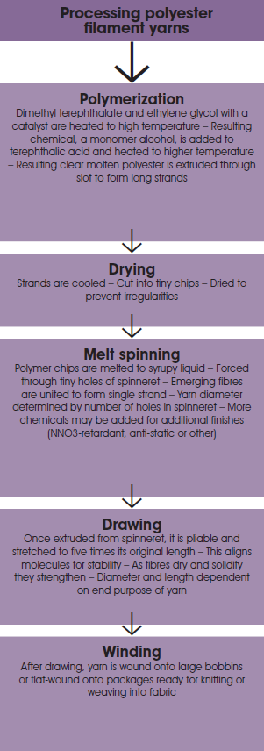

Slide 15
Polyamide (nylon)
First commercially successful synthetic polymer
U.S. and Germany pioneered nylon production in 1930s
Fibres are light, durable and easy to maintain
GORE-TEX®, TACTEL ® and CORDURA® are made from nylon
Base materials are coal and petroleum; nylon is not biodegradable

Slide 16
Aramid fibres (aromatic polyamides)
Fabrics are used in performance and protective clothing industries
Nomex® and Kevlar® most commercially used aramid fabrics
Both are produced by DuPont in fibre or sheet form

Slide 17
Aramid fibres (aromatic polyamides)
Fibres have exceptional thermal and fire-resistant properties
On a weight-for-weight basis Kevlar® is five times stronger than steel; it is cut-resistant and bulletproof
All images in this presentation are subject to copyright. Copyright owners are listed in the book.
By downloading these presentations you agree that they are for classroom use only.

Slide 18
Acrylic fibres
Germany and U.S. involved in research in 1930s
Commercial production commenced in 1950s
Used for knitwear because of wool-like touch
Acrylic brands include Orlon®, Acrilan®, Dralon® and LEACRIL®
Today production centred in Far East, Turkey, India and Mexico

Slide 19
Acrylic fibres
Acrylic is a durable, low-maintenance fibre with good shape retention
Modacrylic (MAC) is a modified version used for flame-retardant garments, children’s clothing and soft toys
Acrylic production can be energy-intensive; fibres do not degrade
Research has found acrylic to be least sustainable fibre from a basket of ten different textiles (Hong Kong Polytechnic University in China report)

Slide 20
Olefin fibres – polyolefin or polyalkene
Polyolefin is a lightweight fibre with the lowest specific gravity of all fibres
Fibres are easy to thermally bond; ideal for competitive swimwear
DuPont produces Tyvek® used for protective apparel
3M produces Thinsulate™ used for skiwear
Olefin is inexpensive to produce, relatively environ-mentally friendly and recyclable

Slide 21
Polyurethane (elastomers)
Elastane is generic term for yarns and fabrics with exceptional elasticity
In North America the term ‘spandex’ is used
LYCRA® best known of all elastane yarns
Elastane is not a fabric; yarns must be used together with other yarns, natural or man-made, to form fabric with elastomeric qualities
Fabric stretch is in the construction; elastane provides the recovery
When stretched to three times its original length elastane should recover rapidly and substantially to its initial length

Slide 22
Polyurethane (elastomers)
Elastane also used for woven fabrics; referred to as weft- or warp-stretch depending on where the elastane yarn has been used
Comfort stretch implies limited stretch and is suited to leisurewear
Elastane has been a driving force in the development of performance clothing
Elastomeric yarns enhance muscle recovery while reducing muscle fatigue

Slide 23
Synthetic rubber
Principal synthetic rubbers are neoprene and Ariaprene™
Ariaprene™ is eco-friendly, non-toxic, and reusable
Bonding synthetic rubber to lightweight fabrics adds stability and strength

Slide 24
Metallic yarns
Metals are not synthetics but are mined from the ground
‘Aluminized’ yarns have replaced gold and silver yarns of the past
Metallic yarns are either produced by lamination or by metallizing
Lamé and brocade are examples of fabrics using metallic yarns

Slide 25
Key points
Synthetic fibres are made from chemicals derived from fossil fuels; artificial fibres are either plant cellulose or bio-engineered
Polyester, nylon, acrylic and polyolefin dominate the synthetic fibres global market
The U.S., Britain and Germany were at forefront of research into synthetics
Polymers are formed by polymerization of monomers (molecules of repeating units bonded together)
Non-cellulose synthetics do not biodegrade; however synthetic production requires little water and land use
Synthetic fibres are generally durable and strong and make ideal intelligent performance fabrics

