Slide 1
+
Fashion

Slide 2
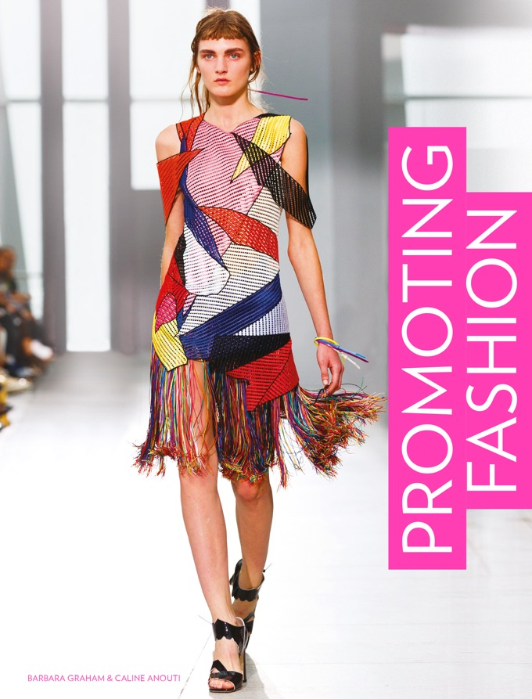

Slide 3
Promoting Fashion / Barbara Graham, Caline Anouti
Chapter 1
Consumers and Consumer Trend-forecasting

Slide 4
Objectives
Create a consumer profile using socio-demographic groupings and psychographics.
Differentiate between consumer groups by generation and attitudes.
Understand how different eras influence trends.
Watch how trends develop, grow and fade, both fads and longer-term tendencies.
Create trend predictions by learning how a trend forecasting agency researches and distills relevant material.

Slide 5
Key Theories
Diffusion of Innovation model (Rogers).
Postmodern / Post-postmodern theory.

Slide 6
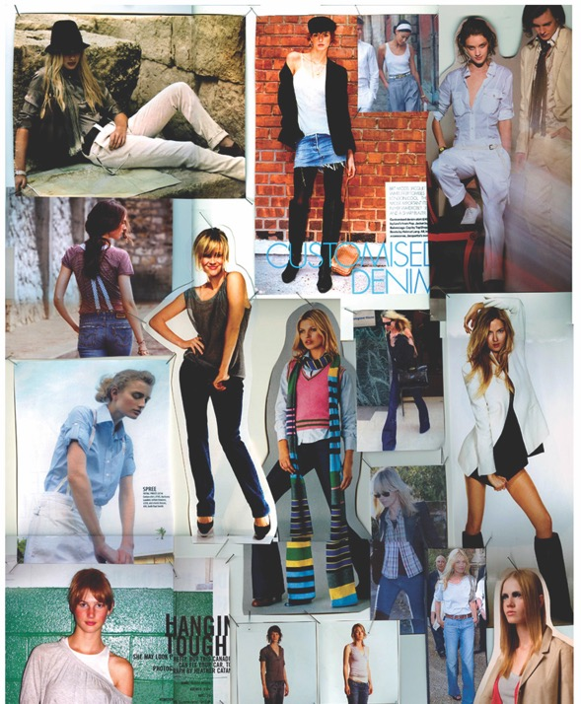
Consumer Profiling
Customer profile boards are often generated by product designers.
These act as a visual building block for the consumer type.
All images in this presentation are subject to copyright. Copyright owners are listed in the book. By downloading these presentations you agree that they are for classroom use only.

Slide 7
Consumer Profiling
The way consumers are profiled has changed since the 1950s, when people were expected to be passive users of product ideas from all-powerful brands.
Promoters of fashion now need the active contribution of consumers.
Today, a more detailed picture is formed to suggest how consumers may behave or what they may aspire to.

Slide 8
Consumer Profiling
Socio-economic profiling
In the UK, the National Readership Survey (NRS) was developed in the mid-1960s to classify types of consumer through social status.
NRS Socio-Economic Groupings or the social grade definition system is still referred to occasionally when dealing with media such as fashion magazines.

Slide 9
Consumer Profiling
Geo-demographic profiling
Geo-demographic systems such as Mosaic, developed in the 1980s, were introduced on the principle that where a consumer lived would be consistent with certain behaviour.
As of 2018, Mosaic Global compiled data from 26 million households in 25 of the world’s top economies.
The system is based on the belief that there are similarities in enclaves of inhabitants across the globe.

Slide 10
Consumer Profiling
Consumer psychographics
VALS 2 is one of the best-known systems of psychographic profiling.
Developed in 1989 by a team of US academics, VALS 2 built on Arnold Mitchell’s original Values and Lifestyles model (1978).
VALS 2 uses lifestyle factors, motivators, attitudes and consumer psychology to predict behaviours.
Anyone can take the VALS survey online.

Slide 11
Consumer Profiling
Emotive segmentation
Developed by VisualDNA, emotive segmentation adds detail to psychographic profiling to help brands target consumers more individually.
The system accepts that location is no longer relevant to online behaviour.
Using data gathered by visual quizzes, VisualDNA credits a consumer’s general interests, aspirations and dreams, resourcefulness, state of mind, openness, conscientiousness, extroversion, agreeableness and neuroticism.

Slide 12
Generational Attitudes
Another method of profiling consumers is based on the generation in which a person was born.
Changing attitudes to ageing, in particular to the word ‘old’, are now blurring long-held generational groupings.
Age compression (desire to be older sooner) among young consumers and age expansion (desire to stay younger longer) among older consumers are factors.

Slide 13

Generational Attitudes
KGOY (Kids Getting Older Younger).
Tweens (ages 10–14) maturing quickly.
Adolescence lasting until early thirties.
Baby boomers, born after WWII, not accepting the word ‘old’.
60-year-old model Yasmina Rossi for the Dreslyn and Land of Women collaboration, 2016.
All images in this presentation are subject to copyright. Copyright owners are listed in the book. By downloading these presentations you agree that they are for classroom use only.

Slide 14
Generational Attitudes
Brand implications
Swing Generation (Silent Generation) | Baby Boomers | Generation X | Generation Y (Millennials, Echo Boomers) | Generation Z (Centennials, Boomlets)
Born pre-1946 | Born 1946–64 | Born 1965–80 | Born 1981–90 | Born 1991–2002
Brands: Trusted | Brands: Heritage | Brands: Anti | Brands: Creative | Brands: Inventive
Attitude: Brands should last a lifetime. | Attitude: Brands are social badges. | Attitude: Branding is a commercial device. | Attitude: Brands should put consumers first. | Attitude: Want to engage with brands.
Admire: Quality, longevity, hierarchy. | Admire: Heritage values. | Admire: Limited editions. | Admire: Being engaged with brands. | Admire: Being credited by inclusive brands.
Personal focus: Repair, reuse, recycle. | Personal focus: Reinvention. | Personal focus: Being cool. | Personal focus: Contribution. | Personal focus: Being engaged.

Slide 15
Generational Attitudes
The Flat Age
In 2014 The Future Laboratory predicted a further blurring of generational divides: ‘The Flat Age’.
Technologically engaged baby boomers accounted for 45% of global spend on luxury products.
We are moving away from a youth-driven society to one where age is less relevant.

Slide 16
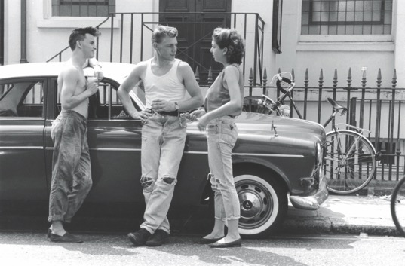
The Development of Consumer Trend-watching
In 1985 Levi’s established a template for a successful ad. No other jeans brand managed to replicate it.
The Dirtbox look or ‘hard times’ style was a major trend in London.
Innovators were snapping up Levi’s 501s and the brand tapped into this demand.
Dirtbox rockabillies on King’s Road, London, in the 1980s
All images in this presentation are subject to copyright. Copyright owners are listed in the book. By downloading these presentations you agree that they are for classroom use only.

Slide 17
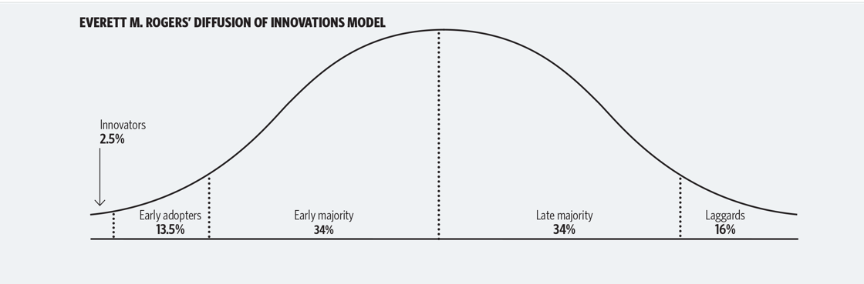
The Development of Consumer Trend-watching
The Diffusion of Innovation
All images in this presentation are subject to copyright. Copyright owners are listed in the book. By downloading these presentations you agree that they are for classroom use only.

Slide 18
The Development of Consumer Trend-watching
The Diffusion of Innovation
Innovators (2.5%) translate an idea to a certain frame of reference.
Early adopters (13.5%) are better connected than innovators and are happy to make an idea more acceptable.
The early majority (34%) observes how a trend fares before adopting it themselves.
The late majority (34%) needs lots of examples of a trend’s success before adopting it.
Laggards (16%) are much more resistant to change.

Slide 19
Postmodernism
Since the early 1960s we have been living in a time described as postmodern – a reaction to the progressive, optimistic spirit of the modern era (1900–1960).
Postmodernism represents exhaustion and the questioning of truth.
Postmodernism is under much debate by theorists, as is the idea that we have entered a post-postmodern era.

Slide 20
Postmodernism
Fragmentation
Fragmentation is the breaking down of political stability, economic theories and social organization in tandem with the increasing influence of media opinion.
We are unsure what is actual news, what is opinion or what is embellished truth.
‘Fragmentation’ is also used to describe the breaking down of segments of consumer groups to almost personal status.

Slide 21
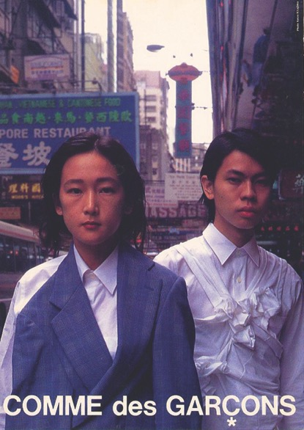
Postmodernism
Dedifferentiation
Dedifferentiation is the blending of what were once high and low cultures, such as politics and celebrity, or high fashion and gritty urban landscapes.
It also refers to the blurring of boundaries such as gender.
Comme des Garçons, 1995.
All images in this presentation are subject to copyright. Copyright owners are listed in the book. By downloading these presentations you agree that they are for classroom use only.

Slide 22
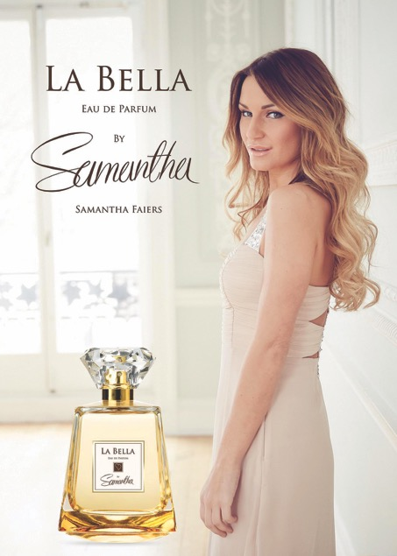
Postmodernism
Hyper-reality
Hyper-reality is the elevation of fantasy worlds and a questioning of what is real and what is simulation.
Has grown to encompass reality TV, virtual worlds and immersive gaming experiences.
Reality TV star ad campaign.
All images in this presentation are subject to copyright. Copyright owners are listed in the book. By downloading these presentations you agree that they are for classroom use only.

Slide 23
Postmodernism
Pastiche / Bricolage
The use of collages of existing styles and codes, reassembled with a sense of playfulness.
John Paul Gaultier, 2014.
All images in this presentation are subject to copyright. Copyright owners are listed in the book. By downloading these presentations you agree that they are for classroom use only.

Slide 24
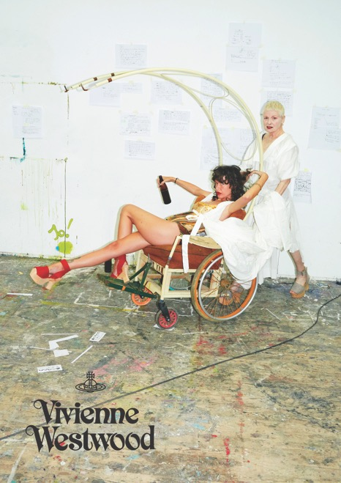
Postmodernism
Anti-foundationalism
The desire to deconstruct; to question what is outerwear and what should be concealed.
The details of construction are respected.
There is a desire to see ‘behind the scenes’.
Vivienne Westwood, 2015.
All images in this presentation are subject to copyright. Copyright owners are listed in the book. By downloading these presentations you agree that they are for classroom use only.

Slide 25
How a Trend-forecasting Agency Works
Consumer-watching is an established industry with companies such as trendwatching.com, The Future Laboratory, WGSN and trendstop providing key trends to both fashion and other sectors.

Slide 26
How a Trend-forecasting Agency Works
The trendwatching.com perspective
In 2018, trendwatching.com had over 2,000 trend-spotters around the globe.
Anyone with an eye for trends or business innovations can apply to join their trend-spotting network and submit trend ideas.
Offices in New York, São Paulo, Singapore, London and Lagos manage the potential trends that pour in from their trend-spotting network.
Confirmed trends are synthesized into premium services reports for paying clients and later free bulletins for subscribers.

Slide 27
A report from trendwatching.com.
All images in this presentation are subject to copyright. Copyright owners are listed in the book. By downloading these presentations you agree that they are for classroom use only.

Slide 28
Key Points
The profiling of consumers has changed from location- and job-based factors to incorporate attitudes, motivations, aspirations, intentions and personality traits.
Long-held generational attitudes are blurring and changing as age slowly becomes less relevant.
The era in which we live dictates that certain types of trends will emerge and be acceptable.
Knowledge of the consumer should be at the heart of all product branding as well as marketing ideas.

