Slide 1
+
Fashion

Slide 2
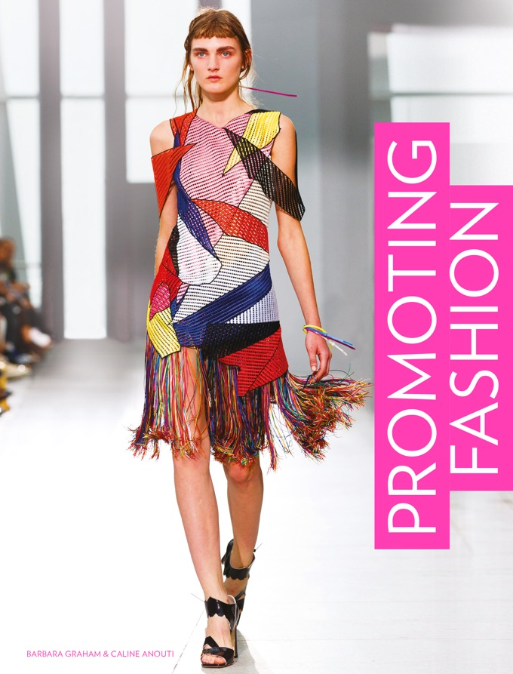

Slide 3
Promoting Fashion / Barbara Graham, Caline Anouti
Chapter 10
Catwalk Fashion Shows and Trade Fairs

Slide 4
Objectives
Find out when and where international fashion events and trade shows take place.
Consider the role of such events in marketing communications.
Understand what is involved in showing at a fashion week or trade fair.
Invite consumers to be involved.

Slide 5
International Fashion Weeks and Trade Fairs: An Overview
Showing at a fashion week or trade show is an effective, if costly, way to reach a wider audience.
It is the quickest way to see the right store buyers.
Therefore it is closely linked to personal selling objectives.
ROI is directly measurable against orders achieved.
It also attracts trade and fashion press.

Slide 6
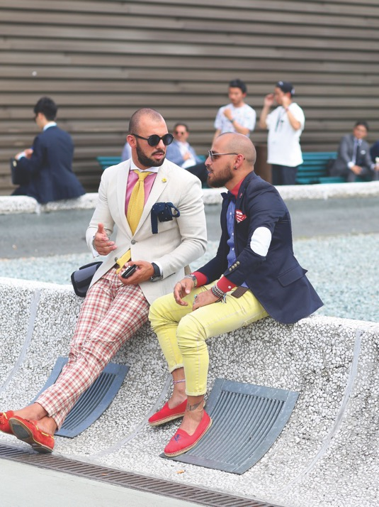
International Fashion Weeks and Trade Fairs: An Overview
Trade fairs such as Pitti Uomo in Florence are popular B2B networking events.
Pitti Uomo is one of the earliest shows in the year and a great place to observe trends.
All images in this presentation are subject to copyright. Copyright owners are listed in the book. By downloading these presentations you agree that they are for classroom use only.

Slide 7
International Fashion Weeks and Trade Fairs: An Overview
Show timings
Selling seasons were traditionally six months before goods appeared in stores.
Spring/Summer is still shown in August/September and Autumn/Winter in February/March.
This gives designers and brands time to take orders, manufacture and ship goods to stores.

Slide 8
International Fashion Weeks and Trade Fairs: An Overview
Pre-collections
Catwalk designers show ‘pre-collections’. Pre-spring, Resort or Cruise collections are shown in June/July.
Developed by US labels offering lighter ranges to wealthy clients travelling to warmer climates.
In Europe these collections are in-store from November until early spring at full price.

Slide 9
International Fashion Weeks and Trade Fairs: An Overview
As well as fashion weeks, there are trade fairs such as Tranoi in Paris, Project in Las Vegas, Panorama in Berlin and CHIC in Shanghai.
There are specialist fairs for denim, lingerie, footwear and streetwear.
Buyers plan their time to see the most interesting and lucrative labels.

Slide 10
Cities of Fashion
Milan, Paris, New York and London (the big four) are the historical cities of fashion.
Increased spending power in newer economies has spawned new fashion cities including São Paulo, Tokyo, Mexico City, Seoul, New Delhi, Shanghai, Tel Aviv and Moscow.
Labels may show in a city where they have invested in a flagship store or seek to reach a new audience.

Slide 11
Showing at the International Fashion Week Catwalk Shows
To show at a major fashion week, a brand needs a venue, stylists, models (15–20), hair and make-up artists, PR and production staff and possibly a celebrity appearance.
In 2014 the cost was in the region of $33,000 – excluding the garments.
Agencies such as the British Fashion Council (UK) or Council of Fashion Designers (US) can help with costs.
New designers are encouraged to work with these bodies.

Slide 12
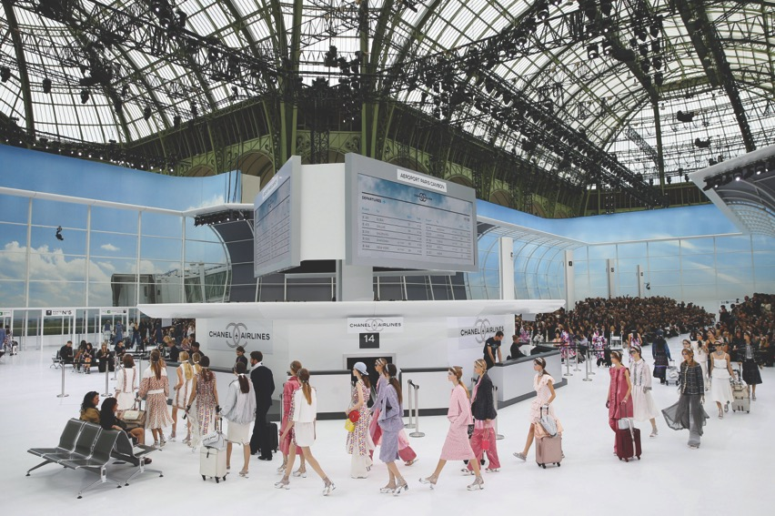
Showing at the International Fashion Week Catwalk Shows
The cost of staging an elaborate show such as Chanel’s SS2016 is unknown. The brand created Chanel Airlines, including check-in desk and departure boards, set inside the Palais-Royale Paris.
All images in this presentation are subject to copyright. Copyright owners are listed in the book. By downloading these presentations you agree that they are for classroom use only.

Slide 13
Showing at the International Fashion Week Catwalk Shows
International fashion week websites, applications and entry criteria
Schedules, exhibitor details, locations, press rooms and designer profiles are available at sites such as LondonFashionWeek.co.uk and NYFW.com.
To enter, designers must have been in business for a number of years and have a minimum number of stockists – and provide references.
Static exhibitions connected to fashion weeks can provide a cheaper alternative for newcomers.

Slide 14
Showing at the International Fashion Week Catwalk Shows
Involving the consumer
At a trunk show, designers seek to take orders from valued clients in an exclusive setting.
Livestreaming means the consumer is increasingly able to order from the catwalk.
Burberry were the first to exploit new technology in AW 2011–12. Some clients were promised delivery in seven weeks of items ordered from the catwalk.
In subsequent years the brand livestreamed on Twitter and used Twitter Buy.

Slide 15
Showing at the International Fashion Week Catwalk Shows
Involving the consumer
In 2016 Burberry previewed real-time show preparations on Snapchat. The footage disappeared 24 hours later.
In 2015 Givenchy showed SS2016 at Pier 26 New York and offered 920 tickets in a draw.
In 2016 Burberry showed a men’s and women’s seasonless collection, available from the catwalk.
The campaign and the product were released online and in-store simultaneously, introducing ‘see now, buy now’ shopping.

Slide 16
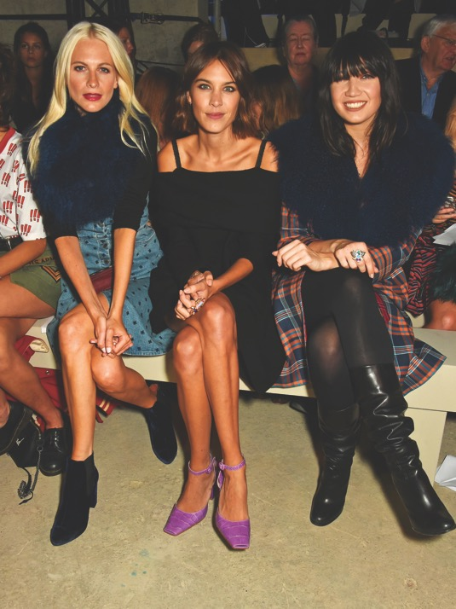
Showing at the International Fashion Week Catwalk Shows
Involving the consumer
Henry Holland 2016. Poppy Delevingne, Alexa Chung and Daisy Lowe wear rings incorporating near-field technology. Corresponding tags on garments enabled a bluetooth connection to a payment network.
All images in this presentation are subject to copyright. Copyright owners are listed in the book. By downloading these presentations you agree that they are for classroom use only.

Slide 17
Showing at Trade Fairs
For premium, mid- and mass-market brands a trade fair offers a more economical and direct route to build relationships with buyers.
RTW trade fairs follow the seasonal selling pattern, taking place in January/ February and July/August, slightly ahead of the catwalk shows.
Brands hope to take forward orders for delivery in six months.

Slide 18
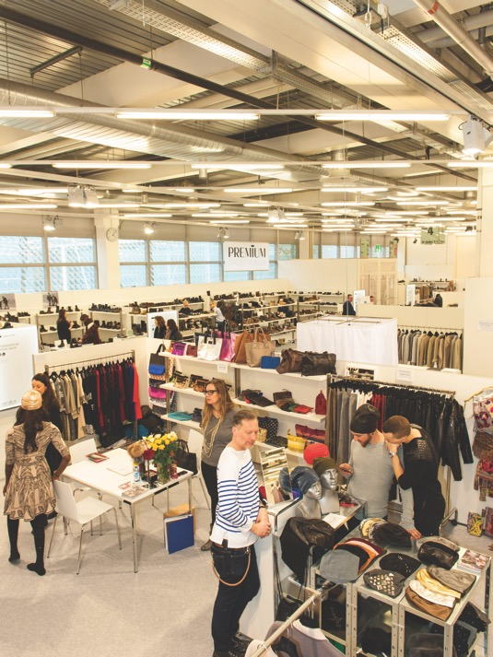
Showing at Trade Fairs
The traditional layout of a trade fair such as Premium in Berlin. Brands are laid out along aisles and grouped together in sympathetic product areas.
All images in this presentation are subject to copyright. Copyright owners are listed in the book. By downloading these presentations you agree that they are for classroom use only.

Slide 19
Showing at Trade Fairs
Increasingly buyers reserve budgets for immediate deliveries, to take advantage of latest trend and sales information.
In this sector brands will show two seasons at once: the main season (for forward orders), and current stock items that they can deliver in a few weeks.
For smaller brands, one sales range may be enough to show buyers.
Larger brands may show to visitors from several territories and countries.

Slide 20
Showing at Trade Fairs
Entry criteria and costs
Entry criteria are not as rigorous as for catwalk shows but organizers like to create a curated, intimate setting.
Brands provide images and meet other criteria such as evidence of workmanship or transparency of approach.
Costs vary with the kudos of the show and size of the stand.
Some brands spend a lot. At Berlin’s Bread and Butter trade fair in 2012, Tommy Hilfiger installed an ice rink complete with model penguins.

Slide 21
Showing at Trade Fairs
Considerations for showing at a trade fair
Brands should show among complementary labels. If the brand is new, make sure that the fair will attract like-minded buyers.
Trade fairs fall in and out of fashion, and negative trade press can drive buyers to other shows.

Slide 22
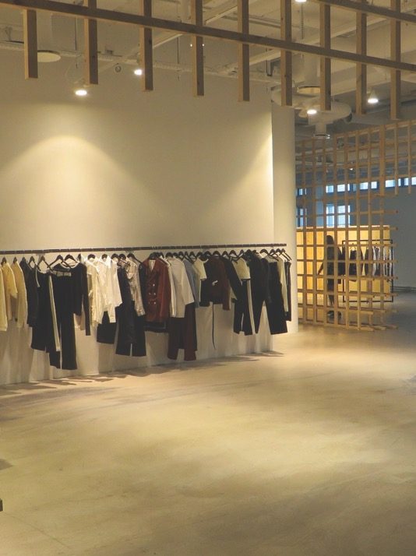
Showing at Trade Fairs
Considerations for showing at a trade fair
John Skelton of London’s LN-CC store co-curated the 2015 edition of CIFF Raven, which enabled buyers to envisage the brands in-store in a B2C sales environment.
All images in this presentation are subject to copyright. Copyright owners are listed in the book. By downloading these presentations you agree that they are for classroom use only.

Slide 23
Showing at Trade Fairs
Involving the consumer
Bread and Butter in Berlin opened to the public in 2015, under new investor, German e-tailer Zalando.
Panel discussions, live music and events were also available to the public.
The idea was mooted earlier and dropped in the face of huge industry objection.
The future of fashion trade fairs remains under debate. Could buyers approach labels directly on social media?
For the moment fairs remain valued forums.

Slide 24
Key Points
Although a significant expense, showing at a catwalk show or a trade fair remains an effective showcase for press and sales.
The evolution of ‘see now, buy now’ culture has disrupted a 40-year-old selling model. Brands are under increasing pressure to sell in-season.
Catwalk shows traditionally integrated a B2B event with PR and personal selling. Now shows are linked to the B2C shopping environment.
Trade fairs too are slowly opening up to B2C sales.

