Slide 1
+
Fashion

Slide 3
Fabric for Fashion / Clive Hallett and
Amanda Johnston
Section 2
Plant fibres: Cotton

Slide 4
Objectives
Describe the history of cotton
Understand the key fibre properties of cotton
Explain the process of cotton cultivation and production
Identify the different types of luxury cotton
Summarize the ecological and sustainable issues regarding cotton

Slide 5
The history of cotton
Cultivation started almost simultaneously in India and South America
First produced 6000 years ago along banks of Indus River (now Pakistan)
Exported to Mesopotamia (now Iraq) and on to Egyptians of Nile valley

Slide 6
The history of cotton
Cotton also indigenous to Central and South America; important to the cultures of pre-Spanish Peru
Important fibre in late medieval Europe
Cotton well known around globe by 1500s
All images in this presentation are subject to copyright. Copyright owners are listed in the book. By downloading these presentations you agree that they are for classroom use only.

Slide 7
The history of cotton
By 16th century cotton cultivated throughout warmer regions of Asia and the Americas
In 18th and 19th centuries, India’s important cotton industry sabotaged during British colonial rule; India only supplied less valuable raw material
All images in this presentation are subject to copyright. Copyright owners are listed in the book. By downloading these presentations you agree that they are for classroom use only.

Slide 8
The history of cotton
Industry
Industrial Revolution boosted manufacturing
Spinning jenny (1764) and spinning frame (1769) enabled spinning of multiple yarns
Invention of cotton gin in U.S. (1794) fundamental to mass production of cotton

Slide 9
The history of cotton
English weavers able to produce to higher and more consistent standard
Textile production became Britain’s leading export
Manchester capital of global cotton trade – nicknamed ‘cottonopolis’

Slide 10
The history of cotton
American cotton after the Civil War
Emancipation of slaves did not diminish importance of southern cotton
Labour forces of black farmers worked on white-owned plantations for a share of the profits – sharecropping
Cotton handpicked until the 1950s
Sophisticated machines to pick cotton introduced in 1950s that would not damage crops

Slide 11
The history of cotton
Cotton market
One third of all global raw cotton is traded internationally
Production and export of cotton involves over 100 countries
Employs 350 million people in its farming, production, transportation and manufacturing
All images in this presentation are subject to copyright. Copyright owners are listed in the book. By downloading these presentations you agree that they are for classroom use only.

Slide 12
The history of cotton
China largest producer and consumer of raw cotton; supplements domestic production with imported raw material
India, Pakistan and Turkey also supplement domestic raw cotton production to fulfil export of finished goods
The cotton belt (southern U.S.) is second largest producer of raw cotton
The U.S. and Israel are the two highest-cost cotton producers

Slide 13
Cotton fibre
Cotton most commonly used natural fibre
Soft fibre that grows around the seeds of cotton plant
Native of tropical and subtropical regions
Untreated cotton fabric has a matt lustre, soft drape and smooth touch
Cotton garments have a good level of moisture absorption
All images in this presentation are subject to copyright. Copyright owners are listed in the book. By downloading these presentations you agree that they are for classroom use only.

Slide 14
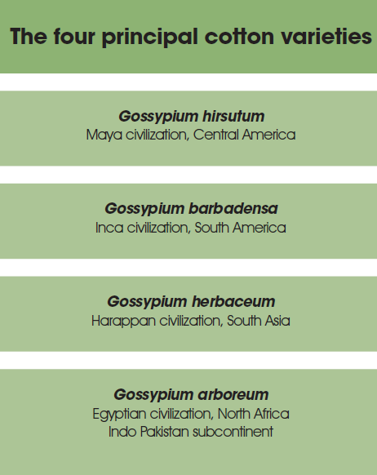

Slide 15
Cotton production
Cultivation requires long, frost-free periods, plenty of sunshine and moderate rainfall
Also cultivated in areas with less rain, water being obtained by irrigation
100 million rural households around the world involved in cotton production

Slide 16
Cotton production
Cotton still mainly picked by hand in developing world
Less than 10% picked weight lost in subsequent production processes
Staple length, colour, cleanliness and micronaire determine price
Once cleaned the fibre is carded and spun into yarn

Slide 17
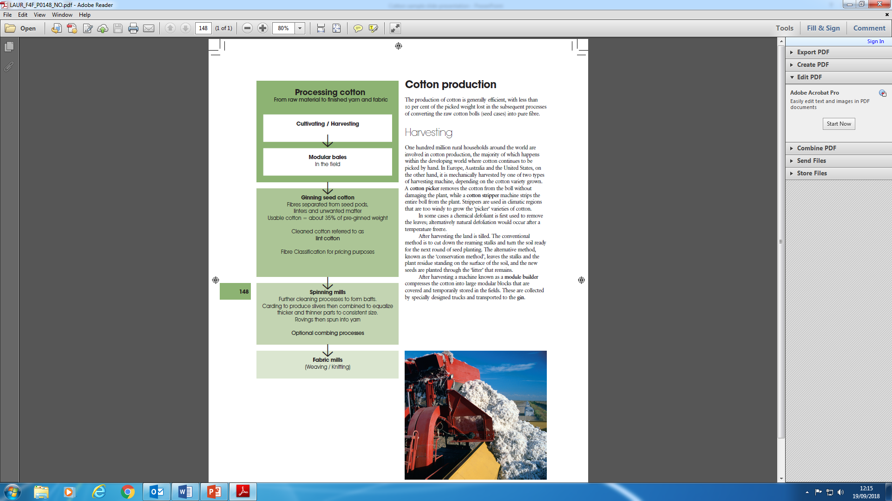

Slide 18
Luxury cotton
Longer staple fibres withstand extra combing processes
Egyptian cotton: only if extra-long staple Gossypium barbdensa or hirsutum species
Sea Island cotton (Gossypium barbdensa): anti-fungal properties
Pima cotton (Gossypium barbdensa): Supima® 100% American-grown Pima cotton with guaranteed staple length (of more than 3.5 cm)

Slide 19
Luxury cotton
Mercerized cotton: treatment rendering yarn/fabric smooth and lustrous
Cotton lisle: similar to mercerized cotton in that all the lint is burnt off
Filo di Scozia®: top grade two-ply, combed long-staple double mercerized
Cotton cupro: made from cellulose fibres from discarded lintners; cotton properties look and feel like silk

Slide 20
Ecological and ethical considerations
Carbon footprint – 30% of harvested cotton for T-shirt production is shipped to a second country for manufacturing
Pesticides/insecticides – prevalent in the developing world; some sources attribute deaths to their use
GM cotton – reduces use of insecticides
Water consumption – thirsty crop presents problems to some countries

Slide 21
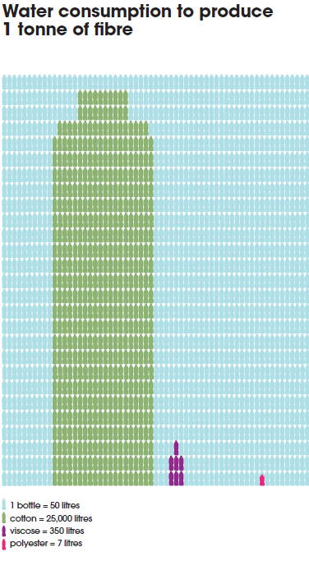
Ecological and ethical considerations
Subsidies – 53% of global cotton is government subsidized
FAIRTRADE® – certification that farmers receive market price for sustainable production
Ethical trading – business model that aims to ensure acceptable minimum labour standards are met in the supply chain
All images in this presentation are subject to copyright. Copyright owners are listed in the book. By downloading these presentations you agree that they are for classroom use only.

Slide 22
Ecological and ethical considerations
Organic cotton
Organic cotton relies on crop rotation and use of natural enemies to suppress harmful insects
More expensive to produce; represents small percentage of global production
Naturally coloured cotton
Peruvian Pima and Tangüis cotton are naturally coloured and organically grown
Requires minimal maintenance, no fertilizers, is insect resistant and less thirsty

Slide 23
Key points
One third of all global raw cotton is traded internationally; China and U.S. are largest producers
Cotton is a soft fibre; garments have a good level of moisture absorption
Cotton cultivation requires sunshine and moderate rainfall; processing involves harvesting, ginning (to turn into fibre), spinning and weaving
Egyptian, Sea Island and Pima cotton are marketed as luxury varieties; mercerized cotton, cotton lisle and Filo di Scozia® represent luxury processing techniques
Ecological and ethical considerations include carbon footprint, the use of pesticides, GM cotton, and high levels of water consumption

