Slide 1
+
Fashion

Slide 3
Fabric for Fashion / Clive Hallett and
Amanda Johnston
Introduction
Fibres to fabrics

Slide 4
Objectives
Describe the fibre to yarn process
Recognize different methods of fabric construction
Explain when dyeing can take place
Identify different surface decoration techniques
Describe the various fabric finishing processes

Slide 5
Fibre to yarn
The term fibre is applied to animal, vegetable or mineral substances
Yarns are fibres spun together forming continuous lengths of interlocked fibres
Yarns are usually woven or knitted together into fabric and either dyed before or after this process
All images in this presentation are subject to copyright. Copyright owners are listed in the book.
By downloading these presentations you agree that they are for classroom use only.

Slide 6
Fibre to yarn
Carding is a brushing process to align fibres in preparation for spinning
Combing is an additional process after carding; it removes short fibres and gives a better and smoother finish
Spinning is the process of twisting fibres together to bind them into a stronger, longer yarn
All images in this presentation are subject to copyright. Copyright owners are listed in the book.
By downloading these presentations you agree that they are for classroom use only.

Slide 7
Fibre to yarn
Yarns are either ‘Z’ twisted (to the right) or ‘S’ twisted (to the left)
Tightness of twist is measured in TPI (twists per inch)
Two or more spun yarns twisted together is referred to as ‘ply’
All images in this presentation are subject to copyright. Copyright owners are listed in the book.
By downloading these presentations you agree that they are for classroom use only.

Slide 8
Fabric construction
Weaving
The 3 main weave types are plain weave, twill weave and satin weave
Plain weave construc-tion has warps and wefts criss-crossing each other at right angles
Plain weaves can be coarse or smooth dependent on thread count
All images in this presentation are subject to copyright. Copyright owners are listed in the book.
By downloading these presentations you agree that they are for classroom use only.

Slide 9
Fabric construction
Twill weave has a visual diagonal effect; more pronounced effect on heavier fabrics
Twill-weave fabrics have a different appearance on face and reverse sides
Higher/finer yarn counts can be used for twill weaving; when packed closely together they produce stronger, more durable fabrics
All images in this presentation are subject to copyright. Copyright owners are listed in the book.
By downloading these presentations you agree that they are for classroom use only.

Slide 10
Fabric construction
Satin weave has a high sheen and smooth surface; has predominance of warp threads to the face side
Sateen weave has a dull sheen and smooth surface; has predominance of weft threads
Pile weaving is a technique used to make velvets and corduroys
Double-cloth weaving creates fabrics with two face sides

Slide 11
Fabric construction
Jacquard loom weaving enables an unlimited variety of designs; the term is applied to both woven and knitted fabrics
Tapestry weaving is done on a vertical loom; warps are hidden
Ikat weaving implies the threads have been dyed at predetermined intervals along their length

Slide 12
Fabric construction
Knitting
Knitting refers to both sweater-knits (totally or partially constructed on a knitting machine) and Jerseywear garments such as T-shirts and polo shirts (cut and made from knitted fabric)
Term refers to any knitted fabric regardless of how fine it is
Needle size, yarn thickness and stitch size dictates fineness of fabric

Slide 13
Fabric construction
The term gauge in machine knitting expresses the needle size
The higher the gauge number the finer the fabric
Denier is a term used in very fine knitwear such as hosiery
All images in this presentation are subject to copyright. Copyright owners are listed in the book.
By downloading these presentations you agree that they are for classroom use only.

Slide 14
Fabric construction
Fully fashioned describes the shaping of knitwear by increasing and decreasing stitches in a row
Cut-and-sewn knitwear implies the fabric is first knitted and the garment is then cut and sewn in a similar way to woven fabrics

Slide 15
Fabric construction
Felting
Felt is a non-woven cloth produced by condensing fibres together
Felted fabrics predate woven and knitted fabrics
30% wool necessary for felted fabric to hold together
All images in this presentation are subject to copyright. Copyright owners are listed in the book.
By downloading these presentations you agree that they are for classroom use only.

Slide 16
Fabric construction
Knotting
Crocheting, lace making and macramé are all forms of knotting
Crocheting is produced using a hooked needle to pull loops of yarn through other loops
Lace is a lightweight fabric patterned with holes either by hand or machine; holes are created by loop twisting or braiding threads independently from backing fabric
Macramé is Arabic in origin; fabric is made by interlinking knots

Slide 17
Dyeing
Dyes are in liquid form or pigments (fine powder form)
Dyeing is performed at either the yarn, fabric or garment stage
Yarn-dyed fabrics are more expensive but also more colourfast
Fabric dyeing (piece dyeing) is a faster, less expensive process
Garment dyeing is the least colourfast method

Slide 18
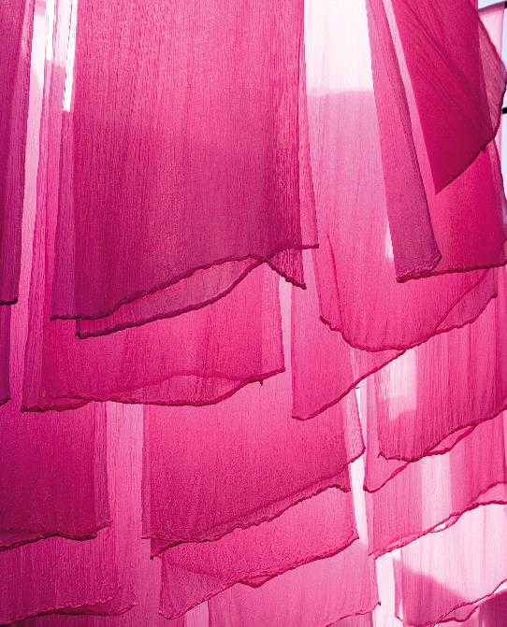
Dyeing
Resist dyeing is a method of patterning fabric by preventing dye reaching certain parts
Resist dyeing methods include wax or rice paste, stitching and tying, and chemical resist
Stripping is a technique to create a design by removing unwanted dye
All images in this presentation are subject to copyright. Copyright owners are listed in the book.
By downloading these presentations you agree that they are for classroom use only.

Slide 19
Surface decoration
Printing
Hand-block printing uses engraved blocks to transfer dye onto the fabric
Silk-screen printing involves dye drawn across a stencil
Rotary-screen printing is used for designs of more than 5 colours
Roller printing is used for large print runs
Heat-transfer printing uses pre-printed paper to transfer colour onto the fabric

Slide 20
Surface decoration
Mordant printing uses a dye fixative to print a design; dye colour only adheres to parts where the mordant has been printed
In resist dyeing waxed areas do not take dye, leaving uncoloured patterns
A bleaching agent is used in discharge printing to remove colour
Digital printing has reduced cost and lead time; allows use of limitless colours

Slide 21
Surface decoration
Devoré
Also known as ‘burn out’
Describes effect achieved when part of a fabric composition is eaten away by the application of a corrosive paste
Laser cutting and engraving
Offers exclusivity to small-scale design brands as fabrics can be cut or engraved to intricate designs
High temperature of laser beams seals the cut edges

Slide 22
Surface decoration
Embroidery
Freehand embroidery is applied without regard to weave structure
Needlepoint and cross stitch are examples of counted-thread embroidery
In canvas work embroidery the under-fabric is completely covered
Smocking is a technique used to gather fabric with decorative stitch-work
Appliqué is a technique for attaching pieces of fabric with decorative stitch-work onto a base cloth

Slide 23
Finishing processes
Waterproofing treatments include oiling, waxing and chemical shower-proofing
Fabric enhancing includes brushing, milling, mercerizing and emerizing
Additive treatments include chemical finishes such as anti-soiling and antibacterial treatments, as well as fire retardant treatments

Slide 24
Key points
Fibres are carded, combed and spun to produce yarn
Weaving and knitting are the main fabric construction methods; alternative methods include felting and knotting
Dyeing can be done at yarn, fabric or garment stage
Printing, devoré, laser cutting and embroidery are different surface decoration techniques
Finishing processes include waterproofing and chemical treatments to either enhance the appearance or function of a fabric

