Slide 1
+
Fashion

Slide 3
Fabric for Fashion / Clive Hallett and
Amanda Johnston
Section 1
Animal fibres: Silk

Slide 4
Objectives
Describe the history of silk
Identify the key properties of silk
Explain the processes of silk production
Summarize the ethical issues concerning silk production

Slide 5
The history of silk
China
Ancient Chinese developed art of silk moth cultivation
Secrets of sericulture were guarded for centuries
Examples of cultivated silk date back to 3000 BC
The Silk Road opened up trade around 2nd century BC
Sericulture taken outside China in 2nd century AD

Slide 6
The history of silk
The Silk Road
Helped establish foundations of modern world
By 3rd century Roman silk textiles sold for their weight in gold
Attempts at raw silk production in Europe (Byzantium) by 6th century
Silk industry in Italian city states grew around 11th century due to immigration from Sicily and Greece and trade with Venetian merchants

Slide 7
The history of silk
By late 15th century silk from Como (Italy) was most valuable
By mid-17th century Lyon (France) capital of European silk trade
English silk industry started in 1560s with mass immigration of French Huguenots fleeing religious persecution
All images in this presentation are subject to copyright. Copyright owners are listed in the book.
By downloading these presentations you agree that they are for classroom use only.

Slide 8
The history of silk
Japan
Silk cultivation spread to Japan around 300 AD
By 1880s Japan supplanted China as largest supplier of raw silk
Today Japan is largest global consumer of silk per person

Slide 9
The history of silk
The Indian subcontinent
Region that is now Pakistan specialized in gold and silver brocade
Islamic teachings forbid men to wear silk because considered unnecessarily extravagant
Mashru (cotton and silk mixture) developed to allow men access to luxury of silk
Today India and Pakistan produce competitively priced silk

Slide 10
The history of silk
Thailand
Thai silk dates back over 3000 years
American entrepreneur Jim Thompson credited in popularizing Thai silk from 1940s
Thai silk production remains primarily a hand-loom cottage industry

Slide 11
The history of silk
Silk market today
China produces over 50% of global silk, India around 15% and Japan just over 10%
Development of artificial fibres (e.g. nylon) initially reduced silk’s appeal
Sand-washed silk increasingly popular from 1990s due to renewed interest in natural fibres
Global production of silk has doubled over past 30 years
35 million people worldwide dependent on silk rearing and processing

Slide 12
Silk fibre
Properties of silk
Bombyx mori moth produces fine, smooth and rounder filaments
Silk is stronger than wool or cotton
Absorbs dye well
Isothermal properties make silk feel cool in summer and warm in winter

Slide 13
Silk fibre
Silk floss or kapok is lightest and warmest of all quilting materials
Fibre structure refracts light lending fabric lustrous reflectiveness
Silk crêpe de chine has liquid drape and fluidity
All images in this presentation are subject to copyright. Copyright owners are listed in the book.
By downloading these presentations you agree that they are for classroom use only.

Slide 14
Silk fibre
Wild silks and raw silk
Wild silks differ in colour graduation and texture
Slubby, bark-like effect and dry textured handle
Silk noil refers to the remaining short fibres left after combing
Raw silk is a term applied to noil to give it better marketing appeal

Slide 15
Silk production
Breeding of silk worms depends on cultivation of mulberry trees
11 tons of leaves sustains 200 kg of cocoons producing 40 kg of silk
Inbred Bombyx mori moths are blind and flightless
All images in this presentation are subject to copyright. Copyright owners are listed in the book.
By downloading these presentations you agree that they are for classroom use only.

Slide 16
Silk production
Insect spins cocoon secreting continuous protein filament (liquid silk)
Liquid silk forced through spinnerets (openings in silkworm’s head) solidifies on contact with air
Within two or three days silkworm has spun 1,600 m of filament
All images in this presentation are subject to copyright. Copyright owners are listed in the book.
By downloading these presentations you agree that they are for classroom use only.

Slide 17
Silk production
Chrysalis killed by steaming or baking before it becomes a moth
Silk cocoons sorted by fibre size and quality
Some perfect cocoons set aside for breeding
5.5 kg of cocoons generates 0.5 kg of raw silk

Slide 18
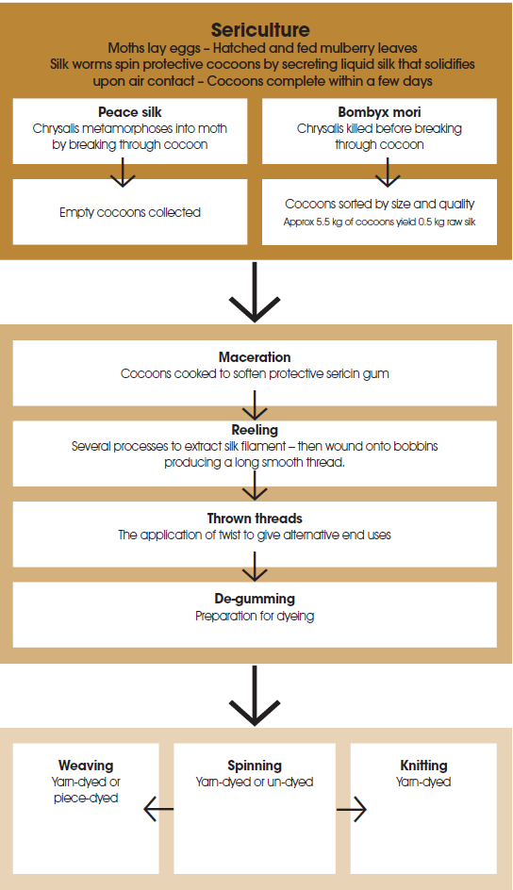

Slide 19
Silk production
Fabric weighting
Silk purchased by weight; unit system used is called momme
Silk loses around 25% of its weight in the de-gumming process
Finishing substance added at dyeing stage to compensate for weight lost
Term ‘pure dye’ indicates no weighting added at dyeing stage
Additional finishing processes may include calendering, tamponing, breaking, steaming and pressing

Slide 20
Ethical considerations
Traditionally harvested cultivated silk kills the larvae
Some of the manufacturing procedures have health and safety implications
Peace (vegetarian) silk refers to silk harvested from cocoons from which moths have emerged naturally so more acceptable

Slide 21
Ethical considerations
Thai silk is hand-reeled and traditionally the pupa is not killed
Ahimsa peace (ethical) silk is made from wild and semi-wild moths (including eri, muga and tassah) and moths are allowed to escape
Silk yarn can be recycled from shredded fabric
All images in this presentation are subject to copyright. Copyright owners are listed in the book.
By downloading these presentations you agree that they are for classroom use only.

Slide 22
Key points
Ancient Chinese developed art of Bombyx mori silk moth cultivation; China now produces 50% of global silk
Silk is strong, absorbs dye well, has isothermal properties and natural lustrous reflectiveness
Sericulture involves the cultivation of silkworms, maceration of cocoons, reeling to extract filament, throwing to apply twist and de-gumming ready for dyeing
Traditionally harvested cultivated silk kills larvae; ethical silk production allows moths to escape

