Slide 1
+
Fashion

Slide 3
Fabric for Fashion / Clive Hallett and
Amanda Johnston
Section 1
Animal fibres: Wool

Slide 4
Objectives
Describe the history of wool
Identify the key properties of wool
Explain the processes of wool production
Identify different types of luxury wool and lambswool
Name the global wool markets
Summarize the ecological and ethical issues regarding wool

Slide 5
The history of wool
Wool for clothing can be traced back tens of thousands of years
Felted wool common-place in Egypt and China long before spinning and weaving developed
Wool first animal fibre to be woven in Europe
Believed Romans started selective breeding of sheep to produce finer fibres
All images in this presentation are subject to copyright. Copyright owners are listed in the book.
By downloading these presentations you agree that they are for classroom use only.

Slide 6
The history of wool
Wool economic engine of Italy and the Low Countries during medieval period and England’s most valuable export
Valuable Spanish merino lambs could only be exported by royal consent
By mid-19th century Yorkshire in England centre of world’s spinning and weaving industries
New-generation wool technology being developed today to adapt wool’s properties

Slide 7
Wool fibre
Sheep are separated into two types – hair sheep (used for meat consumption and manufacturing of leather) and wool sheep
Wool sheep are subdivided into three:
Down breeds (short wool): prefer warmer, drier climates
Long wools: prefer wetter regions with richer pastures
Mountain breeds: exist comfortably on exposed hills

Slide 8
Wool fibre
A keratin organic compound with one-directional overlapping scales
Fibre contains lanolin, which is removed and processed for cosmetics
Fibres have a crimp allowing air to be trapped, giving wool its natural insulating properties
When spun the crimps wrap around each other increasing the wool’s tensile strength
All images in this presentation are subject to copyright. Copyright owners are listed in the book.
By downloading these presentations you agree that they are for classroom use only.

Slide 9
Wool fibre
Springiness of fibre gives wool its ‘memory’, enabling clothes to keep or recover their shape
Fibre’s interior is hydroscopic, attracting moisture while feeling warm
Wool has antibacterial properties and is naturally flame-resistant
All images in this presentation are subject to copyright. Copyright owners are listed in the book.
By downloading these presentations you agree that they are for classroom use only.

Slide 10
Wool production
Over 60% of wool production is for clothing industry
Australia largest producer from primarily merino breeds
New Zealand second largest producer, mainly from crossbred varieties
Fleeces are shorn and removed in one piece; shearing is single greatest expense in wool production

Slide 11
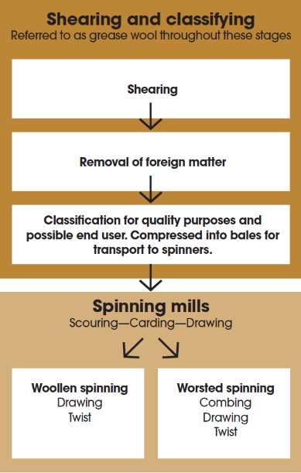

Slide 12
Wool production
Before spinning wool is graded into different classifications
Fibre diameter, measured in microns, main component in determining classification
Finesse, crimp, staple length, cleanliness and colour also considered
Up to this stage referred to as grease-wool
Scouring process removes grease and debris prior to spinning

Slide 13
Wool production
The spinning process includes carding, combing and drawing
Yarn is sold by weight
Yarn count expresses relationship between weight of yarn and its length
Wool count refers to number of hanks of yarn that can be spun from one pound of clean wool

Slide 14
Wool production
Applying twist to the yarn gives it greater tensile strength and flexibility
Woollen spun yarns have been carded and drawn but not combed
Worsted spun yarns have also been combed and are mainly used for fine tailoring
All images in this presentation are subject to copyright. Copyright owners are listed in the book.
By downloading these presentations you agree that they are for classroom use only.

Slide 15
Luxury wool and lambswool
Lambswool
Taken from the first shearing, when the lamb is about 6 months old
Extra fine and soft
Merino
Wool is most prized for its extra-long staple
Merino lambswool is the ultimate luxury, often blended with cashmere

Slide 16
Luxury wool and lambswool
Australia most important producer of merino wool, followed by New Zealand, South Africa, Argentina and Uruguay
Term originally only used for Spanish-bred merino sheep but is now used irrespective of country of origin
Botany wool denotes wool originating from Botany Bay, where first merino sheep landed; represents best quality knitwear
Australia has 4 basic strains of merino – Pepin, Saxon, South Australian and Spanish

Slide 17
Luxury wool and lambswool
Rambouillet or French merino
Cross from Spanish merino and English long-wool breeds
Shetland wool
Small hardy breed of sheep with distinctive fleece in a range of natural shades
Fibres often used undyed
All images in this presentation are subject to copyright. Copyright owners are listed in the book.
By downloading these presentations you agree that they are for classroom use only.

Slide 18
Luxury wool and lambswool
Icelandic wool
Fleeces are double layered with a fine, soft inner fibre and coarser glossy outer fibre
If fibres spun together yarn offers maximum weather protection
Karakul
Also known as Persian lamb
Has tight curl in shades of grey to black often left undyed
Most South African wool is from Karakul sheep

Slide 19
Wool market
Australia largest producer/exporter supplying 25% of world’s consumption, most from merino breeds
New Zealand second largest producer/exporter, mostly from cross-bred sheep (31.5 microns plus); majority sent to China
China major producer but supplements domestic production for its export clothing manufacturing industries
Uruguay third largest producer exporting around 90%

Slide 20
Wool market
Argentina and South Africa key producer/exporters
Turkey, Iran and Great Britain each produce around 2% of global production
Key consumers are Italy, France, Germany, Great Britain and Japan
Italy and Japan use the best merino wool for their fully-fashioned knitwear industries

Slide 21
Wool market
Australia: Woolmark
Registered mark used for branding different types of Australian wool
Guaranteed standard of quality designed to gain consumer confidence
Many variations of original Woolmark design to cover different wools and blends
International Wool Textile Organization (IWTO) covers all aspects of marketing wool for all major producers

Slide 22
Ecological and ethical considerations
Guiding criteria for ecologically sound wool includes: correct grazing of flocks, clean water, predator friendly environment, healthy veterinary practices, livestock and soil chemical control and carbon footprint
Wool if buried in landfill will almost totally biodegrade in less than a year

Slide 23
Ecological and ethical considerations
Recycled wool – the term ‘shoddy’ originates from the fibre reclamation process which has always been part of wool’s production cycle
Reclamation mills sort materials into types and colours to save re-dyeing
All images in this presentation are subject to copyright. Copyright owners are listed in the book.
By downloading these presentations you agree that they are for classroom use only.

Slide 24
Key points
Wool for clothing can be traced back tens of thousands of years
Wool is thermally responsive with natural insulating properties; fibre has good shape ‘memory’
Fleeces are shorn and scoured; spinning process includes carding, combing and drawing
Luxury wools include merino, Shetland, Icelandic and Karakul

Slide 25
Key points
Key producers of wool are Australia, New Zealand and Uruguay; key consumers are Italy, France, Germany, Great Britain and Japan
Recycling of wool has always been part of the production cycle

