Slide 1
+
Fashion

Slide 2
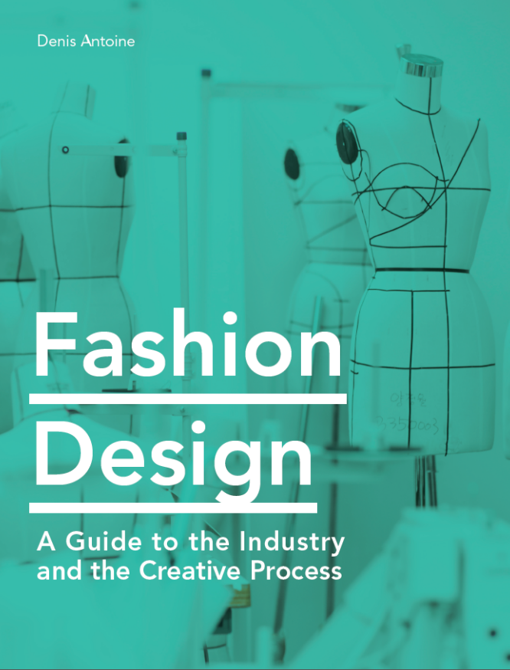

Slide 3
Fashion Design / Denis Antoine
Chapter 7
Portfolios and résumés

Slide 4
Objectives
Consider the presentation of a portfolio of creative work
Create a brand vision and communicate it to an audience
Understand the audiences with whom young designers need to communicate
Evaluate effective layouts used in the visual presentation of portfolio work
Consider digital portfolio-presentation platforms, and the opportunities they provide
Identify the key components of successful résumés
Develop interview skills needed to present design work successfully

Slide 5
Portfolio Presentation
A portfolio is a packaged, edited showcase of work aimed at communicating a designer’s skills and creative vision.
A portfolio can be a physical book or digital presentation.
It is important to start building a portfolio early on in creative training.
All images in this presentation are subject to copyright. Copyright owners are listed in the book.
By downloading these presentations you agree that they are for classroom use only.

Slide 6
Creating a Brand Vision
Developing a portfolio requires establishing a personal brand vision, which is then implemented throughout the visual presentation and packaging of the work.
Designers should:
Identify a personal niche by narrowing focus to the type of work that gives them the highest personal satisfaction
Pull together a set of core value terms associated with their personal niche and develop a brand vision statement
Examples of core value terms: Approachable Technical Modern Artistic Extravagant Luxurious

Slide 7
Creating a Brand Vision
Developing a logo
The logo is a graphic representation of the personal brand and should clearly convey the core brand values.
Key factors in logo design:
Simplicity of images or typography
Readability
Appropriate use of color
Successful brand messaging
All images in this presentation are subject to copyright. Copyright owners are listed in the book.
By downloading these presentations you agree that they are for classroom use only.

Slide 8
Creating a Brand Vision
Packaging
Along with a strong logo, packaging enhances the visual communication of the chosen brand message.
Materials and the use of color and graphic design elements all play an important role.
Common portfolio formats:
Books are easier to read as a single story, but more difficult to present to a larger group
Boxes containing unbound boards are easier to present to larger groups, but can be difficult to keep organized

Slide 9
All images in this presentation are subject to copyright. Copyright owners are listed in the book.
By downloading these presentations you agree that they are for classroom use only.

Slide 10
Understanding Your Audience
To ensure all important information is covered, each individual project included in a portfolio presentation should include:
Cover page
Inspiration / concept board
Mood board
Customer profile
Colors
Process
Materials
Lineup of rendered croquis
Flats
Illustrations
Range board
Lookbook / images of completed garments
Spec packs

Slide 11
Understanding Your Audience
Young designers are likely to present their work to three types of audiences:
Press
Recruiters
Buyers
The ability to edit a portfolio and to customize it for a particular audience is important.

Slide 12
Understanding Your Audience
Each audience type is likely to respond more effectively to a certain balance of elements:
Press – more interested in concept, originality, and creative storytelling
Recruiters – generally want to see a strong balance of creativity and technical execution
Buyers – primarily interested in the commercial viability of the product lines presented

Slide 13
Effective Layout
Format consistency in a portfolio is paramount. All projects should be planned and executed in the same page size and orientation.
Recommended page sizes include 11 x 17 inches (28 x 43 cm; roughly A3) and 11 x 14 inches (28 x 36 cm)
All pages should be either portrait or landscape – not a mix of both
Keep in mind the visual space of a “spread” includes the total size of two pages viewed side-by-side

Slide 14
All images in this presentation are subject to copyright. Copyright owners are listed in the book.
By downloading these presentations you agree that they are for classroom use only.

Slide 15
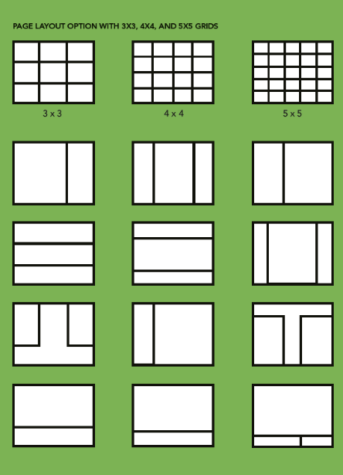
Effective Layout
When developing a multipage presentation, employing a structured layout system based on a simple layout grid pattern is beneficial.
Storyboarding the entire presentation prior to committing to the final layout of each board helps visualize how all the boards flow together.
All images in this presentation are subject to copyright. Copyright owners are listed in the book.
By downloading these presentations you agree that they are for classroom use only.

Slide 16
Digital Portfolios
Recruiters commonly make “first contact” with possible applicants through digital-portfolio platforms.
While personal-portfolio websites allow more creative freedom, they are less easy to discover than platforms such as Behance or ArtsThread. Having a presence in all areas is beneficial.
Digital portfolios should be storyboarded in a similar way to physical-portfolio books, to ensure all “pages” flow effectively. Be aware that some platforms use a vertical image alignment, while others follow a horizontal slideshow format.

Slide 17
All images in this presentation are subject to copyright. Copyright owners are listed in the book.
By downloading these presentations you agree that they are for classroom use only.

Slide 18
Digital Portfolios
Important considerations in developing a digital portfolio:
Page orientation – use a landscape page orientation to match the viewer’s computer screen format
Image resolution – keep images for digital platforms at 72dpi resolution so they are easier to view, open, and share
Cover image – select a strong image as the first point of access to the work
Color management – try to ensure proper color balance across platforms and viewing media

Slide 19
Résumés
A strong résumé is essential in supporting a portfolio of work, as part of any job application.
Designers should:
Ensure content is well-organized and easy to navigate
List only relevant positions and experience for the job
Identify professional skills gained or honed with each new role
Avoid use of overly complex visual material
Use simple infographic tools to indicate competency level in key fields

Slide 20
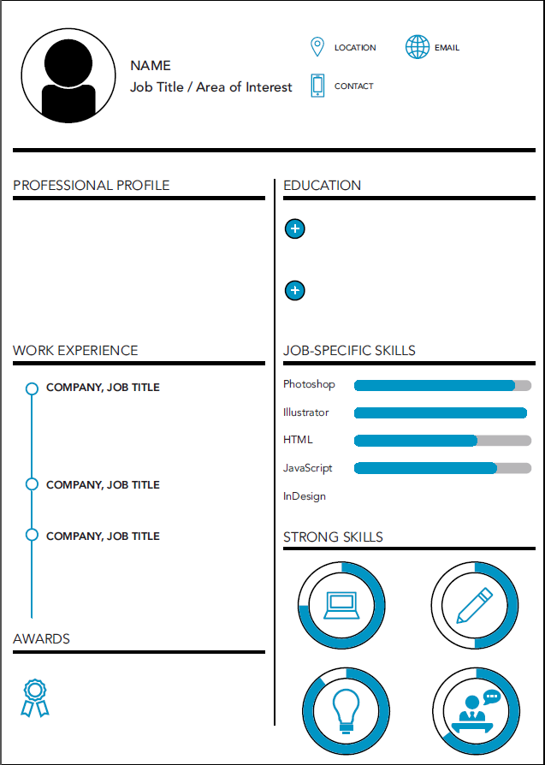
All images in this presentation are subject to copyright. Copyright owners are listed in the book.
By downloading these presentations you agree that they are for classroom use only.

Slide 21
Essential Interview Skills
Applicants should consider any interview as an opportunity to tell recruiters about themselves and their work. They should:
Research – investigate the brand and use the interview to explain how they could benefit the brand, as well as fit within its esthetic
Listen, then talk with purpose – pay close attention to the questions being asked, and then provide brief, informative answers
Self-confidence – engage with interviewers as friends and remember that workplaces thrive when team members exhibit an open, friendly, and supportive demeanor

