Slide 1
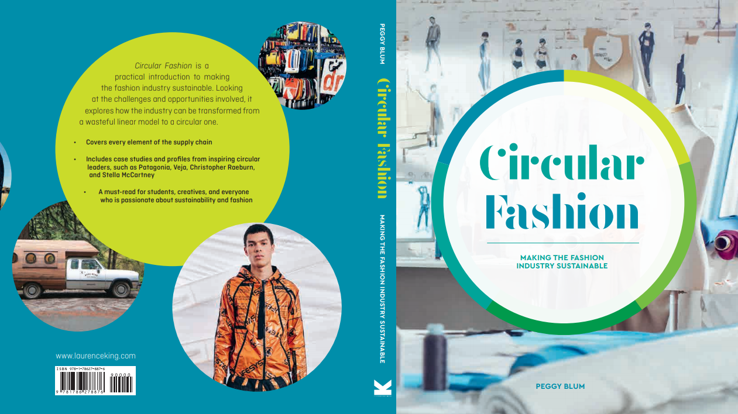

Slide 2

05:
People AND production
Circular Fashion: Making the Fashion Industry Sustainable

Slide 3
The global assembly line
Outsource: To procure (something, such as some goods or services needed by a business or organization) from outside sources and especially from foreign or nonunion suppliers: to contract for work, jobs, etc. to be done by outside or foreign workers. Merriam-Webster Dictionary

Slide 4
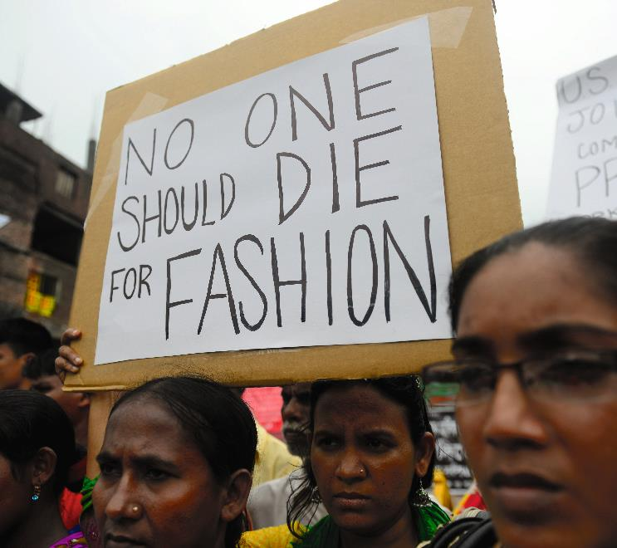
PEOPLE garment workers
A garment worker makes garments
Garment workers may work in large factories as core workers or contract workers for smaller companies
Issues still affecting garment workers include no living wage, hazardous working conditions, lack of representation, long working hours
All images in this presentation are subject to copyright. Copyright owners are listed in the book. By downloading these presentations you agree that they are for classroom use only.

Slide 5

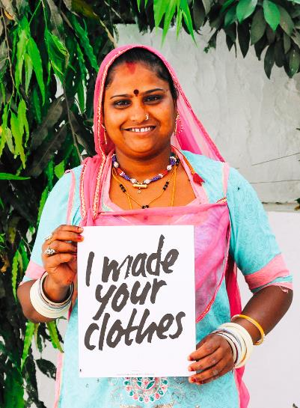
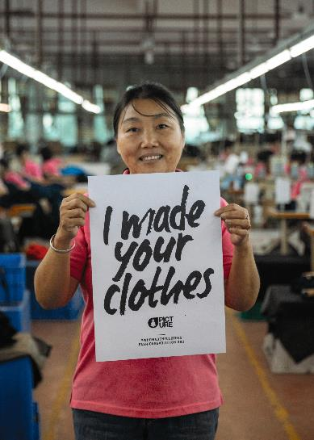
Organizations activism information awareness
Fashion Revolution
Clean Clothes Campaign
The International Labour Organization
Labour Behind the Label
The Solidarity Center
The Worker Rights Consortium
IndustriALL
All images in this presentation are subject to copyright. Copyright owners are listed in the book. By downloading these presentations you agree that they are for classroom use only.

Slide 6
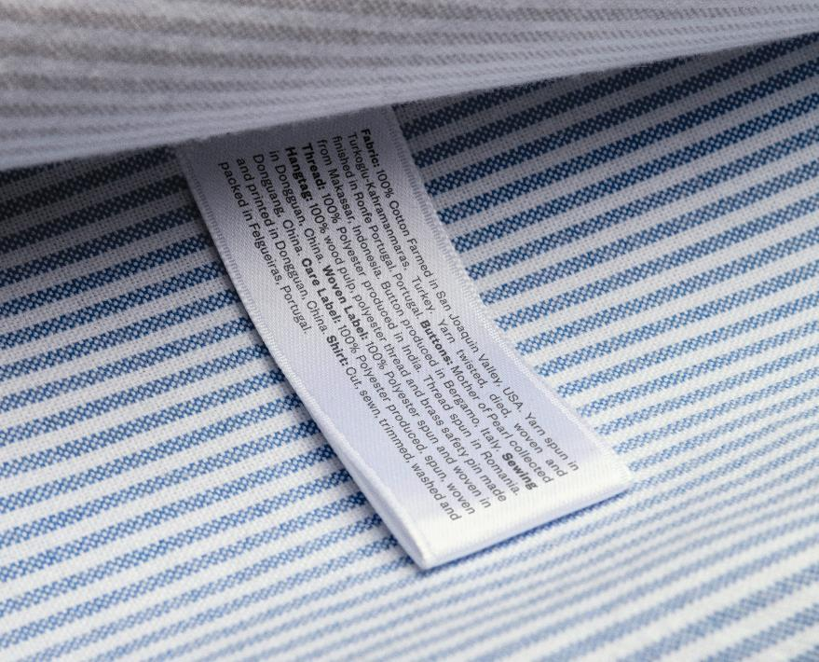
PRODUCTION
Supply chain transparency
Environmental profit and loss
Local production
All images in this presentation are subject to copyright. Copyright owners are listed in the book. By downloading these presentations you agree that they are for classroom use only.

Slide 7
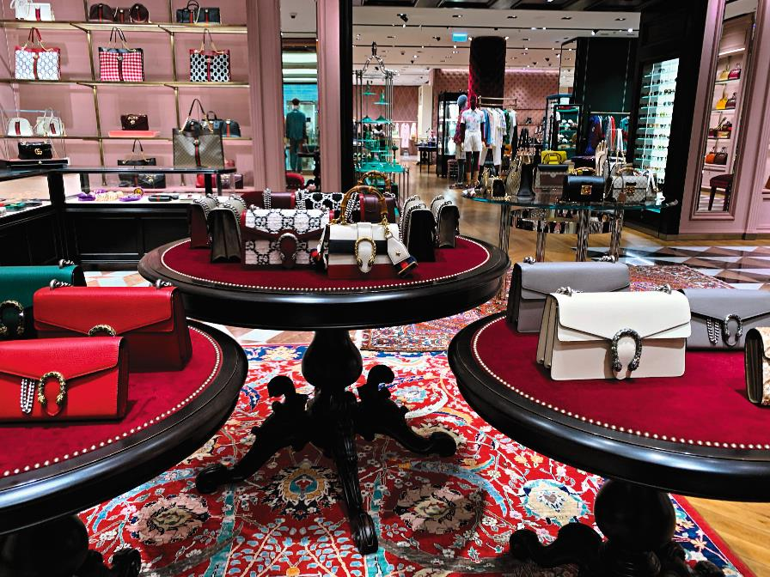
Environmental profit AND loss
All images in this presentation are subject to copyright. Copyright owners are listed in the book. By downloading these presentations you agree that they are for classroom use only.

Slide 8
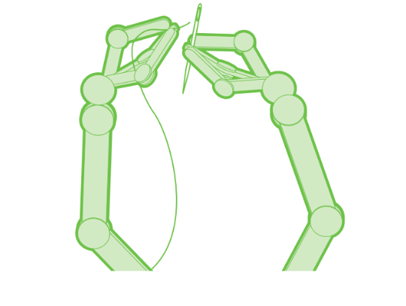
INDUSTRY 4.0
The internet of things
The Cloud
3D printing
All images in this presentation are subject to copyright. Copyright owners are listed in the book. By downloading these presentations you agree that they are for classroom use only.

Slide 9
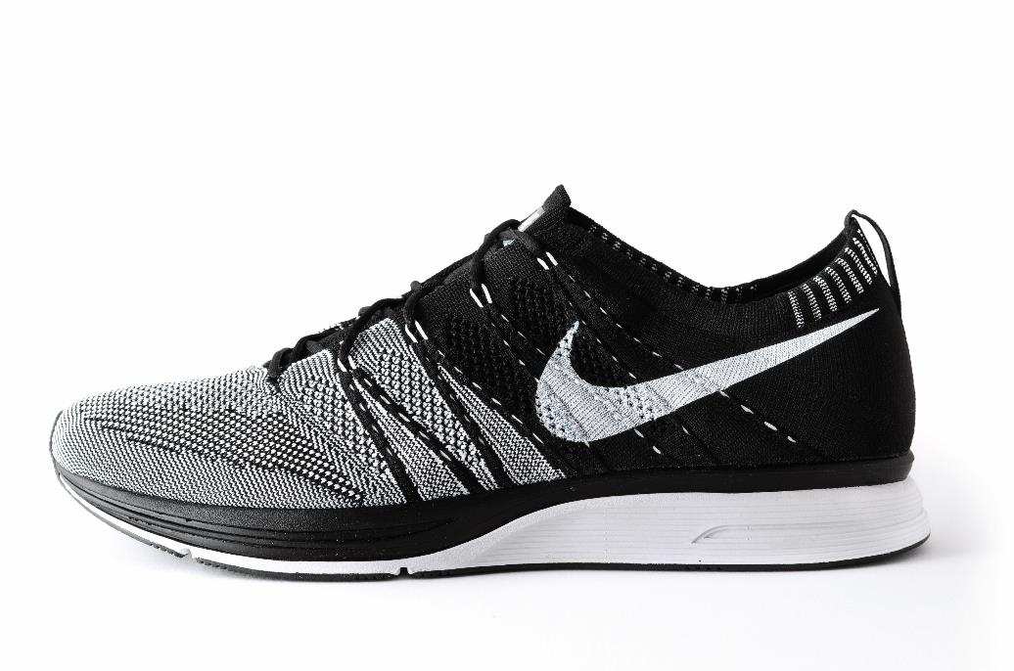
Automation AND Robotics
Sewbots
Knit on demand
Finishing
All images in this presentation are subject to copyright. Copyright owners are listed in the book. By downloading these presentations you agree that they are for classroom use only.

Slide 10
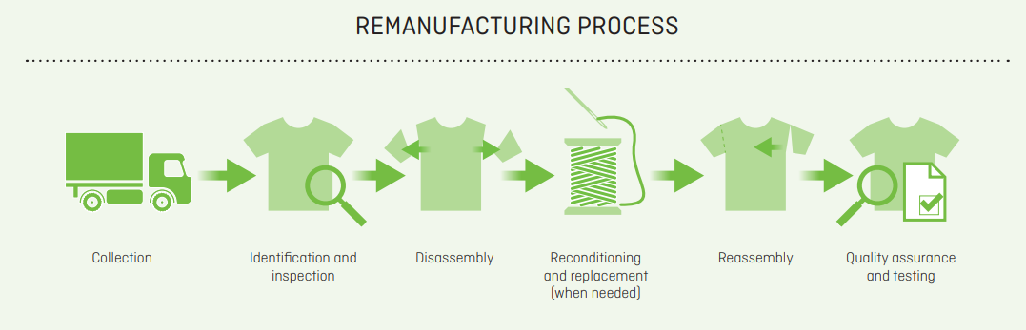
remanufacturing
All images in this presentation are subject to copyright. Copyright owners are listed in the book. By downloading these presentations you agree that they are for classroom use only.

Slide 11
Think Piece
Are robots the way forward? Discuss the advantages and disadvantages of robots replacing garment workers in the fashion industry.

Slide 12


