Slide 1
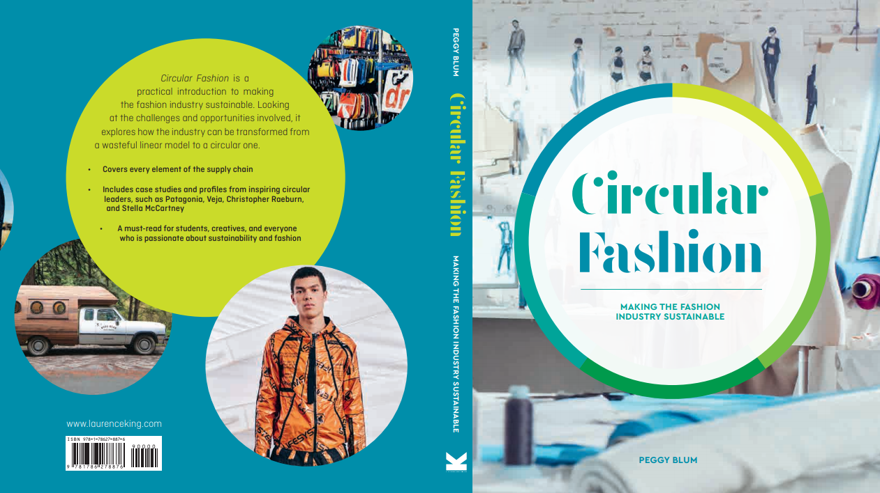

Slide 2

10:
Tools
assessments standards
Circular Fashion: Making the Fashion Industry Sustainable

Slide 3
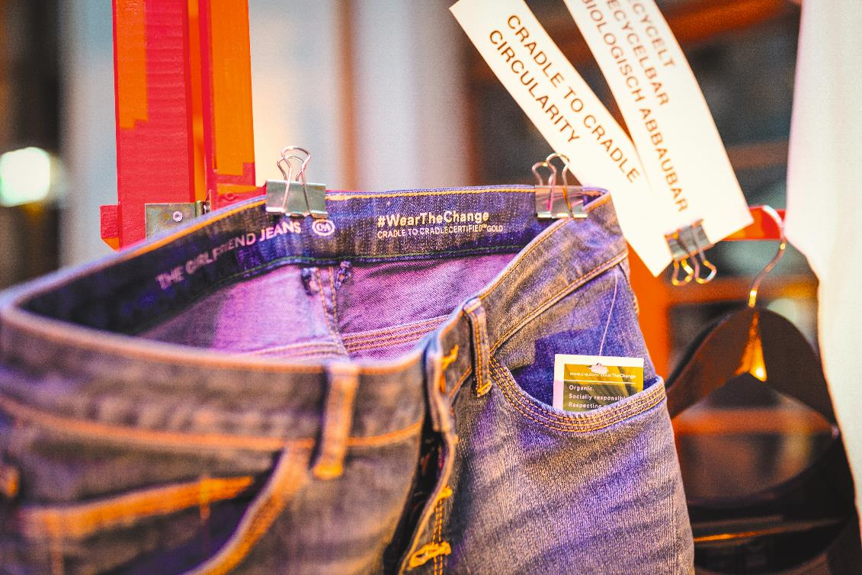
Circular criteria
All images in this presentation are subject to copyright. Copyright owners are listed in the book. By downloading these presentations you agree that they are for classroom use only.

Slide 4
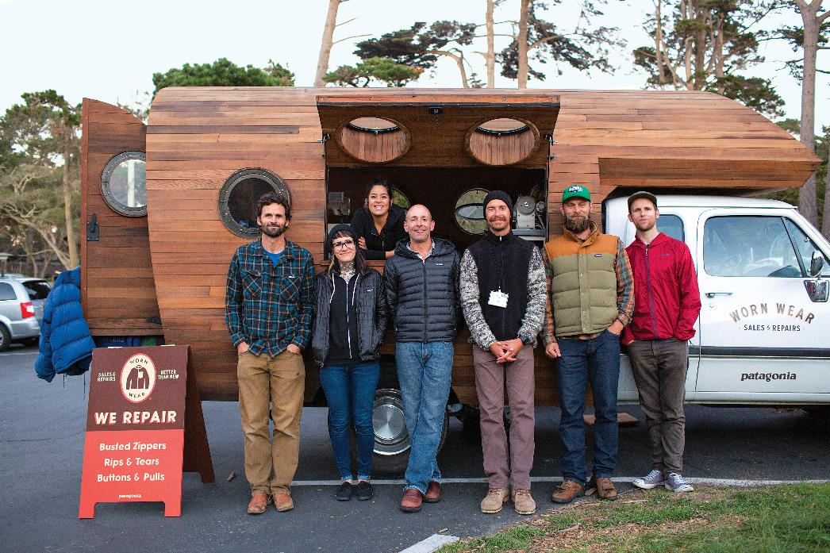
B corporations
B Corporation: A certification for businesses that balances profits with a positive social and environmental performance. Macmillan Dictionary
All images in this presentation are subject to copyright. Copyright owners are listed in the book. By downloading these presentations you agree that they are for classroom use only.

Slide 5
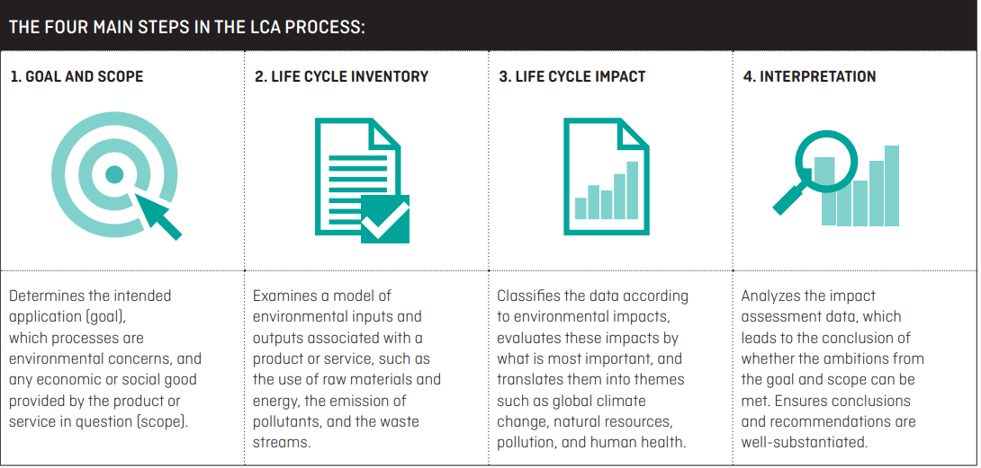
Product life cycle assessment
All images in this presentation are subject to copyright. Copyright owners are listed in the book. By downloading these presentations you agree that they are for classroom use only.

Slide 6
HIGG INDEX
Sustainability assessment tools developed by Sustainable Apparel Coalition.
Used to assess the manufacturing impacts of textile production in the value chain.
Consists of:
Product tools
Facility tools
Brand and retail tools

Slide 7
CRADLE TO CRADLE CERTIFICATION
Cradle to Cradle (C2C) Certified is a globally recognized measure of safer, more sustainable circular products.
Products are certified based on the following measures:
Material health
Material utilization
Renewable energy and climate management
Water stewardship

Slide 8
Think Piece
Why is it important for a brand to embrace Life Cycle Assessments? Do you think a value retailer like C&A can become more sustainable and maintain profitability if it conducts an LCA and follows its recommendations?

Slide 9
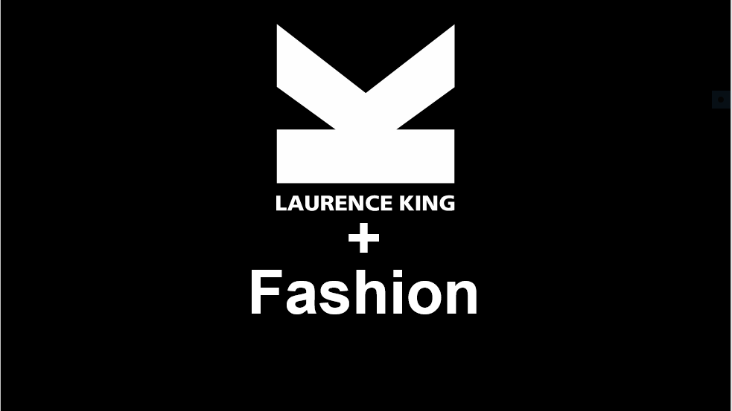
Think Piece
After a proper analysis, determine if your favorite clothing brand is truly a sustainable brand or if it is just greenwashing.
Are you surprised by the results?

