Slide 1
+
Fashion

Slide 2
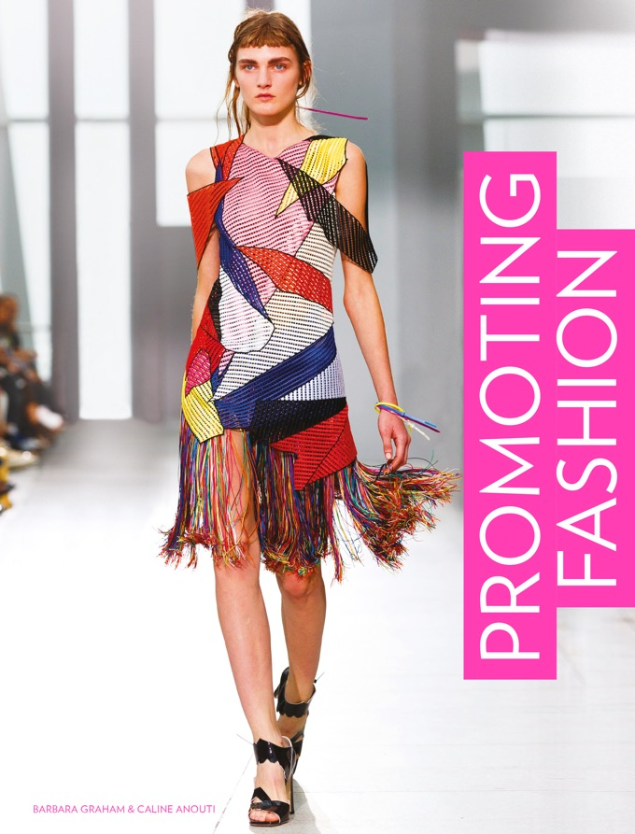

Slide 3
Promoting Fashion / Barbara Graham, Caline Anouti
Chapter 3
Integrated Marketing Communications

Slide 4
Objectives
Learn how the six Ps of marketing underpin the communication tools.
Discover the tools in the communication mix.
Use these tools with Integrated Marketing Communication to create a cohesive and effective brand message.
Create campaign objectives using the SMART model.

Slide 5
Key Theories
The 6 Ps of marketing (De Pelsmacker, 2007).
Integrated Marketing Communications (various sources).
ST DCC framework (Graham and Anouti, 2016).
SMART objectives (various sources).
AIDA (Strong, 1925) and DAGMAR (Colley, 1961).

Slide 6
The Six Ps
The original four Ps of marketing were formalized in the early 1960s. They were:
Product What form was the product or service?
Price How much will it sell for?
Promotion How do we reach the consumer?
Place Where and through what channels will the product be sold?
De Pelsmacker (2007) added People and Persuasion to include employees and consumer perception of the brand.

Slide 7
The Six Ps
De Pelsmacker’s instruments of the marketing mix (2007)
Product | Price | Place | Promotion | People | Persuasion
Benefits | List price | Channels | Advertising | Employees | Element that will change consumer behaviour
Features | Discounts | Logistics | Public relations | Stakeholders | Advantage over similar brands
Options | Credit terms | Inventory | Sponsorship | Management
Quality | Payment periods | Transport | Sales promotion | Customer-facing staff
Design | Incentives | Assortments | Direct marketing | Culture of the company
Branding |  | Locations | Point of purchase
Packaging |  |  | Exhibitions and trade fairs
Services |  |  | Personal selling
Warranties |  |  | Online/offline
All images in this presentation are subject to copyright. Copyright owners are listed in the book.
By downloading these presentations you agree that they are for classroom use only.

Slide 8
The Six Ps
Promotion covers all aspects of how a brand (or retailer) communicates its message to the consumer.
Consumers are targeted via ad campaigns, events hosted by the brand, celebrity involvement and the chance to interact with the brand.
The choice of promotional tools is referred to as the promotional mix or the marketing communications mix.

Slide 9
The Six Ps
Marketing communications include the following:
Advertising.
Public relations (PR), endorsement and sponsorship.
Social media.
Personal selling through online and offline retail.
Direct marketing.
Fashion catwalk shows and trade shows.
Sales promotions.

Slide 10
The Tools of the Marketing Communications Mix
Fashion advertising
Advertising uses paid-for media such as TV, radio, newspapers, magazines and billboards, plus advertising online, including on social media.
Broadcast to a mass audience and is therefore considered a mass communication.
Brands select one or more of the available media types depending on budget.

Slide 11
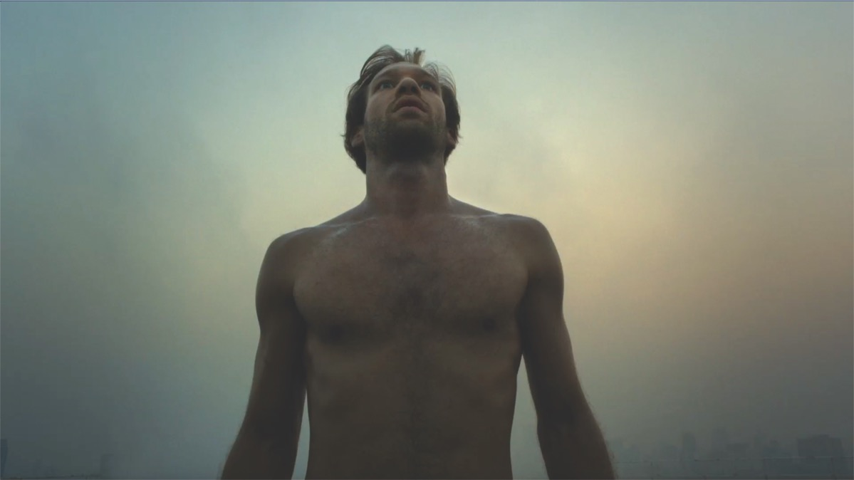
Lacoste’s promotional film The Big Leap, 2014, which aired on French TV to coincide with the opening of the Winter Olympics in Sochi, Russia. The French athletes all wore Lacoste.
All images in this presentation are subject to copyright. Copyright owners are listed in the book.
By downloading these presentations you agree that they are for classroom use only.

Slide 12
The Tools of the Marketing Communications Mix
PR for fashion, endorsement, sponsorship and product placement
PR coverage is considered more credible than advertising, as it appears to be endorsed by a third party.
A third party could be a fashion editor, celebrity, influencer, TV and film director or another, larger, company.
PR for fashion can be a magazine feature, a review on a third party blog or news coverage of an event or endorsement deal.

Slide 13
The Tools of the Marketing Communications Mix
PR for fashion, endorsement, sponsorship
and product placement
Celebrities act as PR when they are given clothes or products to wear.
Celebrities can be contracted to endorse a brand or act as a brand ambassador.
Sponsorship means two companies signing a contract for mutual benefit, such as increased exposure.
Product placement in TV series, films and reality TV shows associates the brand with popular characters.

Slide 14
Coverage by influencers such as Matthew Zorpas, founder of The Gentleman Blogger,
is sought after because of influencers’
direct connection with followers.
All images in this presentation are subject to copyright. Copyright owners are listed in the book.
By downloading these presentations you agree that they are for classroom use only.

Slide 15
The Tools of the Marketing Communications Mix
Social media
Brands open accounts with Facebook, Instagram, Twitter, Snapchat and so on to position themselves in a forum familiar to audiences.
Brands take advantage of users’ ability to like, share and comment on content.
Content is created to involve, engage and entice audiences to contribute – and therefore drive sales.

Slide 16
Followers of Barbour on Twitter and Instagram were invited to contribute photos and videos of the great outdoors.
Over 800 entries competed to win merchandise and take part in an ad campaign.
All images in this presentation are subject to copyright. Copyright owners are listed in the book.
By downloading these presentations you agree that they are for classroom use only.

Slide 17
The Tools of the Marketing Communications Mix
Offline and online personal selling
Personal selling is a one-to-one activity – either to another business or to the consumer.
Quantities, deliveries and other requirements can be tailored to suit the individual buyer.
Online, brands need to consider carefully the shopper’s journey through landing and buying pages, apps and customer service functions.

Slide 18
The Tools of the Marketing Communications Mix
Direct marketing
Direct marketing means emails and digital newsletters, or printed catalogues and invitations mailed to a home address.
A database of potential consumer contacts is central to successful direct marketing.
The capture of online behaviour means that marketing messages can be targeted to a customer’s interests.

Slide 19
The Tools of the Marketing Communications Mix
Direct marketing
A Paul Smith email used with a sales promotion. The brand can track who clicks through to the site from this email, and send them similar incentives in future.
All images in this presentation are subject to copyright. Copyright owners are listed in the book.
By downloading these presentations you agree that they are for classroom use only.

Slide 20
The Tools of the Marketing Communications Mix
Catwalk and trade shows
Luxury and premium labels show on the catwalk at international fashion weeks.
Catwalk shows preview a new season’s collection for fashion media, store buyers and valued consumers.
Trade shows are generally used by premium and mass-market labels for selling directly to store buyers.
Both generate press for the forthcoming season, and result in orders.

Slide 21
The Tools of the Marketing Communications Mix
Sales promotions and retail point of sale
The most familiar form of sales promotion is discounting the price.
Promotions include all forms of timed incentives to buy: competitions, giveaways, free samples, trial periods and so on.
Brands can also reward customers for repeated purchases through loyalty cards, which means offers can be tailored to shoppers’ interests.

Slide 22
The Tools of the Marketing Communications Mix
Sales promotions and retail point of sale
Retail point of sale (POS) refers to the branded material used to entice a consumer to buy.
Examples include banners, posters, showcards, shelf dividers, branded lookbooks, carrier bags and stickers.

Slide 23
Integrated Marketing Communications
Integrated marketing communications, or IMC, means mixing the best choice of communications tools with the necessary media and the message that brands would like to broadcast.
An IMC approach needs to co-ordinate
all brand encounters, medium or message
which contribute to building the brand narrative.
Dahlén et al., 2010.

Slide 24
A Framework for a Promotional Campaign
The following can help deliver IMC, always involving the consumer.
Synergy Does each method of communication, and media used, provide an interesting and immersive experience and reflect the brand’s message?
Technology Does the technology used engage and involve? Measure reactions? Save costs? Reduce reliance on traditional media? Link to a disruptive experience?

Slide 25
A Framework for a Promotional Campaign
Disruption Is there an element within the campaign –a new knowledge, a buzz – that is unexpected and disrupts the way a normal audience would behave?
Consistency Is there a consistent message across all channels that supports the brand’s marketing strategy?
Continuity Can the selected communications deliver these experiences reliably?

Slide 26
Setting Objectives and the SMART Model
Setting objectives will help determine the communications mix and media.
Corporate objectives for companies and brands will be long-term, while marketing and communications objectives are short-term and tactical.

Slide 27
Setting Objectives and the SMART Model
The SMART model is the best-known framework for setting objectives.
S – Specific
M – Measurable
A – Achievable
R – Realistic
T – Time-related

Slide 28
AIDA and DAGMAR
Theoretical models such as AIDA and DAGMAR (shown next) can also suggest the tools for the desired result.
AIDA: Attention, Interest, Desire, Action.
DAGMAR: Defining Advertising Goals for Measuring Advertising Responses.
The aim may be to raise levels of interest (AIDA) or comprehension (DAGMAR).
The models suggest PR, product placement, sponsorship and social media as the most effective tools.

Slide 29
AIDA and DAGMAR
AIDA and DAGMAR and implied suggestions
for types of communication
AIDA | DAGMAR | Suggested strategy for communications
___ | Unawareness | __
Attention | Awareness | Advertising, PR, celebrity endorsement
Interest | Comprehension | PR, product placement, sponsorship, social media
Desire | Conviction | PR, product placement, sponsorship, direct marketing, sales promotion, social media
Action | Action | Sales promotion, direct marketing, personal selling
Smith and Zook (2016).
All images in this presentation are subject to copyright. Copyright owners are listed in the book.
By downloading these presentations you agree that they are for classroom use only.

Slide 30
Using the SMART Model
Case Study
The following is a communications strategy for a start-up designed by students at London Metropolitan University.
The product was handbag-sized pots of solid perfume, with the brand name Head, Heart and Base.
As a start-up the aim was to raise awareness rather than promote long-term sales.
Objectives focused on low-cost PR, establishing a database, and targeting social media.

Slide 31
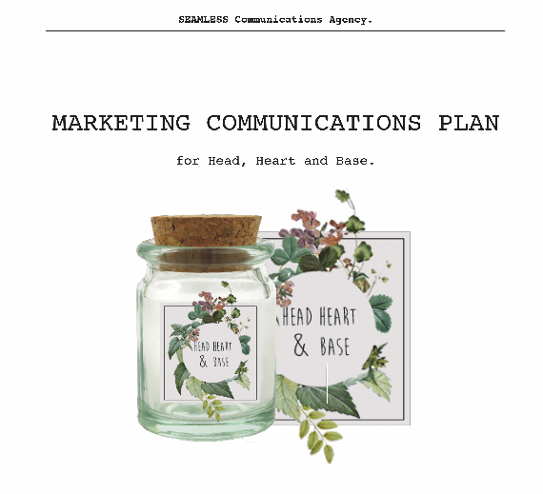
Using the SMART Model
Case Study
All objectives were specific, achievable and measurable.
The students used a Gantt chart to plot the order of events on a timeline.
A control column gave evidence that the objectives were met.
Image by Pauline Goetz and Anna Szymanska as Seamless Communications Agency.
All images in this presentation are subject to copyright. Copyright owners are listed in the book.
By downloading these presentations you agree that they are for classroom use only.

Slide 32
Using the SMART Model
Case Study
PR objectives
Begin a blog with daily posts to drive traffic to the website.
Send gift samples to 20 third-party bloggers.
Organize workshop events. Post photos and contributions on social media.
By month six, achieve editorial coverage in a sympathetic magazine.

Slide 33
Using the SMART Model
Case Study
Direct marketing objectives
Ensure the website can capture data to build a targeted database of subscribers.
Social media objectives
Ensure in month one that business accounts are set up with Facebook, Instagram and Twitter, to be updated daily on the theme of perfumes.
Sales promotion objectives
By month nine, release discount codes to all subscribers for Christmas, then a follow-up Valentine’s promotion.

Slide 34
Key Points
Promotion is one of the six Ps of marketing, and uses a mix of marketing communications tools.
Tools used by fashion brands are advertising, PR, endorsement, sponsorship and product placement, social media, personal selling, direct marketing, catwalk and trade shows, and sales promotions.
Optimizing the brand message via selected tools and media is known as Integrated Marketing Communications (IMC).
Effective objectives for a campaign can be set using the SMART model, and by using AIDA and/or DAGMAR to match objectives to the outcome.

