Slide 1
+
Fashion

Slide 2
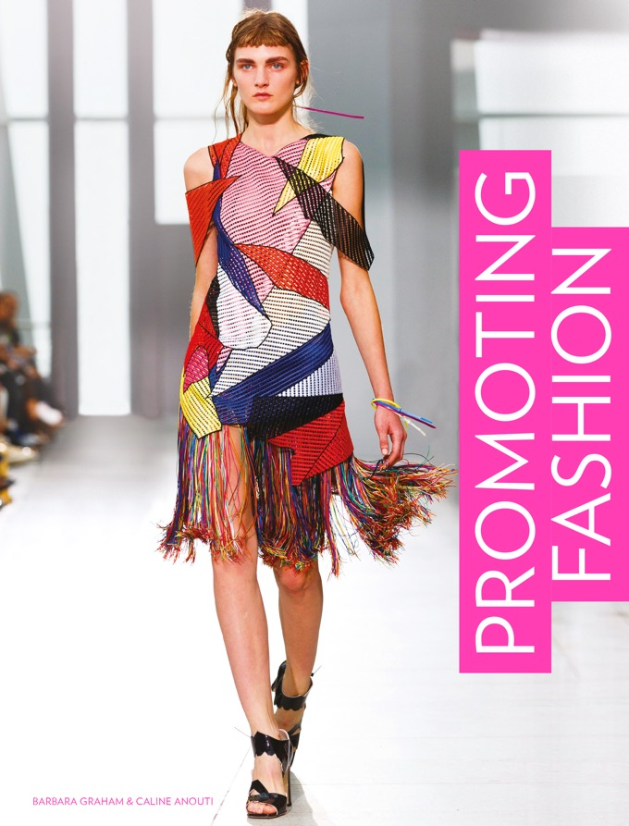

Slide 3
Promoting Fashion / Barbara Graham, Caline Anouti
Chapter 4
Advertising for Fashion

Slide 4
Objectives
Interpret the theory of advertising.
Attract consumers’ attention.
Identify and use different advertising media including TV, print, billboards and guerrilla tactics.
Optimize social media and online advertising.

Slide 5
Key Theories
The 4 Cs of Communication (Fill, 2013).
The transmission model of mass communication (Shannon and Weaver, late 1940s).
AIDA in advertising theory (Strong, 1925).
The four frameworks of advertising (O’Malley, 1991 and Hall, 1992).
Meaning transfer model (McCracken, 2005).

Slide 6
Definitions of Advertising
In general advertising involves the use of a medium such as TV, print or radio, which is paid for by a brand and via which the message is conveyed to the consumer.
Advertising is a paid, mediated form of communication from an identifiable source, designed to persuade the receiver to take some action now or in the future. (Richards and Curran, 2002)

Slide 7
The Value of Advertising
eMarketer (2016) predicts a value of US$674.24 billion to be spent on online, magazine, outdoor, radio and TV media in 2020.
There is a sustained global trend towards TV and online advertising and a decline in print.
The amount spent on online advertising is predicted to soar to US$285 bn by 2020 (marketingtechnews.net, 2016).

Slide 8
Evaluating the Effectiveness of Advertising
Fill’s 4 Cs framework (2013) summarizes the key characteristics of each tool.
It examines its effectiveness as a piece of communication; credibility; cost; and gives a high, medium and low rating for control.
Communications | Advertising
Ability to deliver a personal message | Low
Ability to reach a large audience | High
Level of interaction | Low
Credibility
Given by the target audience | Low
Cost
Absolute costs | High
Cost per contact | Low
Wastage | High
Size of investment | High
Control
Ability to target particular audiences | Medium
Ability to adjust tool as circumstances change | Medium
All images in this presentation are subject to copyright. Copyright owners are listed in the book. By downloading these presentations you agree that they are for classroom use only.

Slide 9
Evaluating the Effectiveness of Advertising
Advantages of advertising
It reaches a large audience with one message.
The cost per contact may be low.
The brand has reasonable control to withdraw the ad should it cause offence.

Slide 10
Evaluating the Effectiveness of Advertising
Disadvantages of advertising
Its ability to deliver a personalized message is low.
There is less opportunity to interact directly.
Audiences know that it is paid for and do not afford it much credibility.
It is expensive.
It is hard to measure the effect of a traditional advertising campaign (TV, print, billboards).

Slide 11
Theorizing Advertising
There are two main schools of thought.
Viewers see new messages and process that information in logical stages (they perceive a ‘hard sell’).
Viewers relate and respond to socio-cultural cues within the message (a ‘soft sell’).
All images in this presentation are subject to copyright. Copyright owners are listed in the book. By downloading these presentations you agree that they are for classroom use only.

Slide 12
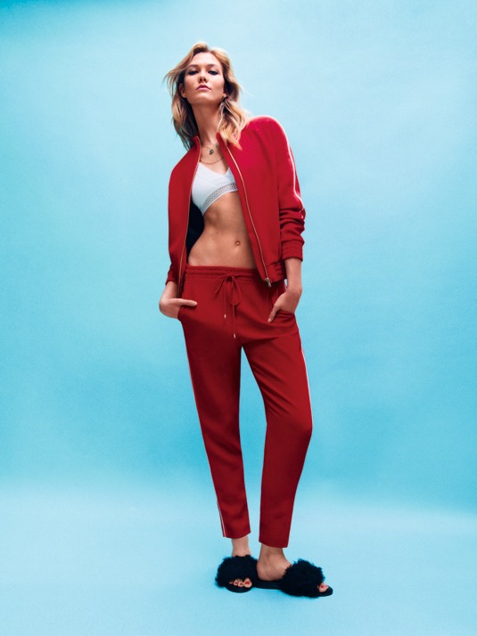
Theorizing Advertising
Left, a Topshop campaign featuring Karlie Kloss. This example of a rational message acts on our desire to be like Karlie Kloss: in demand, well connected, and so on.
It is expected that this model will resonate with Topshop’s young target audience and they will buy.
All images in this presentation are subject to copyright. Copyright owners are listed in the book. By downloading these presentations you agree that they are for classroom use only.

Slide 13
Theorizing Advertising
AIDA in advertising theory
AIDA shows a series of prompts issued by the brand that act as a trigger to buy.
The model accepts that it may take many attempts for desire, then action, to take place.
Many campaigns use a mixture of messages.
O’Malley (1991) and Hall (1992) developed a framework of four possible ways in which advertising can work on viewers (next slide).
The involvement model is of most interest to fashion brands.

Slide 14
Theorizing Advertising
AIDA in advertising theory
The persuasion model: Similar to AIDA; the viewer will move through a series of persuasive messages.
The involvement model: Adverts that seek to engage and involve the viewer.
The salience model: Adverts that aim to stand out by creating a point of difference or discussion.
The sales model: Messages are created to provoke sales through incentives.

Slide 15
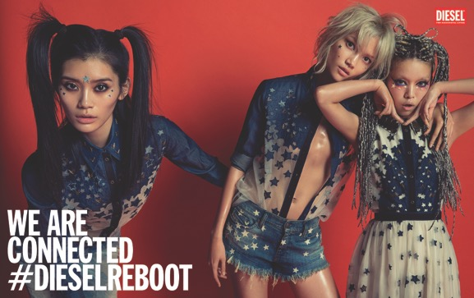
What Advertisers Do to Reach Consumers
Colour
Diesel often use red in their campaigns. Red conveys a sense of danger, heat, passion and impulsive action.
We are Connected #Diesel ReBoot ad campaign photographed by Inez Van Lamsweerde and Vinoodh Matadin.
All images in this presentation are subject to copyright. Copyright owners are listed in the book. By downloading these presentations you agree that they are for classroom use only.

Slide 16

What Advertisers Do to Reach Consumers
Scale and contrast
Viewers regard large, prominent objects as important.
Black-and-white photography can attract attention in a colour-saturated environment.
Natan Dvir’s Coming Soon project for Zara used giant billboards in New York City.
All images in this presentation are subject to copyright. Copyright owners are listed in the book. By downloading these presentations you agree that they are for classroom use only.

Slide 17
What Advertisers Do to Reach Consumers
Provocation
The use of nudity or political, socio-cultural, religious or racial issues.
Semiotics
Viewers attach meanings to messages that are relevant to contemporary society.
Polysemy
Viewers scan an advert for socio-cultural factors and link them to what they already know.

Slide 18
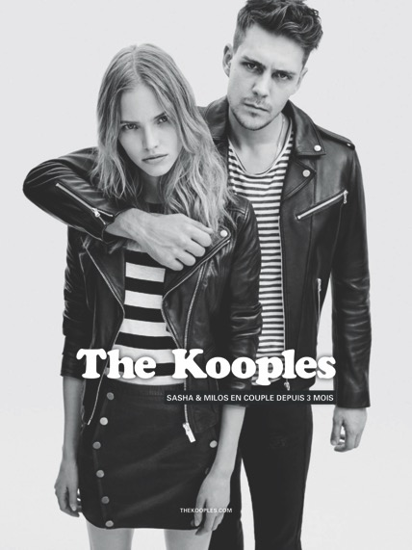
What Advertisers Do to Reach Consumers
Sensory and emotion
Images that promote globally recognized instincts such as love, attraction, comfort etc.
The Kooples use emotional connections to great effect. The ads show couples and how long they have been together.
All images in this presentation are subject to copyright. Copyright owners are listed in the book. By downloading these presentations you agree that they are for classroom use only.

Slide 19
Celebrity in Advertising
The use of celebrity in advertising has been very successful for the fashion industry.
McCracken’s three-stage Meaning Transfer model illustrates how celebrities appeal to our ideal selves.
Self-concept is the consumer’s notion of themselves through the eyes of others.

Slide 20
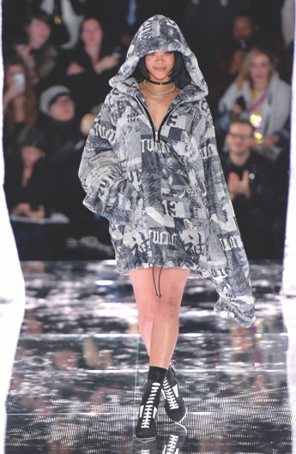
Celebrity in Advertising
Stage 1 Rihanna is known for her confident attitude to dressing.
Stage 2 The viewer transfers these meanings onto Puma.
Stage 3 The consumer decides if Rihanna for Puma matches their notion of their personal self.
Rhianna as a brand ambassador for Puma.
All images in this presentation are subject to copyright. Copyright owners are listed in the book. By downloading these presentations you agree that they are for classroom use only.

Slide 21
TV Advertising
TV advertising reaches a large and untargeted audience, therefore traditionally restricting fashion advertising to products such as fragrance.
The cost is also prohibitive.

Slide 22
TV Advertising
TV sponsorship
Sponsorship is a way to target a message by aligning a brand with a particular TV programme.
Brands create a static or moving film (an ‘ident’ or ‘bumper’) in association with the programme.
Bumpers are the point to restart the programme if viewers are fast forwarding the ads.
Cable channels can provide a cheaper, locally targeted option.

Slide 23
Print Advertising
A feature of glossy fashion magazines.
September and March editions are most sought after.
Magazines share their readership numbers and profiles to help brands match their consumers to readers of the magazine.
Costs vary according to the prestige of the magazine, readership numbers and position.
The inside front cover is the most expensive, followed by the back cover and the first third of the magazine.

Slide 24
Print Advertising
Magazine advertising reach
Circulation is the number of each edition printed.
Reach is estimated at 2.5 times circulation.
Grazia is the only weekly magazine to attract luxury brand advertising.
Advertorials
Advertorials are ads designed to appear part of a magazine. They cost 30–40% more.
May include copy from a magazine staffer, blogger or celebrity.
The words ‘promotion’ or ‘advertisement’ will always appear, but featured subtly.

Slide 25
Billboards
Outdoor advertising encompasses bus shelters, kiosks, train stations and advertising on transport.
Billboard space is sold by size, location, and whether standard or digital/interactive.
Billboards are displayed 24 hours a day and can be placed in popular shopping locations.
Interactive billboards including QR codes make shopping a 24-hour activity.
The major disadvantage is that exposure time can be very short.

Slide 26
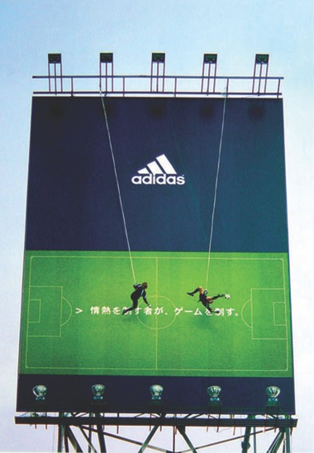
Guerrilla Advertising
Guerrilla campaigns resemble a PR stunt, a news story or street art.
They have a higher potential of going viral on social media, or achieving news coverage as an event.
Not everyone will ‘get’ these messages, but those who do feel like insiders.
A stunt by agency TBWA for Adidas, ‘Vertical Football’ gained international coverage.
All images in this presentation are subject to copyright. Copyright owners are listed in the book. By downloading these presentations you agree that they are for classroom use only.

Slide 27
Online Advertising
Has the advantage of immediate publication and no time or geographical limitations.
Can be targeted to proven viewer interest or type of viewer.
Space is sold by unit size, position and location on the webpage.
Online versions of fashion magazines create a perfect advertising environment.

Slide 28
Online Advertising
Banner advertising
Spaces at the top and sides of webpages are referred to as banners or tiles.
Banners at the top of websites are called leader boards.
Banners carry a hyperlink to the brand’s own site.
The cost is calculated on a per 1,000 impression basis. One impression = one view by a web user.
Space is also sold as MPU (mid-page units) or HPU (half-page units).

Slide 29
Online Advertising
Google AdWords
Google commands a third of all digital adspend.
Paying for Google AdWords places the advertiser at the top of a search for a particular term.
Results feature an ‘Ad’ icon next to them.
Adwords can be targeted to certain consumer groups, and the click-throughs and generated sales are measurable.

Slide 30
Advertising on Social Media
Effective exposure for brands on social media has become a ‘pay to play’ exercise, especially on Facebook.
Brand strategies involve a mix of content and targeted advertising.
Users of social media platforms are counted in MAUs, or monthly active users.

Slide 31
Advertising on Social Media
Advertising on Facebook
In 2016 Adweek.com recorded 1.59 bn Facebook MAUs.
Facebook’s data capture makes targeting of ads by age, gender, location, interests, behaviour or connections effective.
This measurability helps advertisers justify budgets and plan follow-up campaigns.
It also ensures that viewers see ads relevant to them.

Slide 32
Advertising on Social Media
Advertising on Facebook
Facebook offers boosted posts, video ads and dynamic ads based on viewer visits to a host’s website.
Facebook has disrupted the way advertising is paid for; brands can set their own budget.
Depending on budget, Facebook will place the ad at the optimum target market, making advertising on Facebook essentially a bidding process.
Smaller budgets will also see results on social media.

Slide 33
Advertising on Social Media
Advertising on Twitter
Twitter had 320 million MAUs in 2016 and has fewer advertising options than Facebook.
The platform offers great incentives to provoke user comment to hashtagged words and phrases, creating trending topics.
Audiences can be targeted by demographics, interests, by device or similarity to existing followers.
Advertisers can identify key words in the tweets of desired followers.

Slide 34
Advertising on Social Media
Advertising on Twitter
Twitter offers promoted tweets and website cards, which contain a link to the host’s website.
Brands set their own budgets and are charged only when a follower is gained, a post replied to or retweeted.
Advertisers receive the number of impressions gained (views or rollovers), engagement rates, retweets and those users who have made a post a favourite.

Slide 35
Key Points
The sales model and the involvement model are often used in fashion campaigns.
Emotional engagement, use of celebrity and polysemy are effective tools to capture audiences.
Innovations such as QR codes allow for greater interactivity than traditional advertising.
Online advertising can target audiences well, but the challenge to deliver a personal message remains.
All advertising has to be obvious to audiences, who may seek information from more credible sources.

