Slide 1
+
Fashion

Slide 2
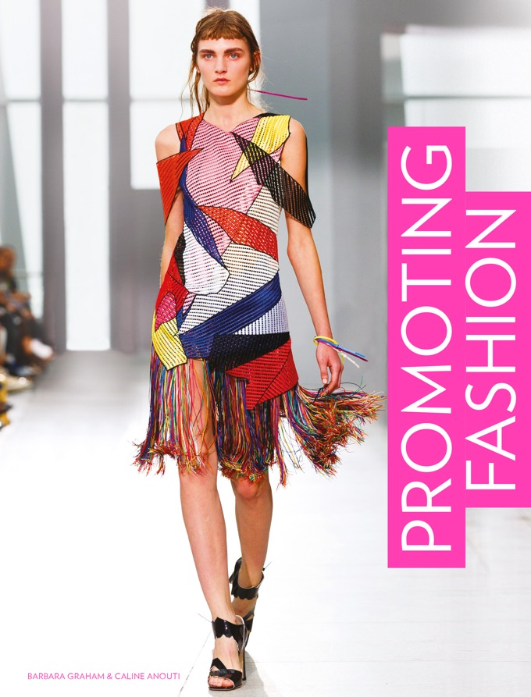

Slide 3
Promoting Fashion / Barbara Graham, Caline Anouti
Chapter 9
Direct Marketing

Slide 4
Objectives
Create and maintain a database to target potential and existing customers.
Focus on the best prospects for sales.
Compose effective direct marketing: catalogues, flyers etc.
Use email to target audiences with personal, interactive messages.
Use cross-platform messaging to get closer to audiences.

Slide 5
Key Theories
The 4 Cs of Communication (Fill, 2013).
Prospect Hierarchy (Egan, 2015).
Recency, Frequency and Monetary model (Various sources).

Slide 6
An Overview of Direct Marketing
Direct marketing (DM) is a form of communication that creates and sustains a dialogue with specific consumer groups.
It is usually used in combination with sales promotions or advertising.
Databases of contacts who may be segmented by age, income, interests or behaviours receive targeted messages.

Slide 7
An Overview of Direct Marketing
The aims of B2C DM are:
To engage consumers using techniques such as e-newsletters, notification of special offers or events, product range information.
To collect information such as personal data, registering of interest, purchasing and repeat purchasing behaviour.

Slide 8
An Overview of Direct Marketing
DM is an industry worth US$2.05 trillion in resulting sales (dma.org, 2015), roughly 8.7% of US GDP.
B2C DM integrates well with other communications to target messages by interest or habit directly to interested parties via inbox, home, or mobile phone.
DM uses a variety of online and offline media including catalogues, printed invitations, emails and telecommunications.
Its cost effective measurability is attractive to stakeholders focussed on ROI.

Slide 9
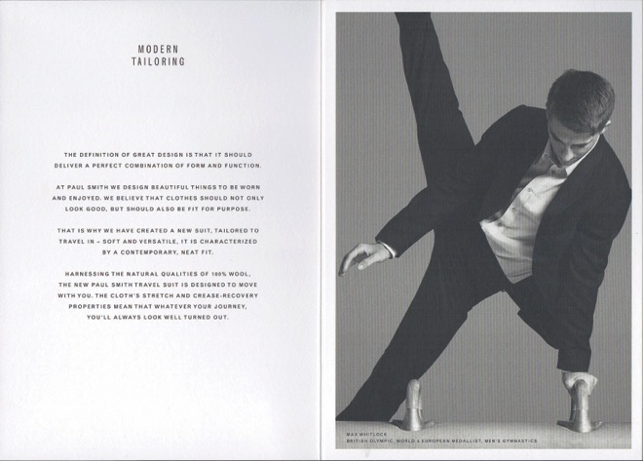
An Overview of Direct Marketing
Personally addressed, high-quality direct marketing messages can attract attention. This card depicting Olympic gymnast Max Whitlock contains a swatch of a new wool suiting. This shows attention to detail and includes the recipient in the design process.
All images in this presentation are subject to copyright. Copyright owners are listed in the book. By downloading these presentations you agree that they are for classroom use only.

Slide 10
Advantages and Disadvantages of Direct Marketing
Communications | Direct marketing
Ability to deliver a personal message | High
Ability to reach a large audience | Medium
Level of interaction | High
Credibility
Given by the target audience | Medium
Cost
Absolute costs | Medium
Cost per contact | High
Wastage | Low
Size of investment | Medium
Control
Ability to target particular audiences | High
Ability to adjust tool as circumstances change | High
Revisiting Fill’s 4 C’s framework (2013) provides an underpinning for analysing the advantages and disadvantages of DM as a tool.
All images in this presentation are subject to copyright. Copyright owners are listed in the book. By downloading these presentations you agree that they are for classroom use only.

Slide 11
Advantages and Disadvantages of Direct Marketing
Advantages of direct marketing
DM, especially digital, can replicate personal selling.
Email and text messaging are trackable in terms of click-through rates.
Measurability means more accurate budgeting for future campaigns.
High level of management control – DM can be used as a communications tool or to drive sales.

Slide 12
Advantages and Disadvantages of Direct Marketing
Disadvantages of direct marketing
Messages may be discarded, deleted or left in junk mail folders.
Promotional material for printed DM can be costly.
Cold-calling as part of telesales can be annoying or even offensive.
Updating and managing B2C databases can be time-consuming and costly.

Slide 13
Customers and Databases
DM aims to acquire new customers and retain existing ones, using lists of consumers.
House lists Small brands or start-ups can ask audiences to register with them.
Compiled lists Basic contact details found in public records.
Response lists Include more detailed profiles and evidence of behaviour. They are purchased from agencies.

Slide 14
Customers and Databases
The price (cost per thousand) is determined by the value of the information to the brand.
The brand then adds their own layers of information.
These lists become the building block of database management, and are used to attract similar individuals.
The process links directly to the importance of establishing a detailed customer profile.

Slide 15
Customers and Databases
Egan, 2015 proposes a prospect hierarchy of customers, demonstrating how consumers are viewed in terms of their strength as a prospect for the brand.
All images in this presentation are subject to copyright. Copyright owners are listed in the book. By downloading these presentations you agree that they are for classroom use only.

Slide 16
Customers and Databases
Suspects One stage above the general public. They match the brand’s existing customer profile.
Profiled prospects Have purchased similar brands and are therefore a stronger prospect.
Referrals Have been referred by an existing customer – therefore more likely to purchase.
Enquirers Have contacted the brand directly and expressed a definite interest.
Lapsed customers Have purchased previously and need to be attracted back.

Slide 17
Direct Mail and Offline DM
Printed, mass-produced promotional materials that are personally addressed and sent by post.
Direct mail takes the form of flyers, invitations, letters and catalogues.
It has a 30% higher response rate than email (dma.org, 2014) and works as an effective driver of traffic to websites.
44% of recipients are expected to visit the site after receiving direct mail.

Slide 18
Direct Mail and Offline DM
Catalogues
Some brands have identified target markets that respond to catalogue mail-outs.
Lifestyle brand The White Company has become a multi-channel operation since its launch as a 12-page brochure in 1994.
All images in this presentation are subject to copyright. Copyright owners are listed in the book. By downloading these presentations you agree that they are for classroom use only.

Slide 19
Direct Mail and Offline DM
Inserts and flyers
Leaflets, flyers or brochures that arrive in the post are a form of direct mail.
They contain advertising messages or inform a selected target segment about special offers or financial incentives.

Slide 20
Direct Mail and Offline DM
Letters and invitations
These address the consumer in a much more personalized way.
Their purpose is to invite clients to private views or sales previews or to inform them of new collections.
They can appear to be a personal invite from the buyers/design team to the audience.

Slide 21
Online DM
Better technology to track responses has increased the use of low-cost email messages and newsletters.
Most websites invite the visitor to sign up for these very early in the journey through the website.

Slide 22
Online DM
Email messages/opt-in email
Email messages have a better response rate if the recipient knows or has opted-in to the sender.
The open rate is 38.6% from a familiar brand and the response rate (a click through to the site) is 7% (dma.org, 2014).
Smith and Zook (2011) give a useful checklist for effective emailing.

Slide 23
Online DM
Email messages/opt-in email
Grab attention in the subject line and first sentence.
Be brief and relevant – use links for further information.
Be as personal as possible.
Provide links to social media platforms.
Provide an opt-out or unsubscribe option.
Provide the brand’s full contact details.

Slide 24
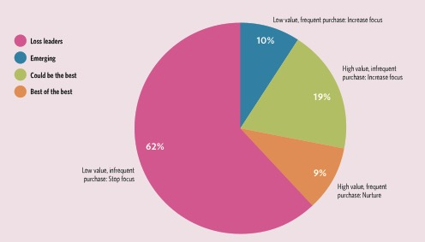
Online DM
The RFM model allows brands to assess who their most valuable customers are, and who to target with which type of message. Resources to low-value customers can be reduced.
All images in this presentation are subject to copyright. Copyright owners are listed in the book. By downloading these presentations you agree that they are for classroom use only.

Slide 25
Telemarketing, Telesales and Text Messaging
Telemarketing and telesales are seldom used by fashion companies.
Developments in text messaging, however, are relevant to the future of DM.

Slide 26
Telemarketing, Telesales and Text Messaging
Telemarketing
Outbound telemarketing Marketers telephone consumers about new product launches and in-store events.
Inbound telemarketing Used more commonly in the fashion industry to provide customer service, technical support, help with returns, or take orders.

Slide 27
Telemarketing, Telesales and Text Messaging
SMS and MMS marketing
Increased smartphone use has enabled one of the most effective forms of telemarketing.
Brands with young consumers found SMS text messages reached their audiences.
Since 2011 it has been possible to send MMS (photos, videos and group messages), potentially increasing the exposure of the message beyond the recipient.

Slide 28
Telemarketing, Telesales and Text Messaging
Telesales
Marketers or automated robocalls or chatbots phone customers to push products and services.
This method is associated with nuisance calling and invasive tactics.
The Do Not Call Registry (US) and the Telephone Preference Service (UK) allow consumers to register not to be called. Unfortunately, this is an insufficient deterrent.

Slide 29
Hybrid Direct Marketing
Direct-response ads – print, TV or online
Direct-response ads typically contain a call to action – a section for the recipient to complete.
These are placed in the mass media but allow an individual response from new prospects.

Slide 30
Hybrid Direct Marketing
Direct marketing versus social media
The effectiveness of email messages is under debate as audiences spend more time on social media.
Social media pushes messages out into communities of interested followers, whereas email is aimed at one recipient.
Social media lacks control over the response to an email, but email lacks the sharing element of social media.

Slide 31
Hybrid Direct Marketing
Cross-platform mobile messaging
Messaging platforms such as WhatsApp blur the lines between social media and DM.
Users can send images, videos and real-time messaging using data (avoiding text messaging costs).
Some retailers are finding they can share promotional content on WhatsApp, with a high rate of conversion to sales.

Slide 32
Hybrid Direct Marketing
WhatsApp, released in 2009, was acquired by Facebook in 2001. It became the most commonly used messaging app in the world.
All images in this presentation are subject to copyright. Copyright owners are listed in the book. By downloading these presentations you agree that they are for classroom use only.

Slide 33
Key Points
The interactivity of DM makes it attractive for tracking ROI.
Offline techniques can reach hidden markets and are effective at driving traffic to websites.
Database management is essential, and start-ups should plan for it.
Consider the receiver of DM. Which technique is appropriate – post or email?
Younger audiences are permanently engaged with smartphones and expect more blended communications made for sharing.

