Slide 1
+
Fashion

Slide 2
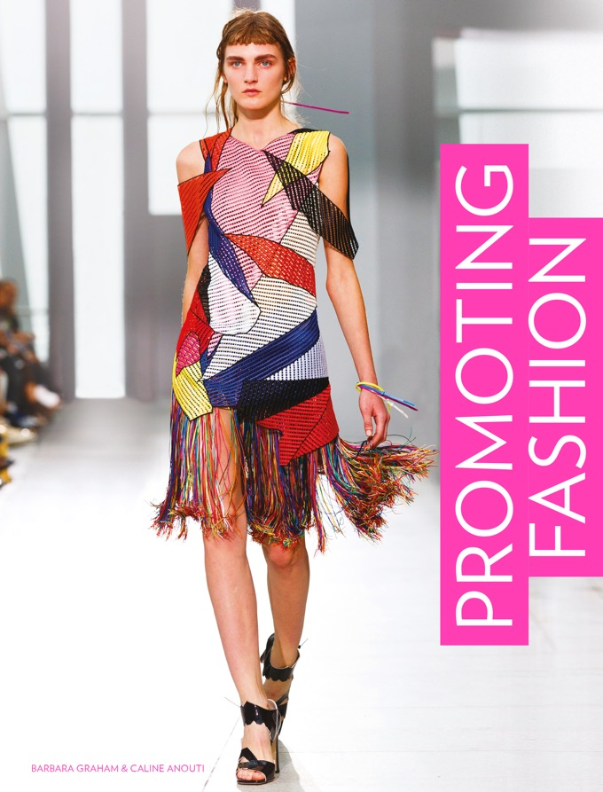

Slide 3
Promoting Fashion / Barbara Graham, Caline Anouti
Chapter 11
Sales Promotion and Packaging

Slide 4
Objectives
Use the tactics of fashion promotion, from online flash sales to loyalty schemes.
Add value to the consumer experience rather than rely on discounting.
Time promotions for the best effect.
Use packaging and the point of sales environment to add value, reinforce identity and maximize sales.

Slide 5
Key Theories
The 4 Cs of Communication (Fill, 2013).
Sales Promotion Objectives Grid (Fill, 2013).
Value-increasing or value-added promotions (Peattie and Peattie, 1993)

Slide 6
Advantages and Disadvantages of Sales Promotion
Communications | Sales promotion
Ability to deliver a personal message | Low
Ability to reach a large audience | Medium
Level of interaction | Medium
Credibility
Given by the target audience | Medium
Cost
Absolute costs | Medium
Cost per contact | Medium
Wastage | Medium
Size of investment | Medium
Control
Ability to target particular audiences | High
Ability to adjust tool as circumstances change | High
Using the ratings given in Fill’s framework, it is possible to analyse the advantages and disadvantages of sales promotions.
All images in this presentation are subject to copyright. Copyright owners are listed in the book. By downloading these presentations you agree that they are for classroom use only.

Slide 7
Advantages and Disadvantages of Sales Promotion
Advantages of sales promotion
The start and end dates of promotions can be controlled.
Specific consumer groups can be targeted by brand-owned databases.
Can be used to shift excess stock.
Sales promotions integrate well with other tools and can be delivered using DM, personal selling, PR and social media.

Slide 8
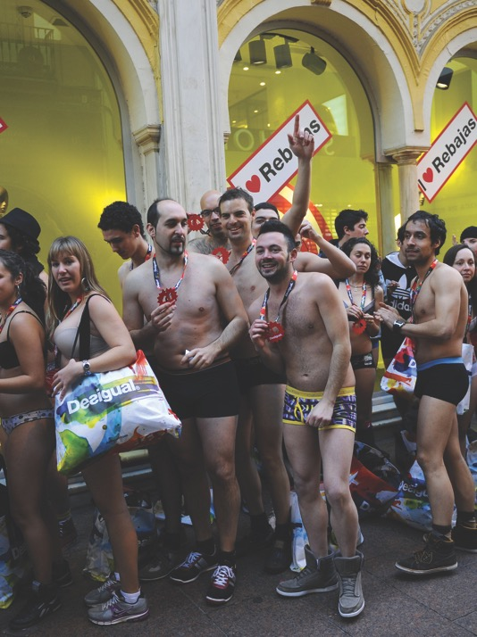
Advantages and Disadvantages of Sales Promotion
Semi-naked party organized by Spanish retailer Desigual. The first 100 shoppers queuing in their underwear won free clothing. The promotion boosted attendance at the January sales, which already had 50% discounts.
All images in this presentation are subject to copyright. Copyright owners are listed in the book. By downloading these presentations you agree that they are for classroom use only.

Slide 9
Advantages and Disadvantages of Sales Promotion
Disadvantages of sales promotion
Promotions with external agencies require organization, preparation and budget.
The intention of discounting is transparent – therefore this aspect is afforded little credibility.
Sales can fall when the promotion ends.

Slide 10
Types of Sales Promotion Used in the Fashion Industry
Discounting is the most overused form of promotion by far.
Large department stores and online retailers mark down goods earlier and earlier in the season.
Low prices for fast fashion, combined with discounting, means that consumers expect a bargain and will not pay full price.

Slide 11
Types of Sales Promotion Used in the Fashion Industry
Discounts and online discounters
Discounting hits the retailer’s 2.7 to 3 times mark-up on landed (own label) or wholesale (brands that have been bought in) price.
Discounting (50–70% is common in US and UK department stores) can affect profit margins.
Zara is often praised as a business model. It uses feedback from the shop floor to reduce the risk of excess stock.

Slide 12
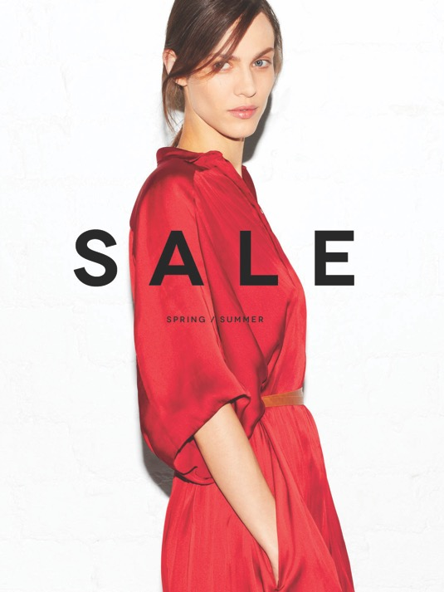
Types of Sales Promotion Used in the Fashion Industry
Discounts and online discounters
Zara typically keep discounts to small quantities of excess stock. They release understated supporting campaign material.
All images in this presentation are subject to copyright. Copyright owners are listed in the book. By downloading these presentations you agree that they are for classroom use only.

Slide 13
Types of Sales Promotion Used in the Fashion Industry
Discounts and online discounters
Flash sales sites provide daily discounts of 50–70% on fashion goods, including luxury items.
Unlike outlet villages which sell last season’s stock at discounted prices, flash sites offer a quicker route to excess stock for limited periods.
These sites provide a solution for luxury labels wishing to avoid in-store discounting.

Slide 14
Types of Sales Promotion Used in the Fashion Industry
Discounts and online discounters
The Chinese practice of tuangou, or group shopping to demand a discount, has spawned sites such Groupon where shoppers are offered deals dependent on interested numbers.
The US initiative Black Friday has spread to Europe, South America, Canada and India.
In the UK, scenes of in-store chaos have led to Black Friday becoming a largely online concern. Planning is needed to cope with deliveries and returns.

Slide 15
Types of Sales Promotion Used in the Fashion Industry
Giveaways
Small items such as branded bags, stickers, badges etc given away at the point of purchase.
Retailers may reward loyal customers with a gift to encourage repeat purchasing.
They usually require customers to register with the hosting brand to encourage positive posts on social media.
Offering a giveaway makes for great content on brands’ own blogs and social sites.

Slide 16
Types of Sales Promotion Used in the Fashion Industry
Loyalty schemes
Reward customers by offering points for purchasing, signing up, promoting the brand or recommending friends to join.
Offer a feel-good alternative to discounting.
Tiered rewards offer a greater value the greater the action.
Higher tiers of rewards can be exclusive previews of sales, VIP customer service and so on.
Can be offered as apps, which provide the retailer with data to personalize rewards.

Slide 17
Types of Sales Promotion Used in the Fashion Industry
Loyalty schemes
In addition to points, Nordstrom’s loyalty programme gives users extra points on certain days in-store.
All images in this presentation are subject to copyright. Copyright owners are listed in the book. By downloading these presentations you agree that they are for classroom use only.

Slide 18
Value-increasing and Value-adding Promotions
Peattie and Peattie (1993) draw an important distinction between promotions that increase value and those that add value.
Value-increasing promotions Price reductions, money-off vouchers and two-for-one offers.
Value-adding promotions The price remains the same but a loyalty card, a free gift or entry to a prize draw may be offered.

Slide 19
When to Use Sales Promotion as a Tool
Sales promotions are not so effective for unknown brands raising awareness, for brands entering new markets or for luxury or high-value goods.
Fill (2003) suggests the below grid, adapted here for the fashion market.

Slide 20
When to Use Sales Promotion as a Tool
All images in this presentation are subject to copyright. Copyright owners are listed in the book. By downloading these presentations you agree that they are for classroom use only.

Slide 21
Packaging and Retail Point of Sale
Packaging and POS items can be viewed as value-added promotional items.
They are potential collectables, engaging or even useful items.
They can also be shared and discussed on platforms such as Pinterest.

Slide 22
Packaging and Retail Point of Sale
Pinterest swing tags and packaging boards.
All images in this presentation are subject to copyright. Copyright owners are listed in the book. By downloading these presentations you agree that they are for classroom use only.

Slide 23
Packaging and Retail Point of Sale
In general fashion is displayed in-store in one of two scenarios:
In a single-brand environment: an own-label store.
In a multi-brand environment: a department store or independent stocking a number of brands.
Packaging and POS are important in both, but vital in the second scenario to help differentiate the brand.

Slide 24
Packaging and Retail Point of Sale
Packaging
Egan (2015) and Smith and Zook (2011) call swing tags, boxes, bottles and product holders ‘the silent salesperson’.
Such items should convey the identity of the brand in-store.
It is the last chance for the brand to convey product, fit and price details.

Slide 25
Packaging and Retail Point of Sale
Packaging
Egan (2015) provides a packaging checklist, amended here for the fashion environment.
It should gain attention.
It should be distinctive.
It should instruct and inform; fit, fabric, size, country of origin.
It should persuade the purchaser to buy; offers, usefulness, collectability.
It should reflect the identity of the brand.
It should motivate brand choices.

Slide 26
Packaging and Retail Point of Sale
Packaging
Canada, Mexico and the US are the world’s largest consumers of packaging.
Paper and board contribute the largest amount by material.
The EU Packaging Waste Directive encourages producers to reuse and recycle packaging, reduce the likelihood of disposal, and lighten its weight.
Consider compostable materials or those using waste products, or materials that close the loop on supply.

Slide 27
Packaging and Retail Point of Sale
Swing tags
Detachable branded tags, to be taken home by the purchaser.
Clockwise from top: Spare buttons (Acne), David Bailey mini-print (Bailey and The Bleach Room), and a mini lookbook (Diesel).
All images in this presentation are subject to copyright. Copyright owners are listed in the book. By downloading these presentations you agree that they are for classroom use only.

Slide 28
Packaging and Retail Point of Sale
Boxes and holders
Fuseproject and Puma came up with a reusable bag and box cut from a single piece of cardboard. It reduced cardboard use by 65%, saving 8,500 tons of paper and a million litres of water.
All images in this presentation are subject to copyright. Copyright owners are listed in the book. By downloading these presentations you agree that they are for classroom use only.

Slide 29
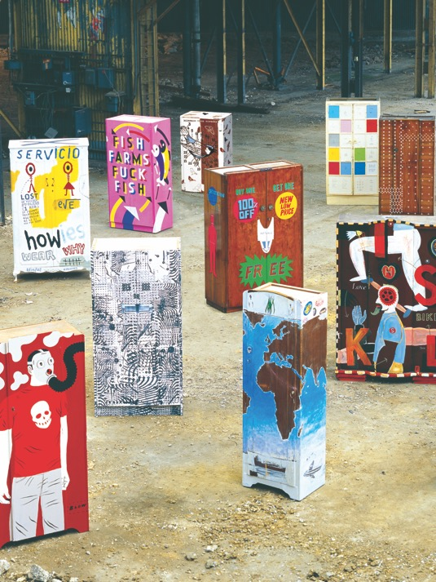
Packaging and Retail Point of Sale
Boxes and holders
Howies achieved positive PR for its use of 14 recycled wardrobes, each decorated by an artist, as in-store display units. They also turned recycled flower bulb packages into t-shirt packaging.
All images in this presentation are subject to copyright. Copyright owners are listed in the book. By downloading these presentations you agree that they are for classroom use only.

Slide 30
Packaging and Retail Point of Sale
Retail point of sale
Integrates with campaign or branded material that the shopper may have seen in other settings.
Provokes previous associations with the brand to create a strong impulse to buy.
The ideal scenario is ‘bathing in the brand’ (Lea-Greenwood, 2012). The shopper sees campaign material, is reminded by location-based advertising, then tempted in-store by appealing windows and POS.

Slide 31
Key Points
Customers expect discounts. Brands could use data to target discounts to a previous purchase or proven area of interest.
Gifts, competitions, loyalty cards and giveaways create a value-added encounter for the shopper, who affords more credibility.
New start-ups should avoid discounting and use the above tactics with caution.
Packaging remains important for differentiation between brands in-store and to convey brand identity. It can also reflect innovations in recycling and reducing waste.

