Slide 1
+
Fashion

Slide 2
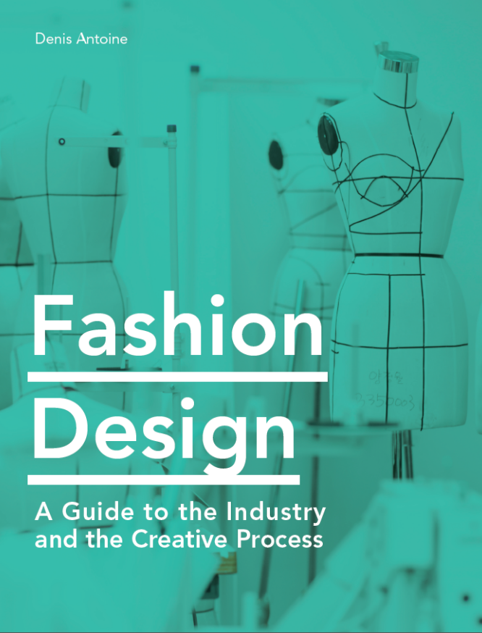

Slide 3
Fashion Design / Denis Antoine
Chapter 4
Textile development

Slide 4
Objectives
Understand the valuable role played by creative textiles in the development of a collection
Identify the structure and the creative applications of constructed surfaces, including woven and knitted fabrications
Explore the technical context and esthetic possibilities of dye applications
Identify a variety of types and creative uses of printed and patterned materials

Slide 5
Objectives
Classify embellished surfaces and evaluate their esthetic capabilities
Evaluate the technical processes and creative applications of manipulated fabrics
Introduce the technical and esthetic uses of laser-cutting in fashion
Explore new technologies and fabrication processes impacting the fashion industry

Slide 6
Creative Textile Development
Designers rarely rely exclusively on sourced textiles.
Original textiles can offer valuable creative value to any range of product, particularly if silhouette and construction are limited by functional needs of the consumer.
Core textile terminology:
Fiber
Yarn
Fabrication
Finishing

Slide 7
Constructed Surfaces / Wovens
Woven fabrications are constructed by interlacing two sets of yarns, known as warp and weft.
Key directions:
Grain is parallel to the warp and the selvedge, and is the most stable
Cross-grain is perpendicular to the selvedge
Bias sits at a 45-degree angle to the grain and is very flexible

Slide 8
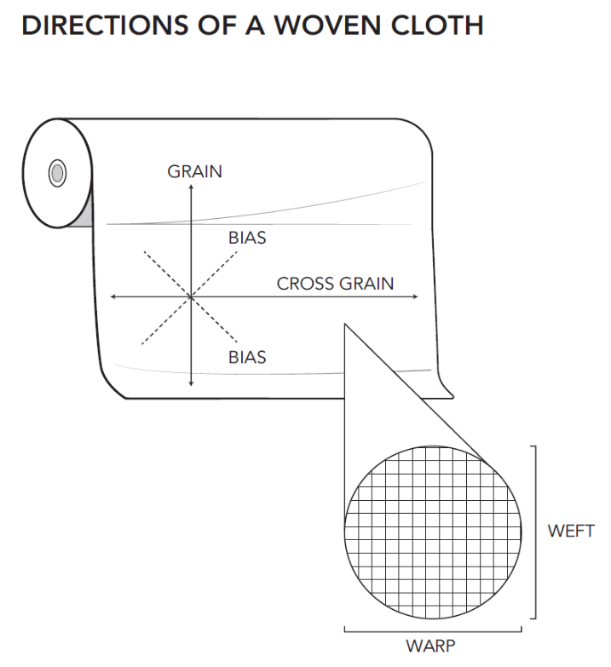
All images in this presentation are subject to copyright. Copyright owners are listed in the book.
By downloading these presentations you agree that they are for classroom use only.

Slide 9
Constructed Surfaces / Wovens
Standard woven structures:
Plain
Oxford
Twill
Herringbone
Satin
Crepe
Complex
All images in this presentation are subject to copyright. Copyright owners are listed in the book.
By downloading these presentations you agree that they are for classroom use only.

Slide 10
Constructed Surfaces / Wovens
Woven design experimentation can be done manually or digitally.
Creative experimentation with woven surfaces can focus on either of the following areas:
Texture – designers can create surface interest by using textured yarns or looping (pile) weaving techniques
Stripes and checks – designers can create a variety of geometric patterns by varying color of the yarns
Technical consideration:
Yarn-dyed fabrics vs. printed stripes and checks

Slide 11
Constructed Surfaces / Wovens
Complex wovens offer ample variety of creative applications.
Complex woven terminology:
Dobby
Jacquard
Brocade
Damask
These techniques tend to be developed in similar ways as printed materials by focusing on visual pattern design first, and then applying these into weaving design software.

Slide 12
Constructed Surfaces / Knits
Knitted fabrics are constructed by looping a yarn around itself or other looping yarns. This imparts insulation and stretch to the materials produced.
Warp knits include tricot, piqué, raschel, and Milanese. These are mostly produced by machine and used in activewear and lingerie.
All images in this presentation are subject to copyright. Copyright owners are listed in the book.
By downloading these presentations you agree that they are for classroom use only.

Slide 13
Constructed Surfaces / Knits
Weft knits include jersey, waffle knit, rib, cable, and Fair Isle among many others. These can be produced by machine or by hand.

Slide 14
Constructed Surfaces / Knits
Cut-and-sew knits:
Produced from knitted fabric cut into garment pieces and assembled using serging machines
Usually categorized by weight (oz/yd² or gr/m²)
Fashioned knits:
Constructed by knitting shaped garment pieces and linking these into a final apparel item
More costly than cut-and-sew construction, but virtually waste-free
Usually categorized by gauge (stitches per linear inch)

Slide 15
Constructed Surfaces / Knits
Creative experimentation with knitted materials can be done manually or digitally. Experimentation with knits can focus on color or texture.
Color-based techniques include stripes, intarsia, and Fair Isle.
Designing for Fair Isle and intarsia requires the use of gauge graphs
Textural knit design includes basic textural knits (such as rib variations and waffles) or more complex cables and knit lace.

Slide 16
Dye Applications
Dyes impart color by chemically binding to fiber.
Certain fibers will work with some dyes but not others.
Creative dye techniques enable variety of outcomes.
Vat-dyeing:
Primarily used to achieve solid color applications
Commonly used in custom color matches and exclusive brand-based color development

Slide 17
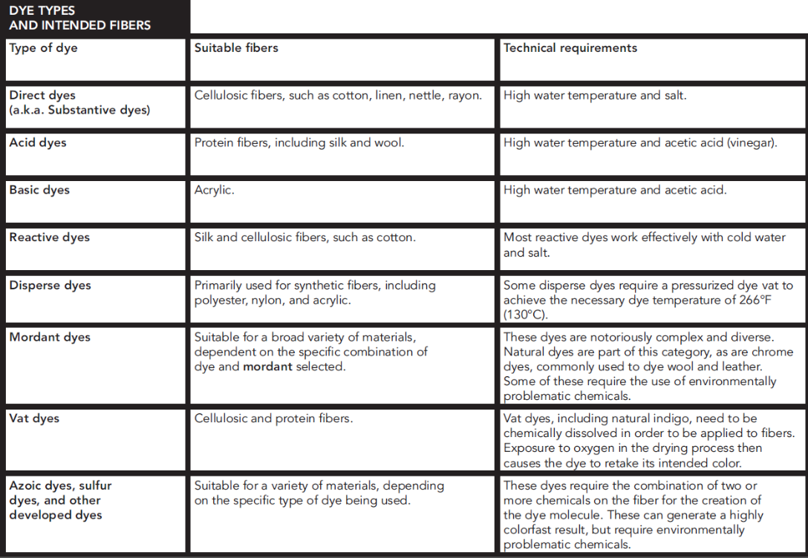
All images in this presentation are subject to copyright. Copyright owners are listed in the book.
By downloading these presentations you agree that they are for classroom use only.

Slide 18
Dye Applications
Dip-dyeing:
Used to achieve a gradient of color (ombré)
Resist-dyeing (wax-dyeing):
Batik, tsutsugaki, Yoruba cloth
Tie-dyeing:
Shibori
Fabric painting
All images in this presentation are subject to copyright. Copyright owners are listed in the book.
By downloading these presentations you agree that they are for classroom use only.

Slide 19
Prints and Patterns
Key categories of printing techniques:
Woodblock
Screen printing
Digital printing
All images in this presentation are subject to copyright. Copyright owners are listed in the book.
By downloading these presentations you agree that they are for classroom use only.

Slide 20
Prints and Patterns
Types of print designs:
Placement prints
Allover repeat prints
Engineered prints
All images in this presentation are subject to copyright. Copyright owners are listed in the book.
By downloading these presentations you agree that they are for classroom use only.

Slide 21
Embellishment
Embellished fabrics have been created in a variety of cultures throughout history. Awareness of cultural context is important.
Embellishments are often mechanized or produced in regions of the world with cheaper labor (i.e. South Asia).
Primary categories:
Embroidery
Beading

Slide 22
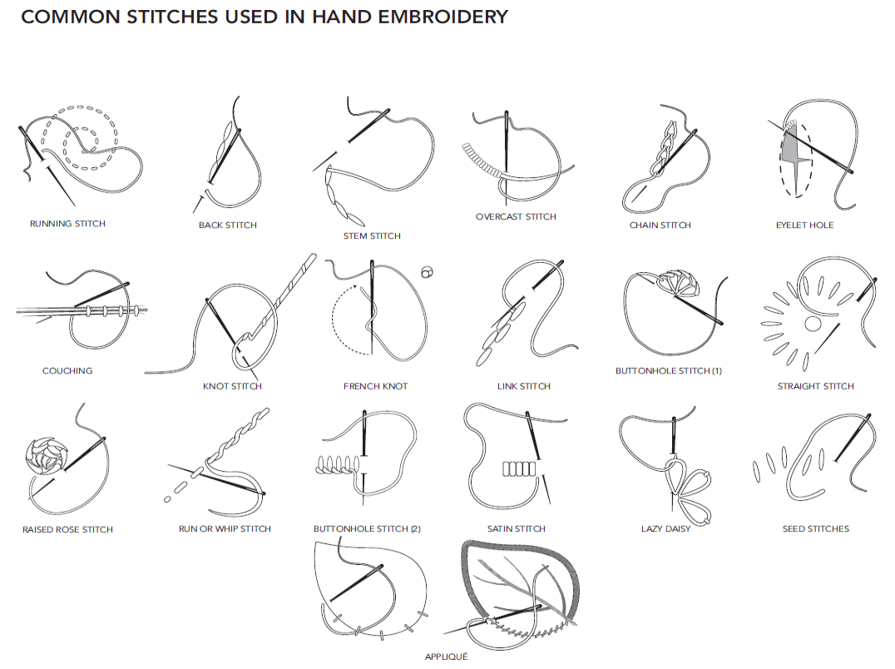
All images in this presentation are subject to copyright. Copyright owners are listed in the book.
By downloading these presentations you agree that they are for classroom use only.

Slide 23
Embellishment
Embellishment techniques:
Beading and sequin work
Appliqué
Glued embellishments
All images in this presentation are subject to copyright. Copyright owners are listed in the book.
By downloading these presentations you agree that they are for classroom use only.

Slide 24
Manipulations
Sewn manipulations:
Smocking, tucking, ruching, patchwork, quilting, trapunto, etc.
Heat-set manipulations:
Pleating, crushing, embossing, etc.
Surface treatments:
Brushing, sandblasting, stonewashing, etc.
Perforation

Slide 25
Laser-cutting
Laser-etching (rastering):
Commonly used as finishing process on denim
Laser-cutting:
Allows quick production of complex perforated materials
Setting up a design requires use of vector-based design software (i.e. Adobe Illustrator or similar)
All images in this presentation are subject to copyright. Copyright owners are listed in the book.
By downloading these presentations you agree that they are for classroom use only.

Slide 26
New Technology and Fabrication Development
3D printing (rapid-prototyping technique) is becoming increasingly applicable to fashion design, challenging traditional production processes.
Resins, latex, and other solution-based materials are being used to explore new ways of constructing garments.

