Slide 1
+
Fashion

Slide 2
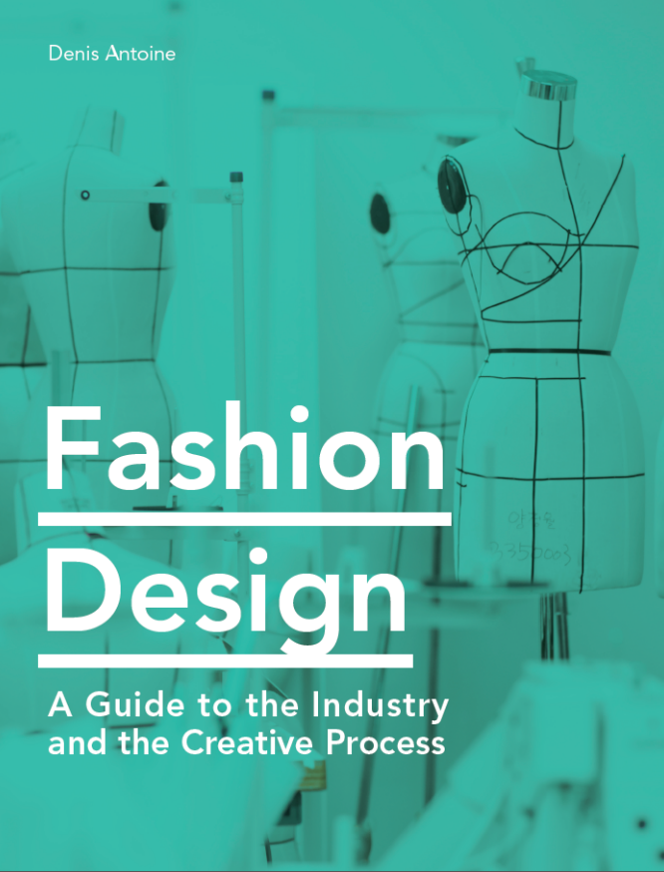

Slide 3
Fashion Design / Denis Antoine
Chapter 5
Design development

Slide 4
Objectives
Explore the many design processes used in creating a collection
Understand the creative uses of sketching, collage, and digital media in collection development
Explore a variety of fashion silhouettes
Identify the multiple approaches and uses of draping on the form

Slide 5
Objectives
Find out about digital draping techniques in collection development
Discover detail-focused design and its uses in collection development
Recognize the importance of sampling ideas in the exploration and presentation of fashion
Learn the steps involved in visualizing an original fashion collection

Slide 6
Design Processes
Key role of designers is to translate inspiration into a full range of fashion products. Employing diverse techniques of design processing can help achieve this goal.
Designers should always record all their creative exploration through a process book. Process books may include sketches, collage, images of original draping, detail sampling, photography, digital media, etc.
Process books may be pre-planned and structured in a bound sketchbook format, or can be compiled from loose-sheet experimentation.

Slide 7
Design Processes
The design process involves three phases:
1. Research investigation
2. Design experimentation
3. Design refinement
All images in this presentation are subject to copyright. Copyright owners are listed in the book.
By downloading these presentations you agree that they are for classroom use only.

Slide 8
Design Processes
Full design exploration should include develop-ment of creative solutions for the following:
Silhouette / volume / shape
Color
Materials / fabrication
Surface / pattern / texture
Construction / details / finishings
Styling / mood / creative context
All images in this presentation are subject to copyright. Copyright owners are listed in the book.
By downloading these presentations you agree that they are for classroom use only.

Slide 9
Sketching, Collage, and Digital Media
To enhance creative value, designers should avoid jumping from raw research to final croquis sketch (fashion sketch).
Observational analysis and image tracing through a variety of drawing-based techniques can unlock the creative potential of research.
All images in this presentation are subject to copyright. Copyright owners are listed in the book.
By downloading these presentations you agree that they are for classroom use only.

Slide 10
Sketching, Collage, and Digital Media
Collage allows exploration of unique combinations and juxtapositions.
Collage can be done manually or digitally.
Including human elements (heads/faces, hands, feet, etc.) can help communi-cate proportion and volume.
All images in this presentation are subject to copyright. Copyright owners are listed in the book.
By downloading these presentations you agree that they are for classroom use only.

Slide 11
Sketching, Collage, and Digital Media
Fashion (croquis) sketching is used to visualize design ideas in relation to the human form.
Traditionally done on an elongated body figure to add elegance and grace.
Experienced designers freehand their croquis sketches, but designers in early stage of training may use croquis templates.
While rendered croquis (used in design presentation) can be time-consuming, quick croquis sketches developed for design experimentation should take two to five minutes.

Slide 12
Exploring Silhouettes
Silhouette refers to the overall shape and volume of an outfit. Intentional use of silhouette can help strengthen the visual storytelling of a line of apparel.
Some silhouettes are naturally better suited for certain markets and product types.
Key fashion silhouettes:
Chemise (V-line) Column
A-line Tubular (I-line)
Hourglass (bell) Trumpet (mermaid)
Trapeze Square
Cocoon Tunic

Slide 13
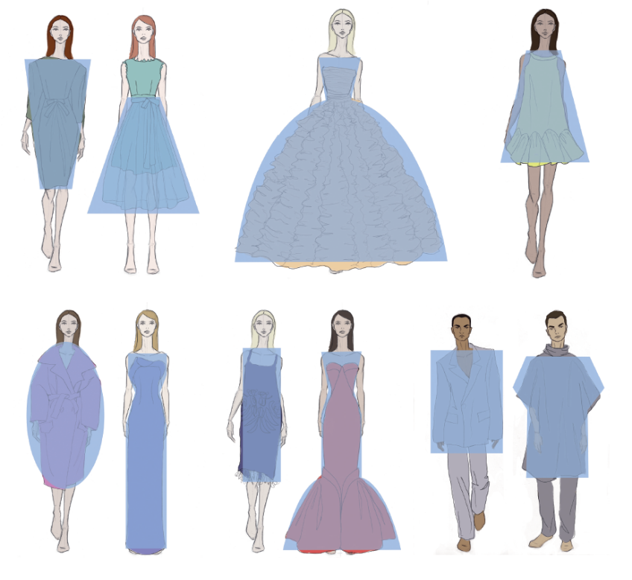
All images in this presentation are subject to copyright. Copyright owners are listed in the book.
By downloading these presentations you agree that they are for classroom use only.

Slide 14
Draping on the Form
Types of common approaches to draping:
Moulage
Surface draping
Garment fitting
Geometric pattern experimentation
Deconstruction
All images in this presentation are subject to copyright. Copyright owners are listed in the book.
By downloading these presentations you agree that they are for classroom use only.

Slide 15
Draping on the Form
Moulage involves the manipulation of fabric on the form to generate the shape, volume, and functional construction of the intended garment. The resulting material sections can be translated to working patterns.
All images in this presentation are subject to copyright. Copyright owners are listed in the book.
By downloading these presentations you agree that they are for classroom use only.

Slide 16
Draping on the Form
Surface draping focuses on the addition of surface interest onto a base layer or functional understructure. This may include techniques such as 3D pleating, smocking, or ruching.
Garment fitting focuses on editing the fit of existing garments three-dimensionally. While may be limited in terms of originality of outcome, it is commonly used in more commercially minded companies.

Slide 17
Draping on the Form
Geometric pattern experimentation involves cutting fabric into a variety of shapes and placing these on the form. Approach is at the core of zero-waste pattern cutting.
Deconstruction involves the taking apart and reassembling of existing garments. Effectively a form of 3D collage with the added benefit of waste repurposing.
All images in this presentation are subject to copyright. Copyright owners are listed in the book.
By downloading these presentations you agree that they are for classroom use only.

Slide 18
Draping on the Form
Documenting draped experiments:
Plain contrasting background
Lighting
Perspective distortion and camera placement
Documenting all angles
Photographic documentation of original drapes is then traced over and translated into a croquis sketch as part of the process book.
Working patterns resulting from draped experiments must be fully marked up to be usable for 3D design refinement.

Slide 19
Digital Draping
Beyond traditional design processes, digital draping happens at the intersection of digital technology and
3D-design exploration.
2D to 3D:
Projecting imagery directly onto a dress form or a garment muslin
3D modeling and AR/VR:
Maya, Google Tilt Brush, etc. allow generation of original garment shapes directly into a 3D digital environment

Slide 20
Detail-focused Design
Value of many garments comes from refined execution of construction details.
Approaches for visualizing/ communicating construction elements:
Mock-ups
Technical drawings
All images in this presentation are subject to copyright. Copyright owners are listed in the book.
By downloading these presentations you agree that they are for classroom use only.

Slide 21
Sampling Your Ideas
Fashion is a multi-layered sensory experience.
Quality evaluation of a design idea requires full and precise understanding of all elements employed.
Samples included in the process book (or dedicated sample box) play a pivotal role in communicating the quality and value of the proposed designs.
All images in this presentation are subject to copyright. Copyright owners are listed in the book.
By downloading these presentations you agree that they are for classroom use only.

Slide 22
Visualizing Your Collection
Once all the creative possibilities of the inspiration have been explored loosely, the next step is to refine and visualize a collection of designs.
Moving from loose design ideas to a refined collection involves two steps:
1. Styling
2. Editing

Slide 23
All images in this presentation are subject to copyright. Copyright owners are listed in the book.
By downloading these presentations you agree that they are for classroom use only.

Slide 24
Visualizing Your Collection
Styling is the process of combining individual design ideas into effective outfits.
Loose design ideas may focus on individual garments such as jackets, pants, or sweaters.
Once all separate design options have been rendered in croquis format, designs can be visualized as complete outfits, layering and combining garment types, and visualizing color use.
Focus on lifestyle of intended consumer is important to success of this process.

Slide 25
Visualizing Your Collection
Editing is the final step in visualizing the collection.
All the styled outfits are combined into an effective range of design offerings.
Designers must be aware of the value of offering a variety of garment types, functional needs of the consumer, and buyers’ priorities.
Moving a design from 2D to 3D (prototyping) can be costly, so effective editing of the collection is essential to avoid unnecessary waste of time and resources moving forward.

