Slide 1
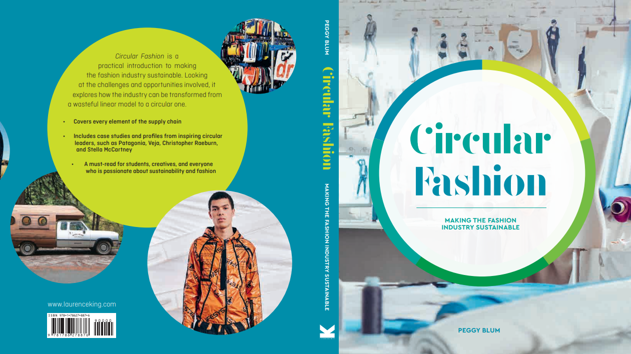

Slide 2

Introduction:
The Evolution of the
Fashion Industry
Circular Fashion: Making the Fashion Industry Sustainable

Slide 3
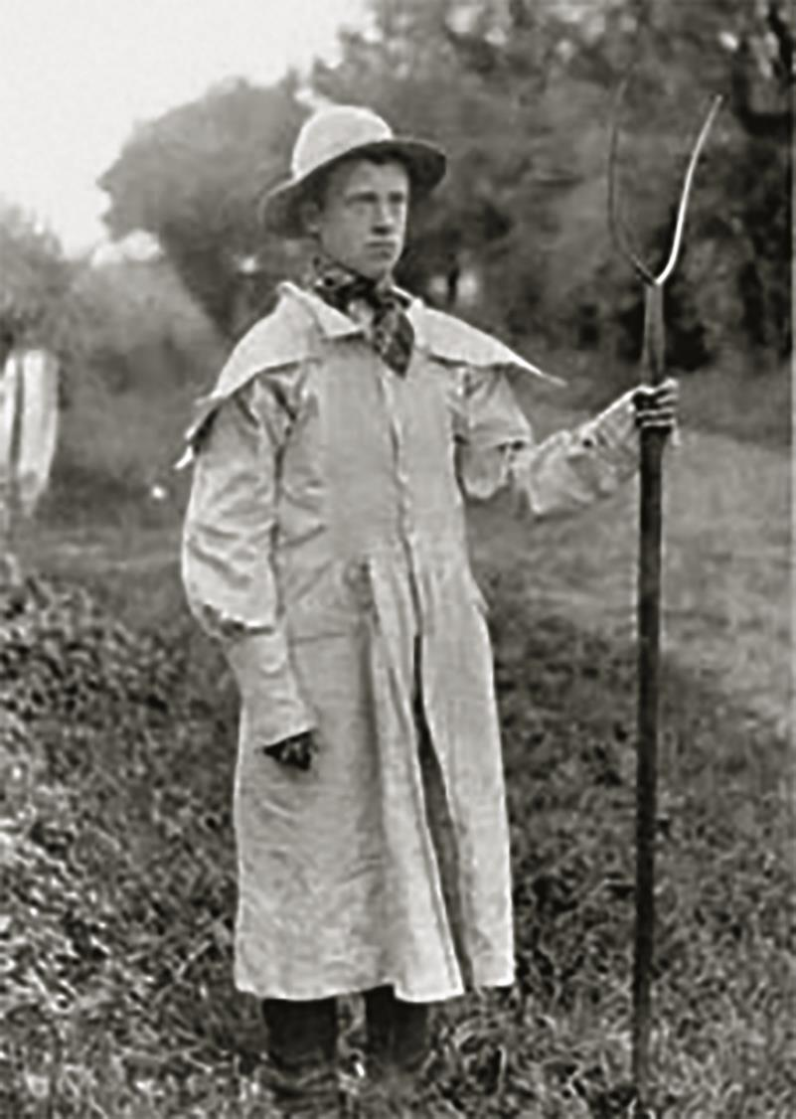
The Domestic System 1300-1750
Agrarian society
Families sewed and repaired their own clothing
Cloth was made from plant fibers and handspun
Clothing was valued for generations
Home-based cottage industries emerged
Ready-made smocks
Slow production methods
All images in this presentation are subject to copyright. Copyright owners are listed in the book. By downloading these presentations you agree that they are for classroom use only.

Slide 4
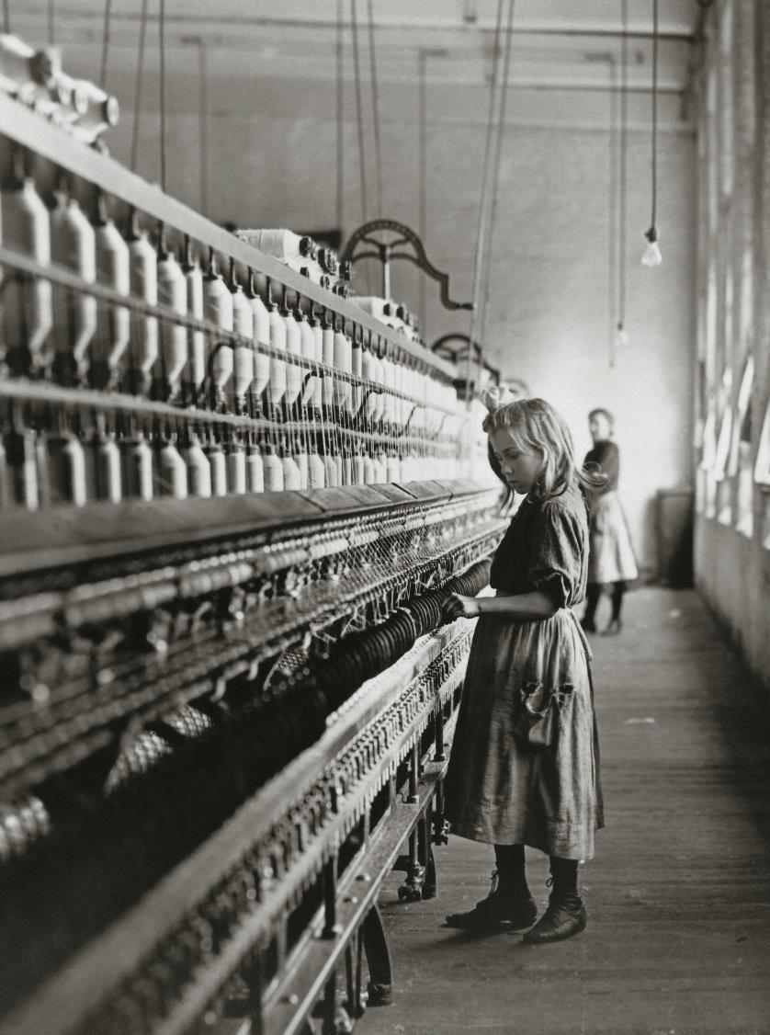
The Factory System 1760-1830
New inventions and technologies emerged
Spinning jenny, power loom, cotton gin
Sewing machine
Faster production methods
Cloth became more readily available
Industrial Revolution
Manufactories
Sweatshops
Mass produced and less expensive goods
All images in this presentation are subject to copyright. Copyright owners are listed in the book. By downloading these presentations you agree that they are for classroom use only.

Slide 5
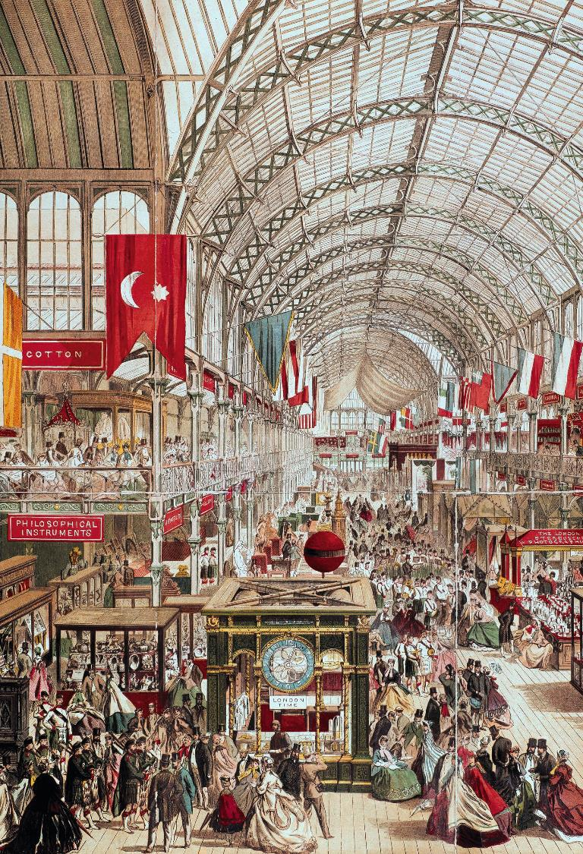
The Dawn of Ready-to-Wear
Prosperous middle class emerged
Great Exhibition,1851 in London
The birth of the department store
Shopping as a leisure activity
French couturiers
Introduction of synthetic fibers
Mass-produced and affordable clothing in standard sizes became readily available for public consumption
All images in this presentation are subject to copyright. Copyright owners are listed in the book. By downloading these presentations you agree that they are for classroom use only.

Slide 6

Planned Obsolescence AND Fast Fashion
New ideas and innovation
“Lightbulb moment”
Clothing with limited lifespans
Fastest production model
Speed to market
Social media influences
Consumer demand for low price and trends
Low quality, poor construction, and inferior materials
Discarded clothing increases
All images in this presentation are subject to copyright. Copyright owners are listed in the book. By downloading these presentations you agree that they are for classroom use only.

Slide 7
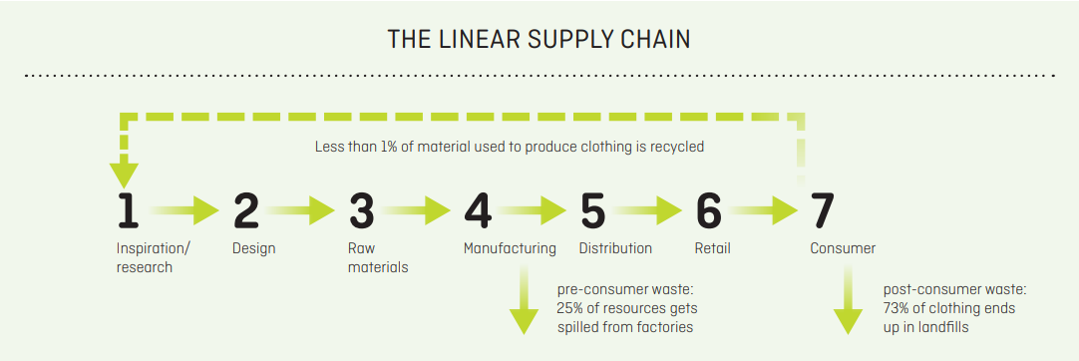
Take-Make-Dispose
The linear economy is a traditional economy model based on a “take-make-consume-throw away” approach to resources.
All images in this presentation are subject to copyright. Copyright owners are listed in the book. By downloading these presentations you agree that they are for classroom use only.

Slide 8
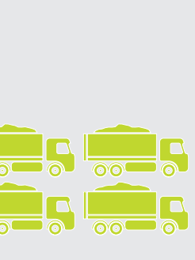
Waste
Overconsumption/overproduction
Pre-consumer waste
Fashion supply chain problems
Post-consumer waste
Fast fashion creates a global environmental crisis
Rethinking material waste
All images in this presentation are subject to copyright. Copyright owners are listed in the book. By downloading these presentations you agree that they are for classroom use only.

Slide 9
Think Piece
Imagine a world without waste.
How can we challenge ourselves to think more deeply about the products we create, the waste we generate, and our own clothing consumption habits?

Slide 10


