Slide 1
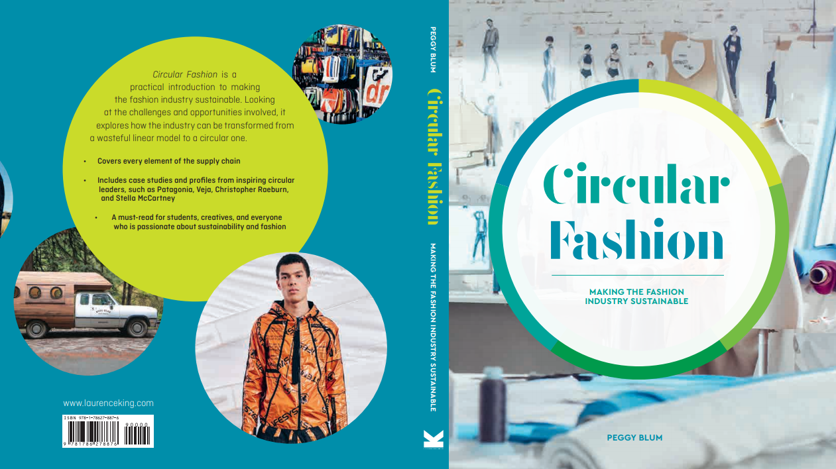

Slide 2

01:
A Circular mindset
Circular Fashion: Making the Fashion Industry Sustainable

Slide 3
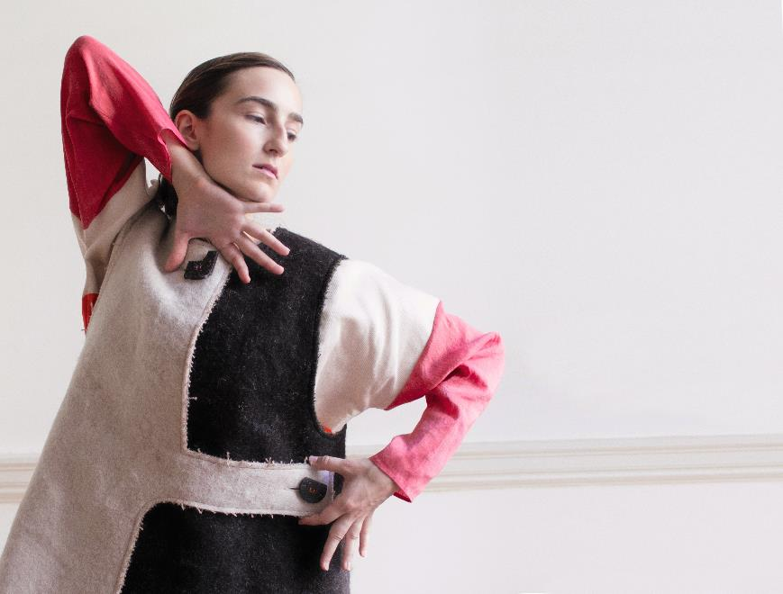

Circular Fashion
Nature: A circular system
Learning from nature
Shifting from linear to circular
Circular fashion definition
All images in this presentation are subject to copyright. Copyright owners are listed in the book. By downloading these presentations you agree that they are for classroom use only.

Slide 4
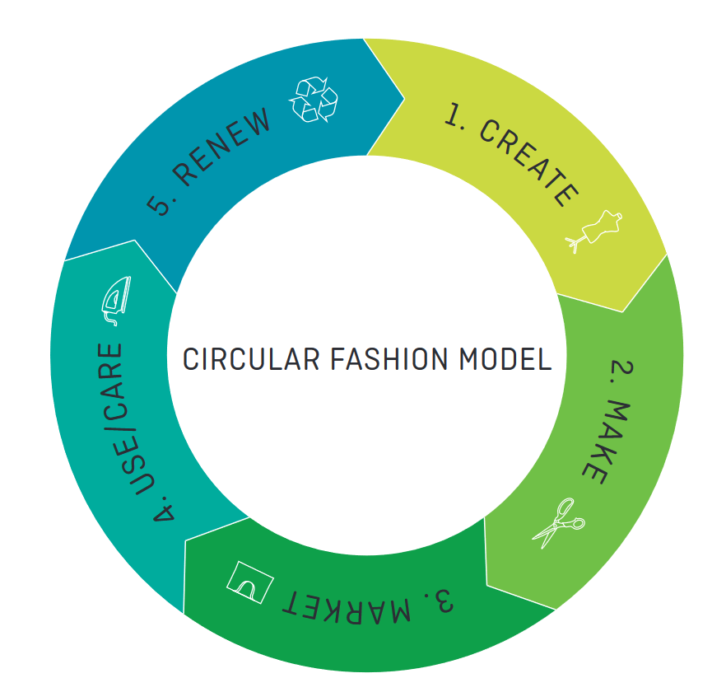
A Circular fashion model
A circle of responsibility
Create: What is it that we want to circulate?
Make: Human-centric innovations and technologies that design out waste
Market: Environmental Profit and Loss (EP&L) model, cross-industry collaborations
Use/care/repair: Extending product lifespans, garment warranties, self-repair kits
Renew: Industry information exchanges, recycling technologies
All images in this presentation are subject to copyright. Copyright owners are listed in the book. By downloading these presentations you agree that they are for classroom use only.

Slide 5
CHANGING mindsets
CONSUMER MINDSET
INDUSTRY MINDSET
How consumers look for sustainable messages from brands
Common language: Brand’s communication messages to consumers
Fashion and rational purchasing decisions
Exciting sustainable fashion at no extra cost
Organizational change
Sustainability as an investment
Long-term efficiency and positive environmental impacts
Sustainability as standard operating procedure
Systems thinking

Slide 6
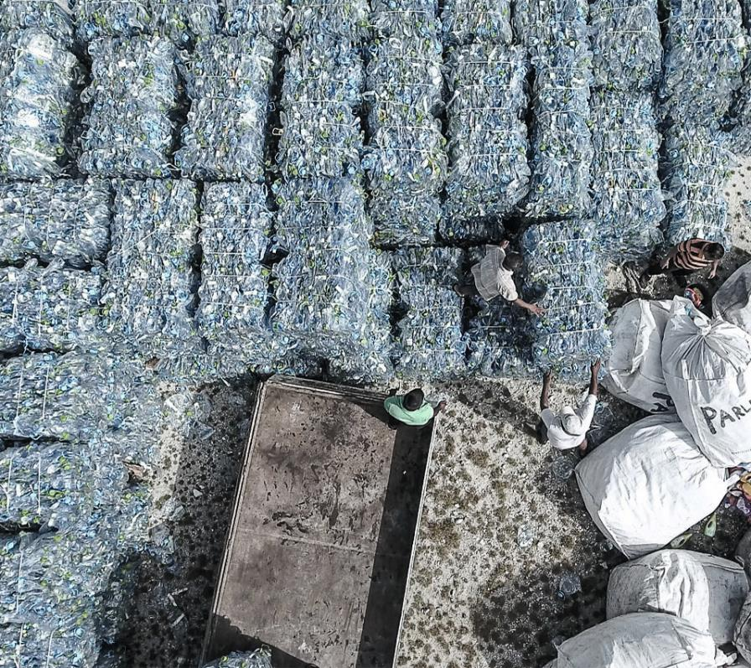
The circular economy
Cradle to Cradle
Performance economy
Industrial economy
Natural capitalism
All images in this presentation are subject to copyright. Copyright owners are listed in the book. By downloading these presentations you agree that they are for classroom use only.

Slide 7
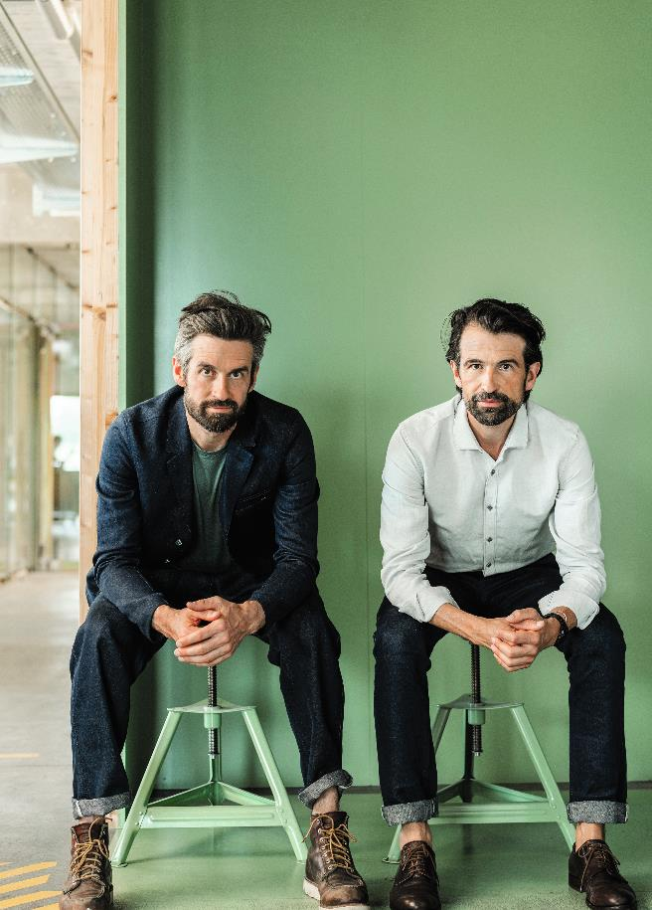
Circular leaders
Visionaries
Collaborative
Purpose driven
People, planet, profit
Adopt a circular mindset
All images in this presentation are subject to copyright. Copyright owners are listed in the book. By downloading these presentations you agree that they are for classroom use only.

Slide 8
Think Piece
How can we change mindsets so that we can all live a more sustainable life, and so life here on this planet can continue?

Slide 9


