Slide 1
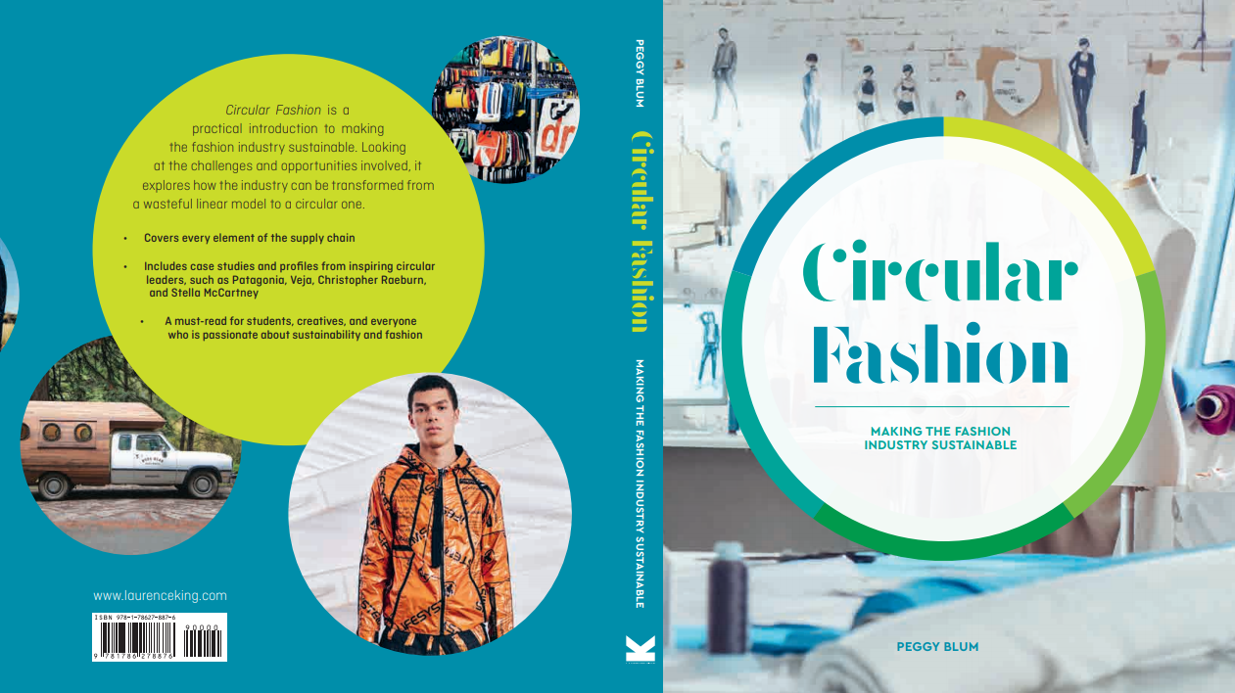

Slide 2

02:
Design thinking and re-thinking
Circular Fashion: Making the Fashion Industry Sustainable

Slide 3
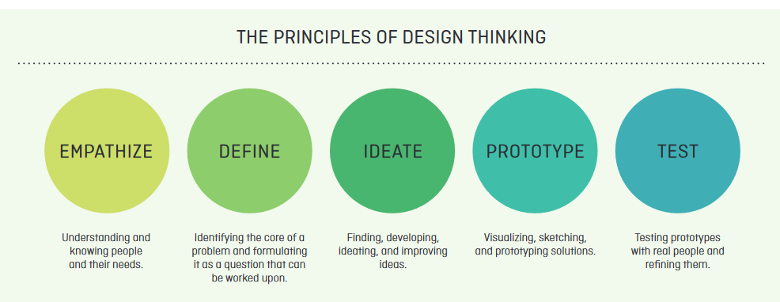
Design thinking
Design thinking is a strategy used to introduce sustainable and circular processes, principles, and mindsets.
All images in this presentation are subject to copyright. Copyright owners are listed in the book. By downloading these presentations you agree that they are for classroom use only.

Slide 4

Circular fashion design considerations
Longevity in design
Dematerialization
Designing with waste
Disassembly
All images in this presentation are subject to copyright. Copyright owners are listed in the book. By downloading these presentations you agree that they are for classroom use only.

Slide 5

Longevity in design
Slow design
Durability
Repairability
Biodegradability
All images in this presentation are subject to copyright. Copyright owners are listed in the book. By downloading these presentations you agree that they are for classroom use only.

Slide 6
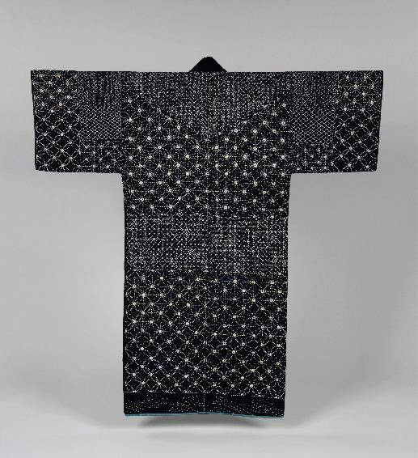
DEMATERIALIZATION
Zero-waste design
Wearable technology
Made-to-order
All images in this presentation are subject to copyright. Copyright owners are listed in the book. By downloading these presentations you agree that they are for classroom use only.

Slide 7
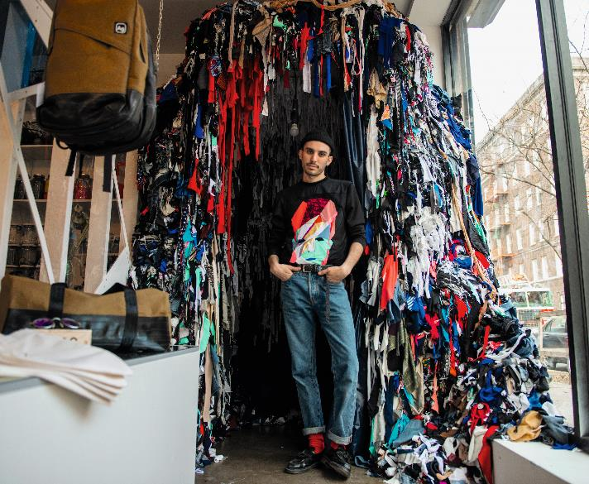
Designing with waste
Upcycling
Recycling
Designing with discarded materials
All images in this presentation are subject to copyright. Copyright owners are listed in the book. By downloading these presentations you agree that they are for classroom use only.

Slide 8

Disassembly
Sustainable architectural model
Cradle to Cradle methodology
Assemble/reassemble
Versatility
All images in this presentation are subject to copyright. Copyright owners are listed in the book. By downloading these presentations you agree that they are for classroom use only.

Slide 9
Think Piece
Consider how a garment can be designed for disassembly. Start by identifying each component (material, buttons, trims, linings, etc.) of the product, and then take into account how each component can be reused or recycled.

Slide 10


