Slide 1
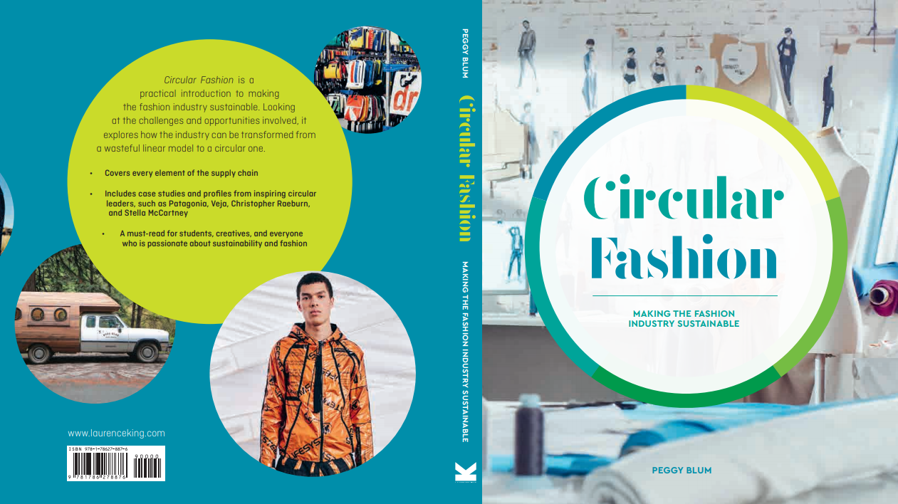

Slide 2

03:
MATERIALS
Circular Fashion: Making the Fashion Industry Sustainable

Slide 3
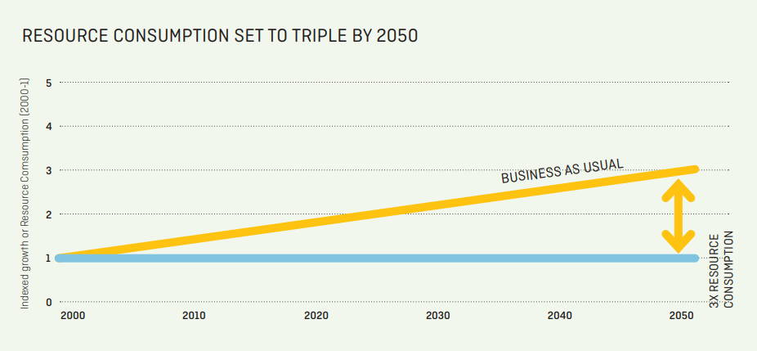
Global resource use
Population shifts
Rising middle class
Fashion production and consumption accelerates
Resource use accelerates
All images in this presentation are subject to copyright. Copyright owners are listed in the book. By downloading these presentations you agree that they are for classroom use only.

Slide 4
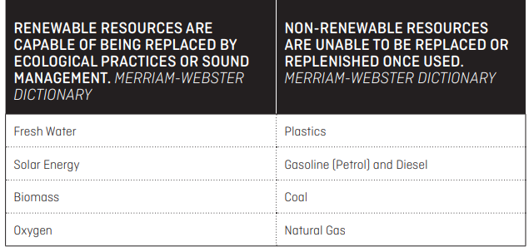
Renewable and non-renewable resources
All images in this presentation are subject to copyright. Copyright owners are listed in the book. By downloading these presentations you agree that they are for classroom use only.

Slide 5
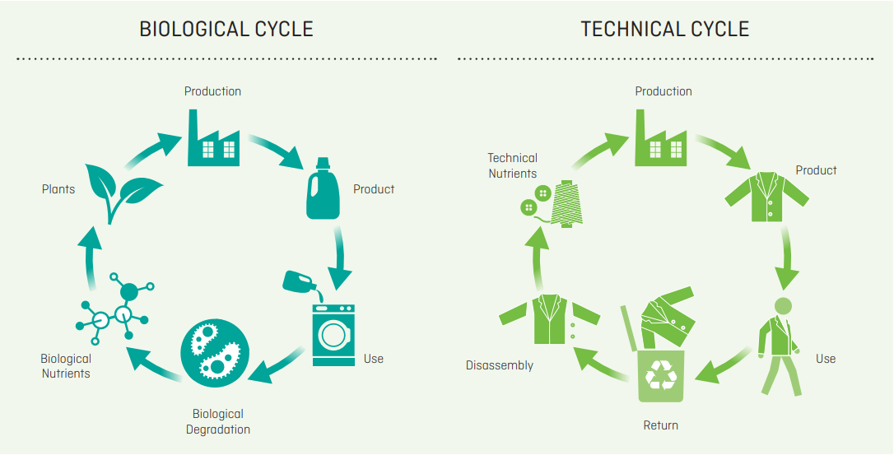
Biological and technical cycles
Biological cycles renew and restore living systems
Technical cycles recover and restore non-biodegradable materials through reuse, repair, remanufacture, or recycle strategies
All images in this presentation are subject to copyright. Copyright owners are listed in the book. By downloading these presentations you agree that they are for classroom use only.

Slide 6
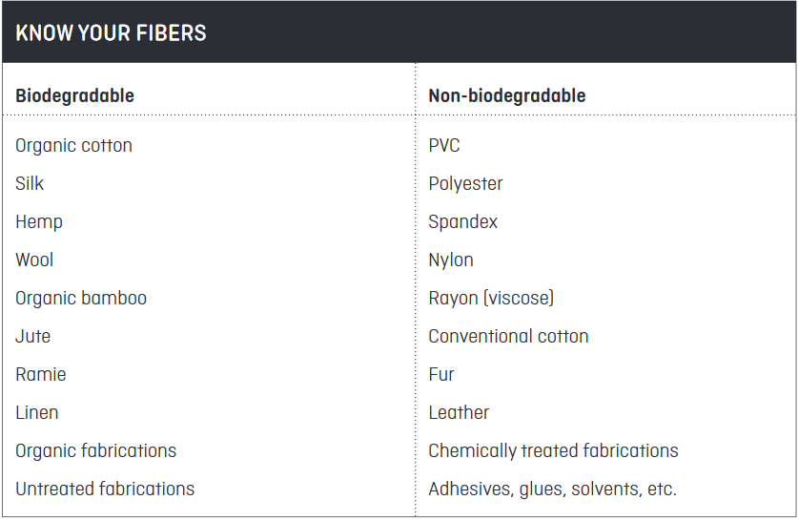
Circularity and resources
Biodegradable is a substance that will decay naturally and in a way that is not harmful to the environment
Non-biodegradable is a substance or chemical that cannot be changed to a harmless natural state by the action of bacteria and may therefore damage the environment
All images in this presentation are subject to copyright. Copyright owners are listed in the book. By downloading these presentations you agree that they are for classroom use only.

Slide 7
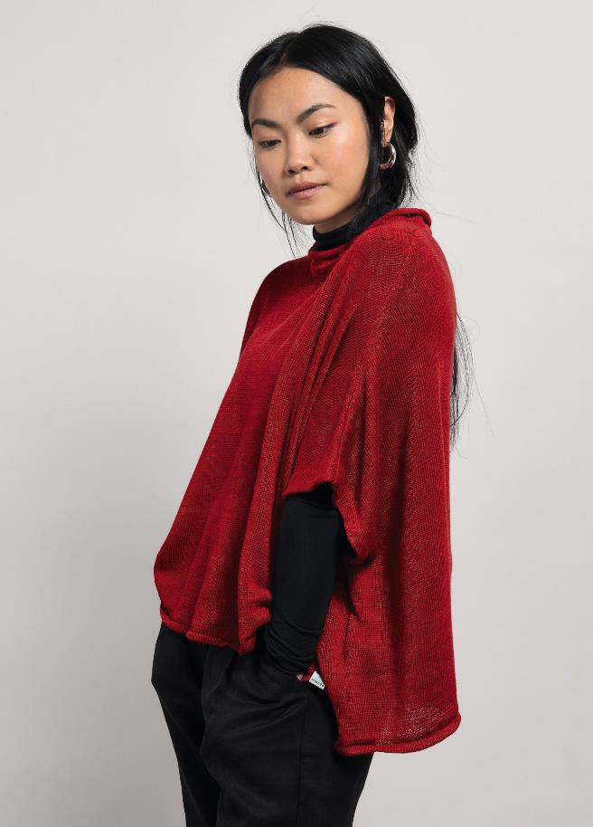
Natural Materials
Natural materials are sourced directly from nature, be it from animals (such as wool or fur), insects (such as silk), or plants (such as cotton, hemp, or jute).
All images in this presentation are subject to copyright. Copyright owners are listed in the book. By downloading these presentations you agree that they are for classroom use only.

Slide 8
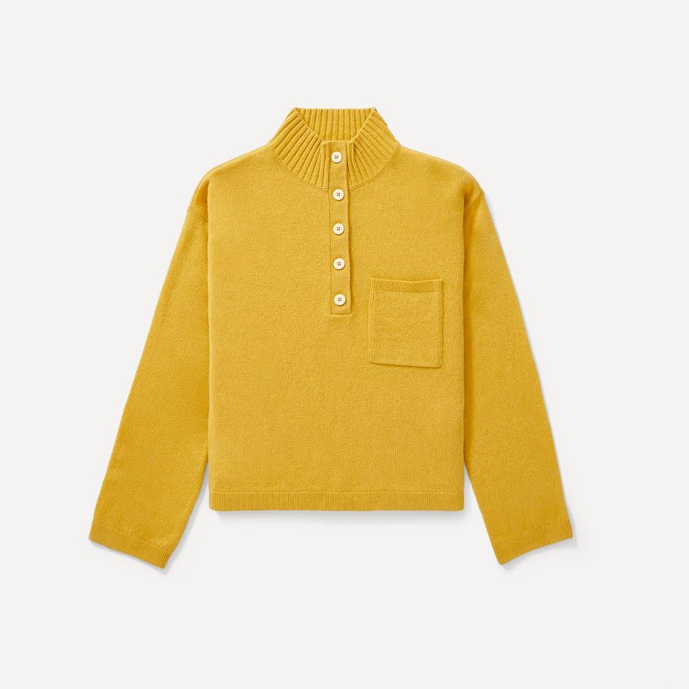
Animal and insect Fibers
Leather
Fur
Feathers
Wool
Cashmere
Silk
All images in this presentation are subject to copyright. Copyright owners are listed in the book. By downloading these presentations you agree that they are for classroom use only.

Slide 9
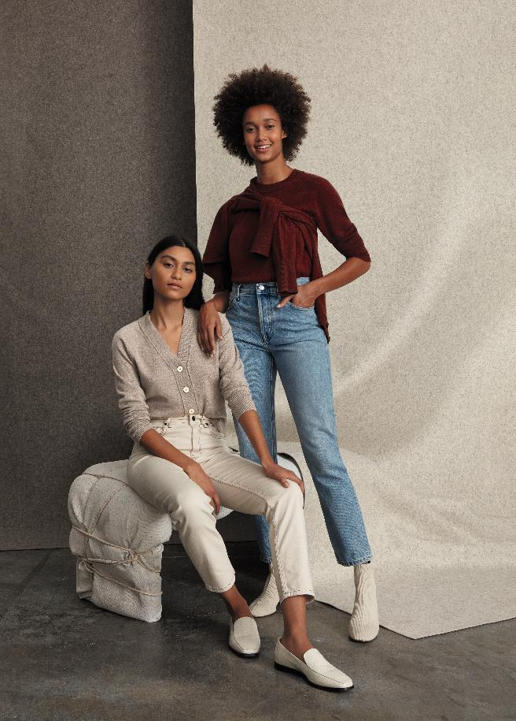
Plant Fibers
Linen (flax)
Cotton
Hemp
All images in this presentation are subject to copyright. Copyright owners are listed in the book. By downloading these presentations you agree that they are for classroom use only.

Slide 10
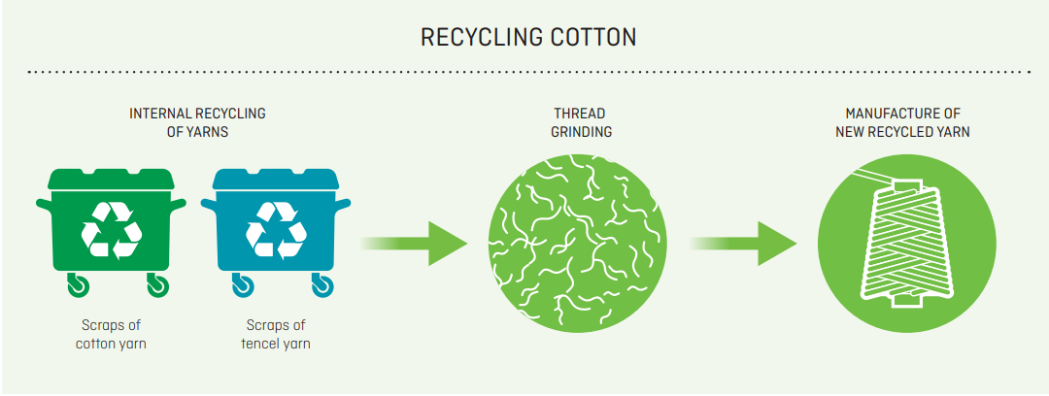
Circular alternatives
Organic
Recycling
Innovation
All images in this presentation are subject to copyright. Copyright owners are listed in the book. By downloading these presentations you agree that they are for classroom use only.

Slide 11
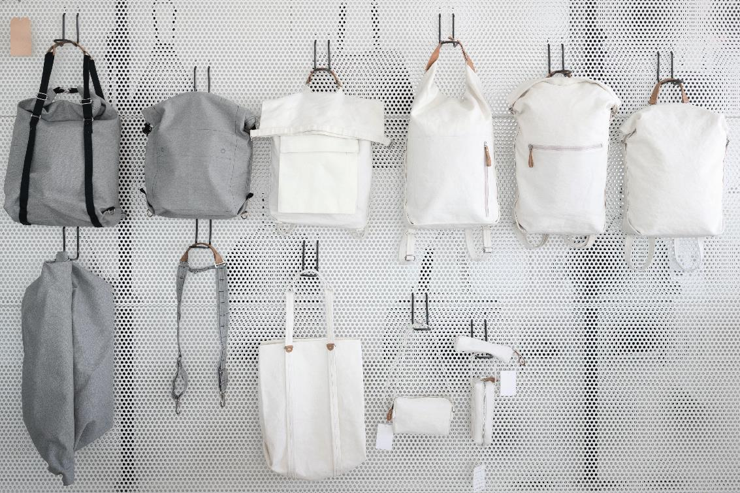
Alternative plant fibers
Cork
Pineapples
Oranges
Abacá (bananas)
Mushrooms
Bamboo
All images in this presentation are subject to copyright. Copyright owners are listed in the book. By downloading these presentations you agree that they are for classroom use only.

Slide 12
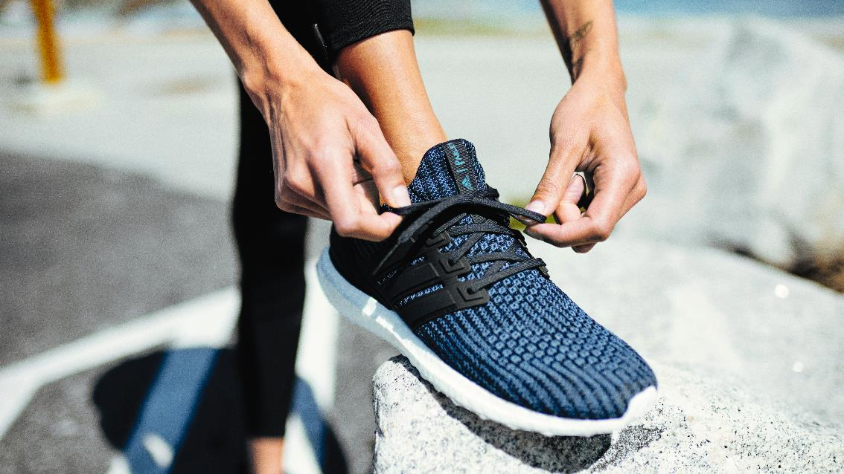
Artificial and synthetic Materials
Unnatural fibers are known as artificial or synthetic
Artificial fibers, such as rayon (viscose) and lyocell, are regenerated by humans from natural sources such as plant cellulose
Synthetic fibers, such as polyester and nylon, are made of manufactured materials formed through chemical processes
All images in this presentation are subject to copyright. Copyright owners are listed in the book. By downloading these presentations you agree that they are for classroom use only.

Slide 13
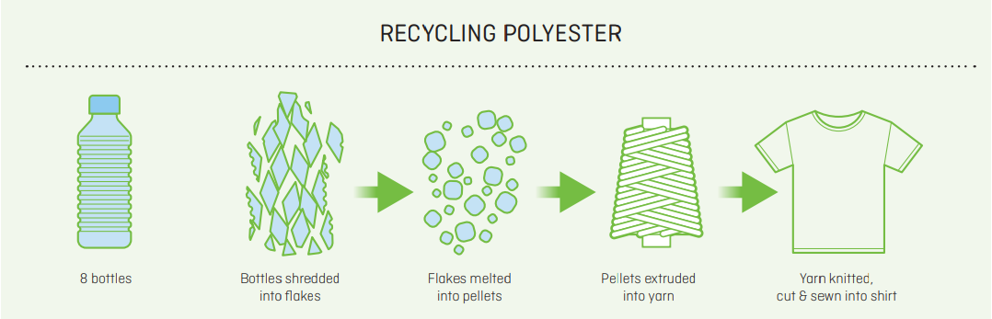
Circular alternatives
Recycling
Ocean plastics
Innovation: Biowaste
All images in this presentation are subject to copyright. Copyright owners are listed in the book. By downloading these presentations you agree that they are for classroom use only.

Slide 14
Think Piece
For our circular future, which fabrics do you believe are the most promising alternatives for conventional cotton, synthetic polyester, and animal-derived materials?

Slide 15


