Slide 1
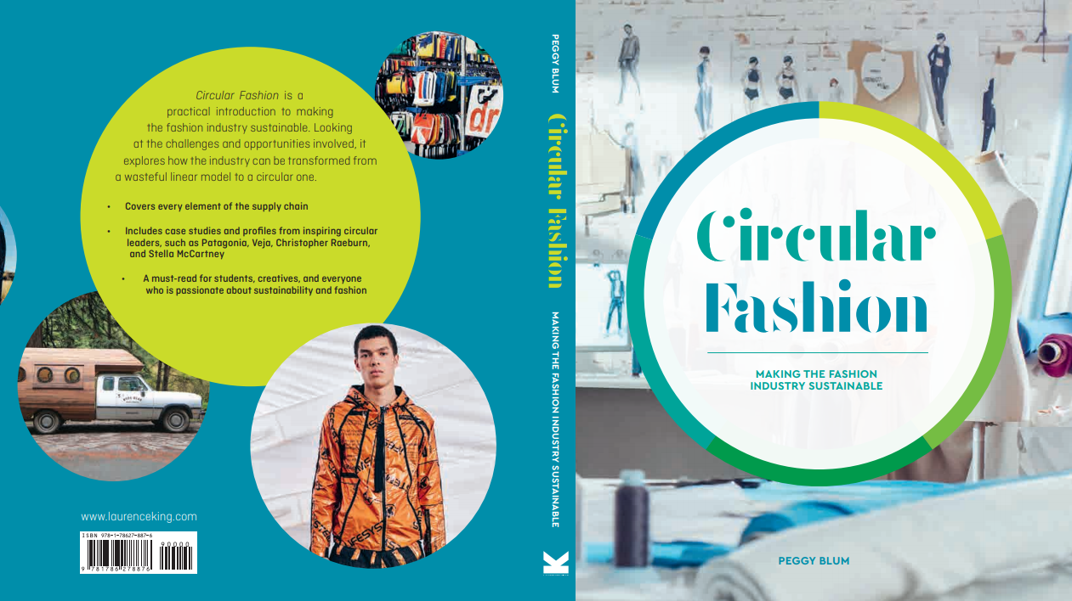

Slide 2

04:
Processing
Circular Fashion: Making the Fashion Industry Sustainable

Slide 3
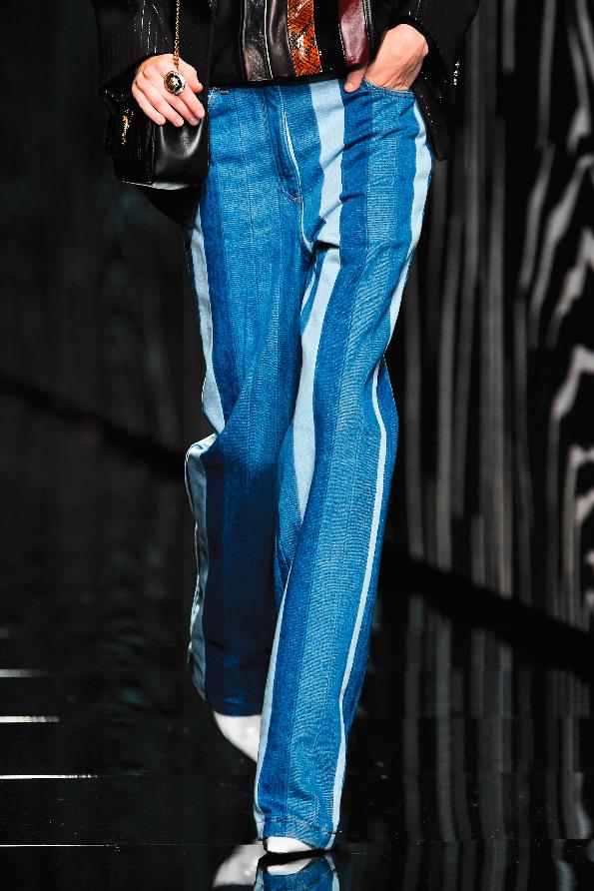
Chemical use
Polyfluorinated chemicals (PFC)
Formaldehyde
Flame retardants
Cadmium, mercury, lead
Azo dyes
All images in this presentation are subject to copyright. Copyright owners are listed in the book.
By downloading these presentations you agree that they are for classroom use only.

Slide 4
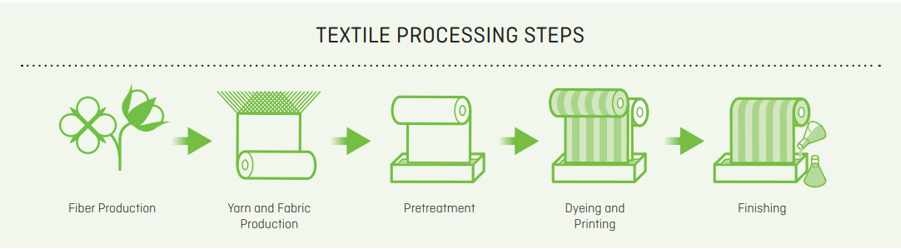
Textile production
All images in this presentation are subject to copyright. Copyright owners are listed in the book.
By downloading these presentations you agree that they are for classroom use only.

Slide 5
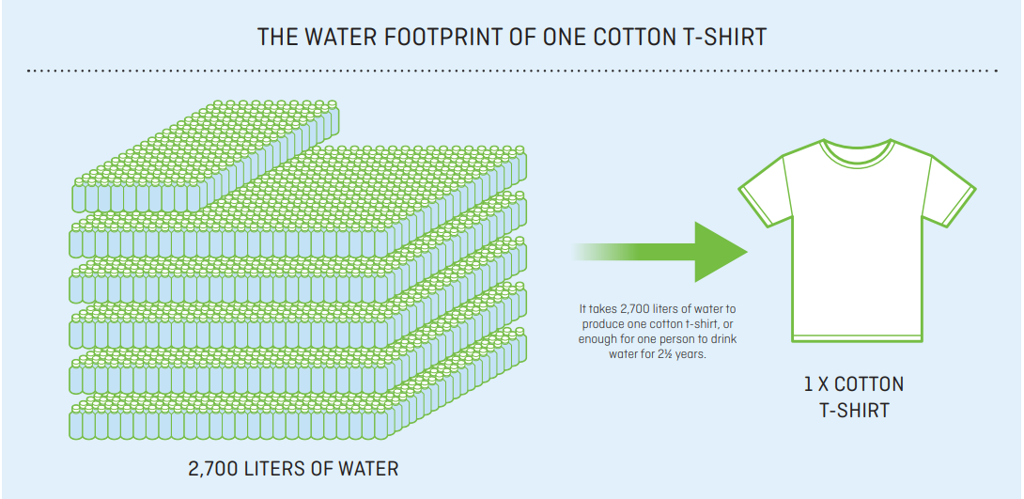
WATER USE
Textile wastewater (TWW)
Recycled water
All images in this presentation are subject to copyright. Copyright owners are listed in the book.
By downloading these presentations you agree that they are for classroom use only.

Slide 6
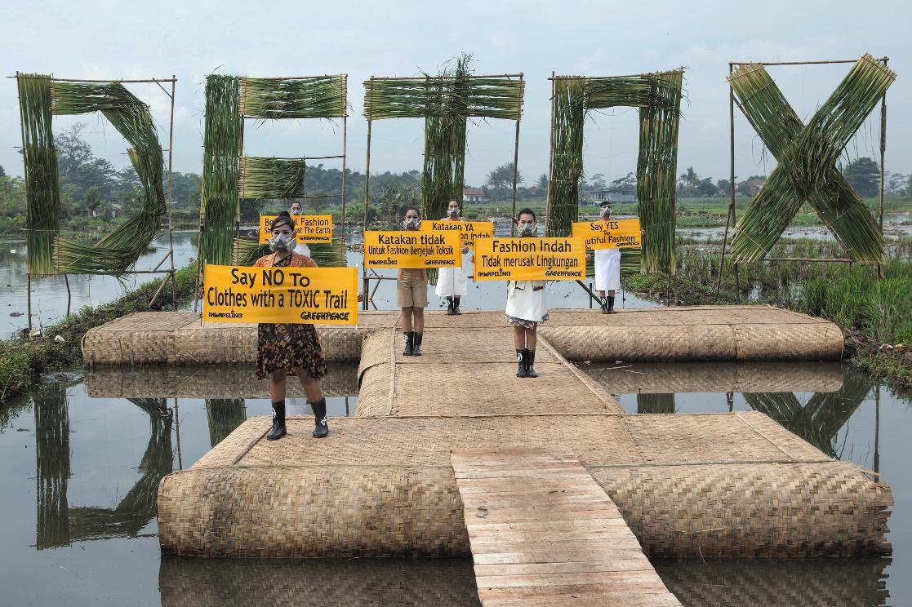
LAND use greenhouse GAses
All images in this presentation are subject to copyright. Copyright owners are listed in the book.
By downloading these presentations you agree that they are for classroom use only.

Slide 7
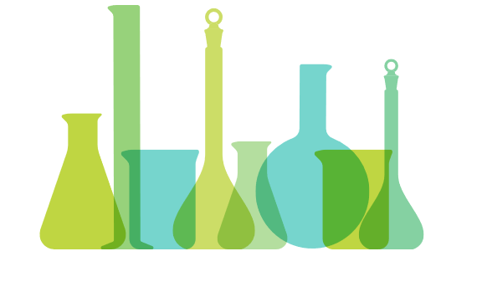
Circular alternatives
Green chemistry
Bacteria dyestuffs
Crab shell fixatives
Waterless dyes
Organic farming
Regenerative land use
All images in this presentation are subject to copyright. Copyright owners are listed in the book.
By downloading these presentations you agree that they are for classroom use only.

Slide 8
Circular Assessment tools
All images in this presentation are subject to copyright. Copyright owners are listed in the book.
By downloading these presentations you agree that they are for classroom use only.

Slide 9
Think Piece
Consider an item of clothing you are wearing. Trace its origin. Was the fiber the material is made from once growing in a field, on an animal’s back, or splashing around at the bottom of an oil well? Determine how many processes it took so you could wear this single item of clothing.

Slide 10


