Slide 1
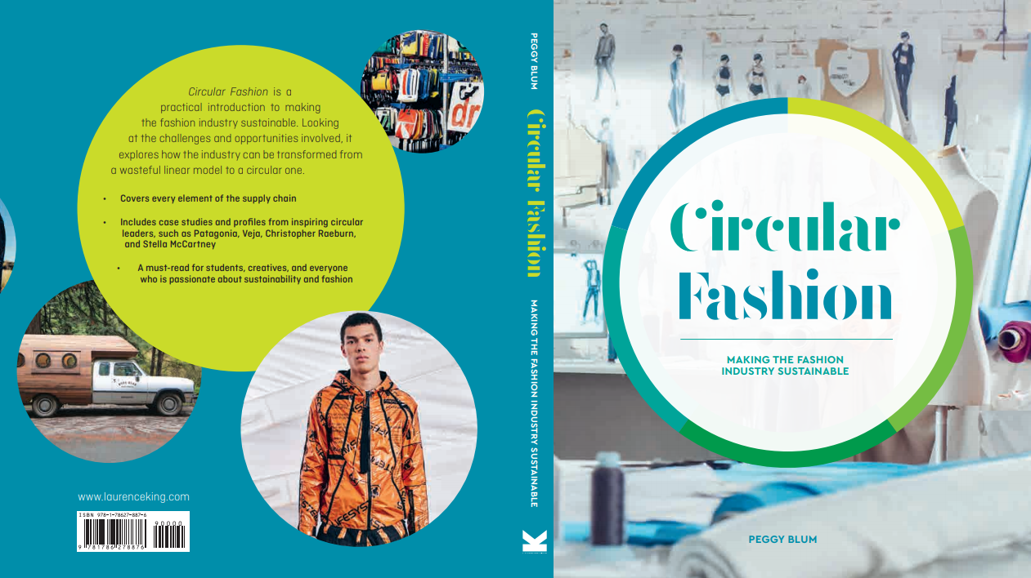

Slide 2

06:
Logistics And Transport
Circular Fashion: Making the Fashion Industry Sustainable

Slide 3
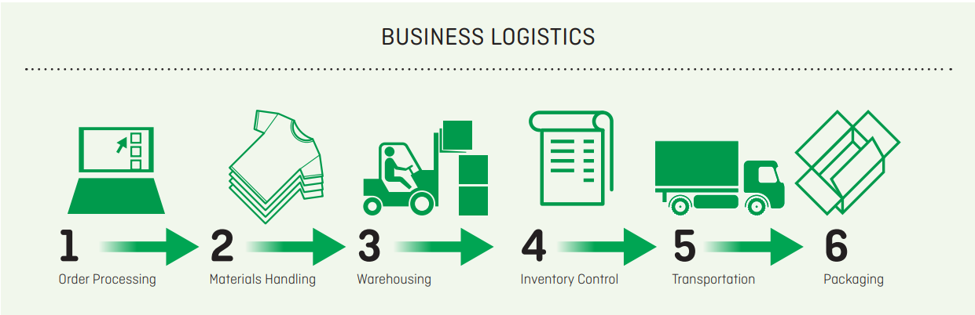
BUSINESS logistics
Speed-to-market logistics
Packaging
Plastic hangers
Robots
Third party logistics
All images in this presentation are subject to copyright. Copyright owners are listed in the book. By downloading these presentations you agree that they are for classroom use only.

Slide 4
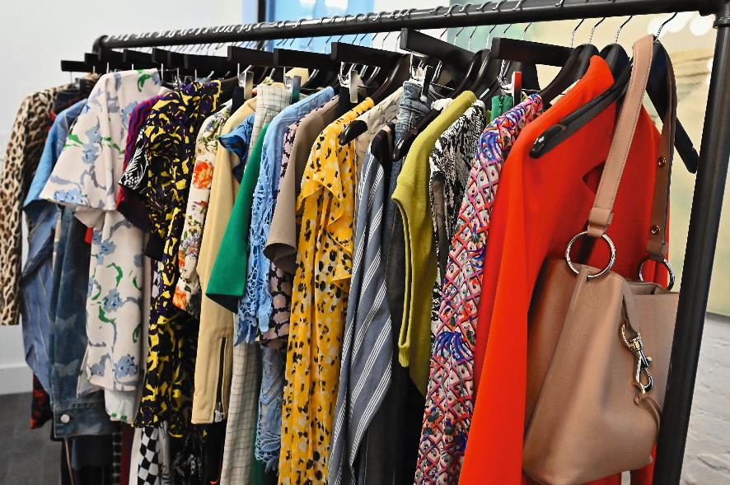
Packaging reconsidered
Recycled and upcycled packaging materials
Using less packaging
Innovative plant-based materials
Recycled plastic hangers
Recycling hanger components
All images in this presentation are subject to copyright. Copyright owners are listed in the book. By downloading these presentations you agree that they are for classroom use only.

Slide 5
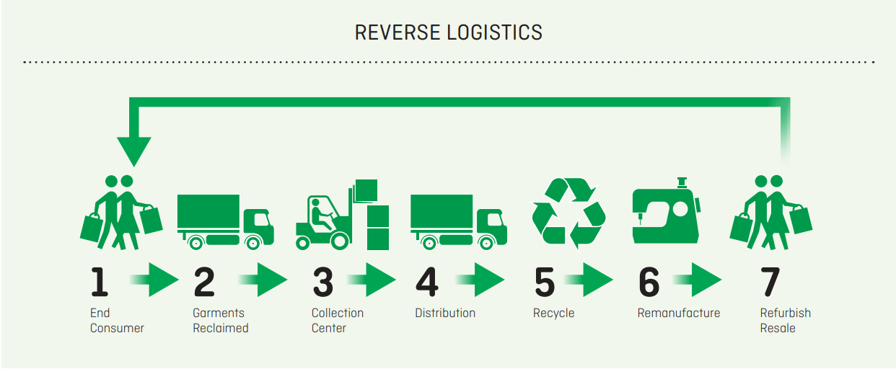
Circular reverse logistics
Take-back programs
Sustainable returns
Extended producer responsibility
All images in this presentation are subject to copyright. Copyright owners are listed in the book. By downloading these presentations you agree that they are for classroom use only.

Slide 6
Transport Road – Sea – air – Rail
Greenhouse gas: Any of the gases that are thought to cause the greenhouse effect, the steady rise in temperature of the earth’s atmosphere caused by an increase in gases especially carbon dioxide (CO2) in the air surrounding the earth, which trap the heat of the sun. Oxford Learner’s Dictionary
Carbon emissions: Carbon dioxide that planes, cars, factories, etc. produce, thought to be harmful to the environment. Cambridge Dictionary

Slide 7
Transport green freight
Green freight practices
Greener transportation networks
Carbon accounting: The process by which organizations quantify their Greenhouse Gas (GHG) emissions, so that they may understand their climate impact and set goals to limit their emissions. Supply Chain Solution Center, 2019

Slide 8
Think Piece
How can innovations and technologies in transportation benefit our future circular fashion economy?

Slide 9


