Slide 1
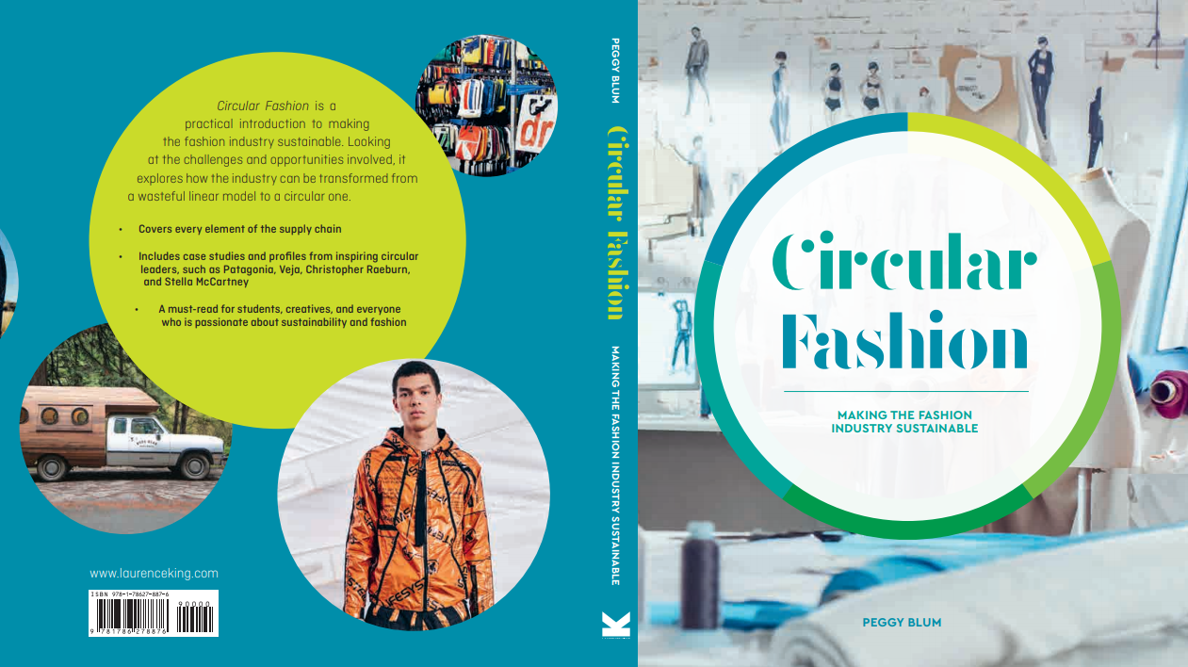

Slide 2

07:
REtail
Circular Fashion: Making the Fashion Industry Sustainable

Slide 3
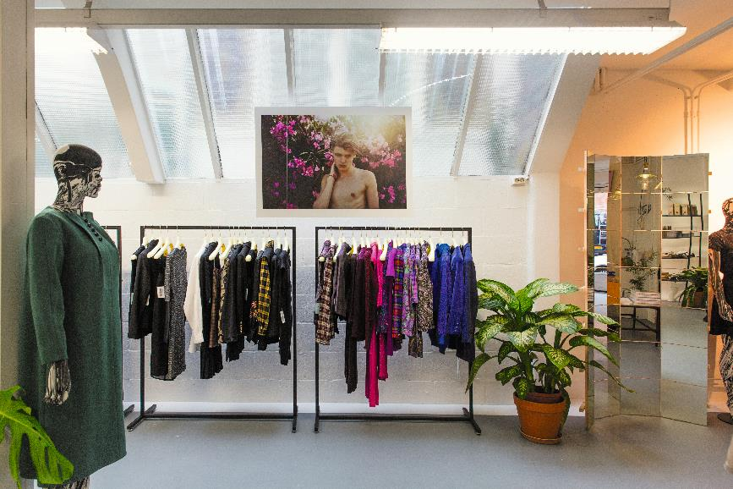
Retail Reality
All images in this presentation are subject to copyright. Copyright owners are listed in the book.
By downloading these presentations you agree that they are for classroom use only.

Slide 4
Circular retail MOdels
Recommerce
Rental
Subscription
Circular by design
Zero waste

Slide 5
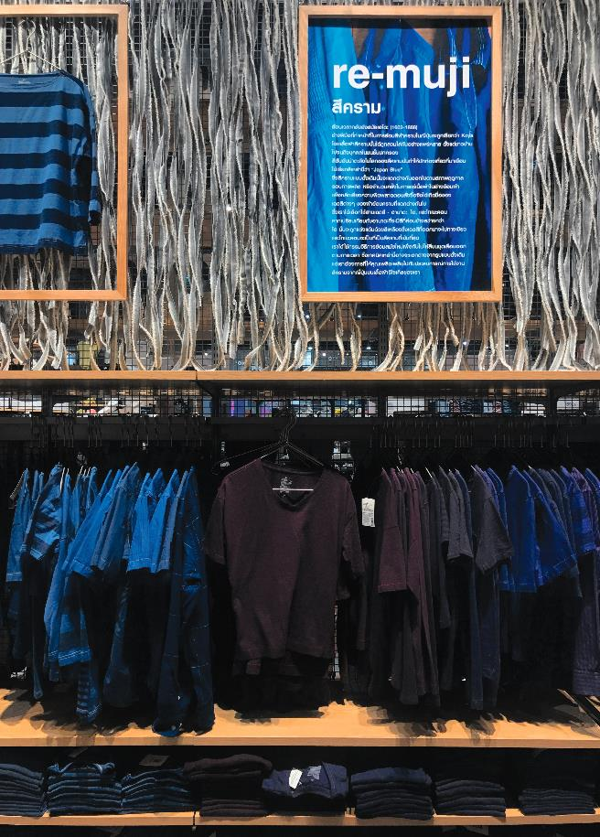
Recommerce MODEL
The evolution of secondhand clothing
Charity or thrift shops
Online resale platforms
Upcycle/recycle
In-store take-back programs
Consignment shops
All images in this presentation are subject to copyright. Copyright owners are listed in the book.
By downloading these presentations you agree that they are for classroom use only.

Slide 6
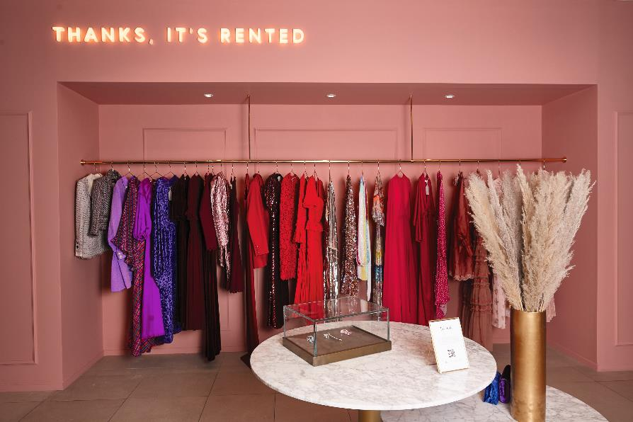
Rental MODEL
One-off hire of a garment for a short period of time
Users buy access to fashion products
Online peer-to-peer rental platforms
All images in this presentation are subject to copyright. Copyright owners are listed in the book.
By downloading these presentations you agree that they are for classroom use only.

Slide 7
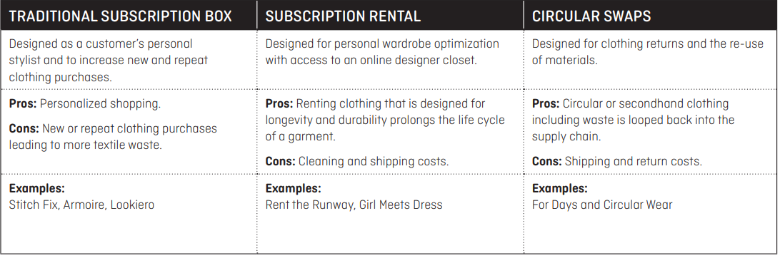
SUBSCRIPTION MODEL
All images in this presentation are subject to copyright. Copyright owners are listed in the book.
By downloading these presentations you agree that they are for classroom use only.

Slide 8
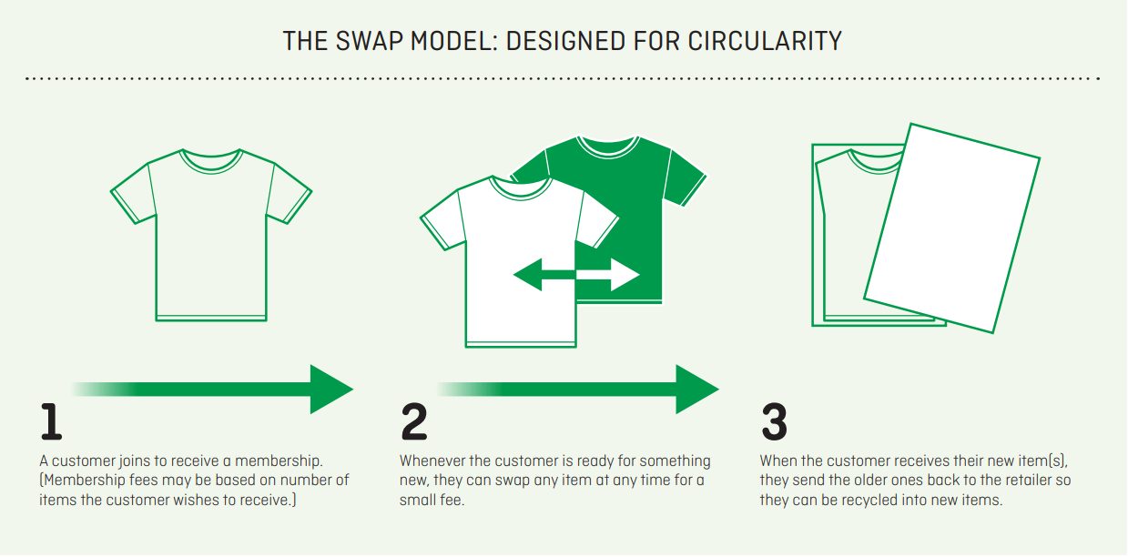
CIRCULAR BY design MODEL
All images in this presentation are subject to copyright. Copyright owners are listed in the book.
By downloading these presentations you agree that they are for classroom use only.

Slide 9
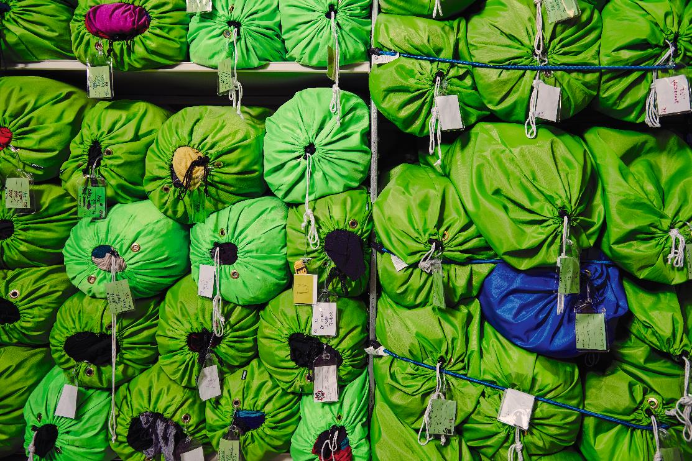
ZERO-waste RETAIL MODEL
Waste as a value proposition
Processes to foster waste reduction
Minimal, eco-friendly or no packaging
Retail store brands created from factory scraps
Eco-friendly store design and displays
All images in this presentation are subject to copyright. Copyright owners are listed in the book.
By downloading these presentations you agree that they are for classroom use only.

Slide 10
Think Piece
As new circular designed fashion products enter the marketplace, what types are best suited for specific circular retail models?

Slide 11


