Slide 1
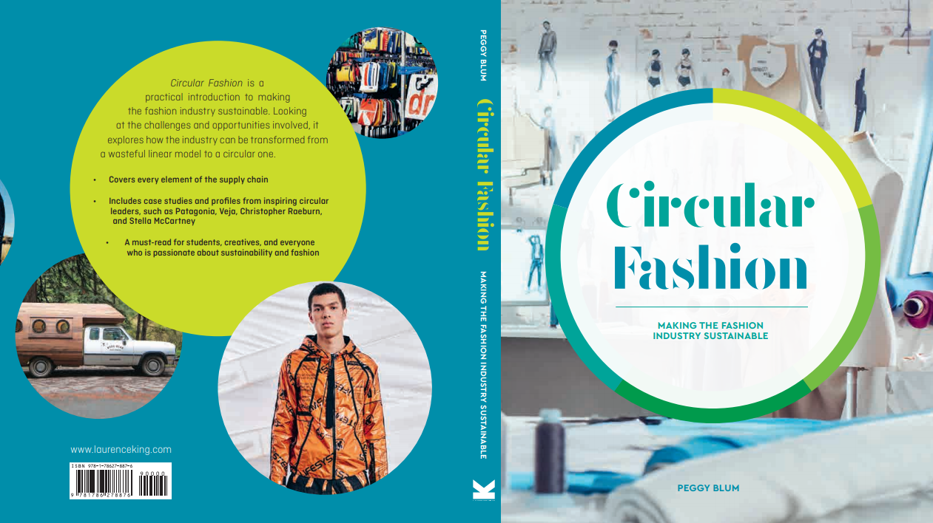

Slide 2

08:
marketing
Circular Fashion: Making the Fashion Industry Sustainable

Slide 3
Sustainability Marketing
Triple bottom line: People, planet, profit
Long-term strategic planning and financial investment
Authentic and transparent messaging to consumers

Slide 4
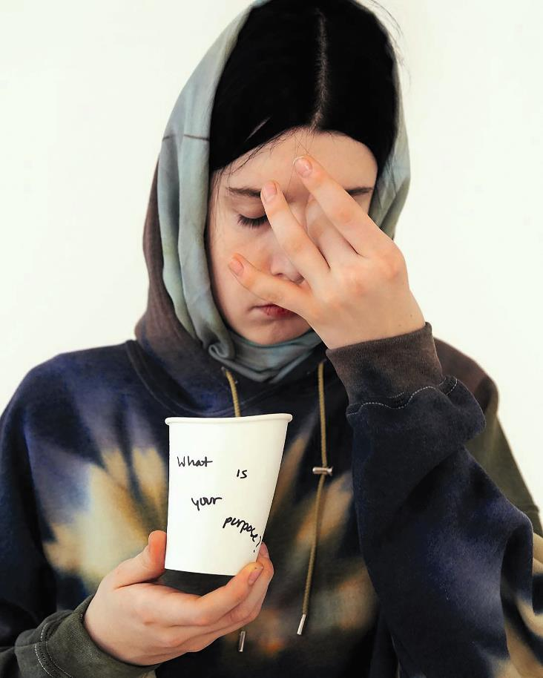
Sustainability or hype?
All images in this presentation are subject to copyright. Copyright owners are listed in the book.
By downloading these presentations you agree that they are for classroom use only.

Slide 5
Sustainability marketing plan
Design circular products as a starting point
Use industry tools, such as labels and certifications
Use simple and direct communication methods
Engage customers
Keep “bragging rights” to a minimum
Use ethical messaging and accurate information
Ensure sustainability permeates throughout the value chain and community

Slide 6
greenwashing
Greenwashing: Expressions of environmentalist concerns
especially as a cover for products, policies, or activities.
Merriam-Webster Dictionary

Slide 7
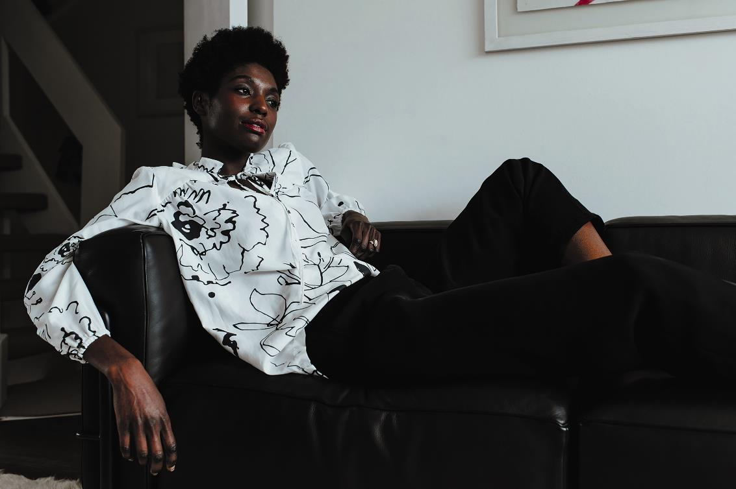
How to research a sustainable brand
Does the brand use mostly organic, recycled, or biodegradable materials?
Does the brand report on its own carbon footprint with solutions in place?
Does the brand allow customers to repair its products and then eventually recycle the products through a take-back program?
All images in this presentation are subject to copyright. Copyright owners are listed in the book.
By downloading these presentations you agree that they are for classroom use only.

Slide 8
Marketing circular fashion
Save the world/don’t save the world
Good humor
Circular narratives
Positive connections
Circular ecosystems
All images in this presentation are subject to copyright. Copyright owners are listed in the book.
By downloading these presentations you agree that they are for classroom use only.

Slide 9
Think Piece
After a proper analysis, determine if your favorite clothing brand is truly a sustainable brand or if it is just greenwashing. Are you surprised by the results?

Slide 10
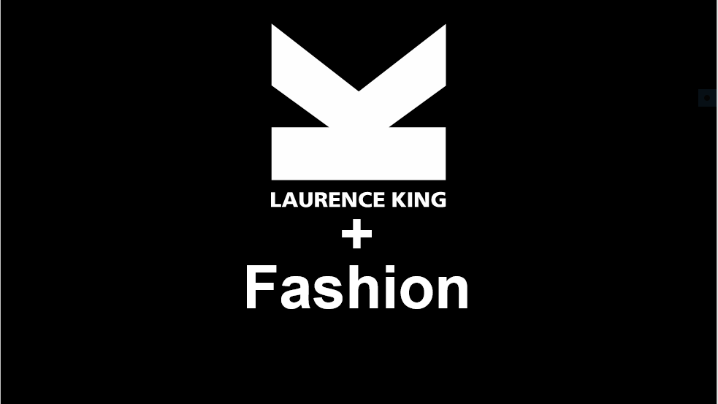
Think Piece
After a proper analysis, determine if your favorite clothing brand is truly a sustainable brand or if it is just greenwashing.
Are you surprised by the results?

