Slide 1
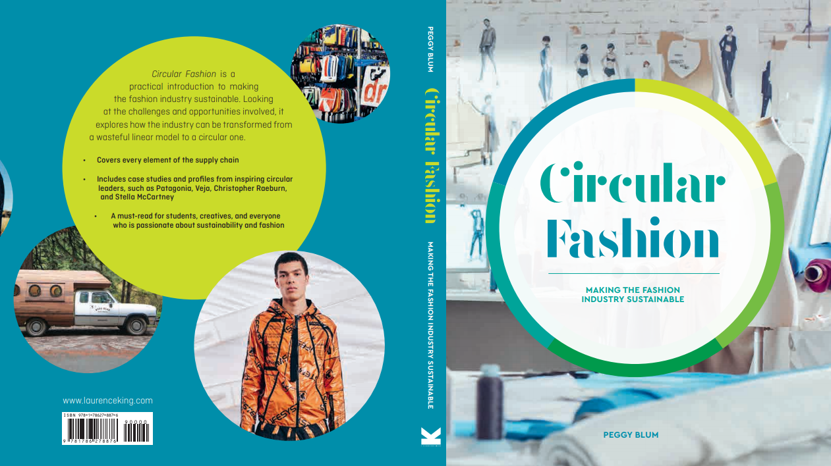

Slide 2

09:
consumption
Circular Fashion: Making the Fashion Industry Sustainable

Slide 3
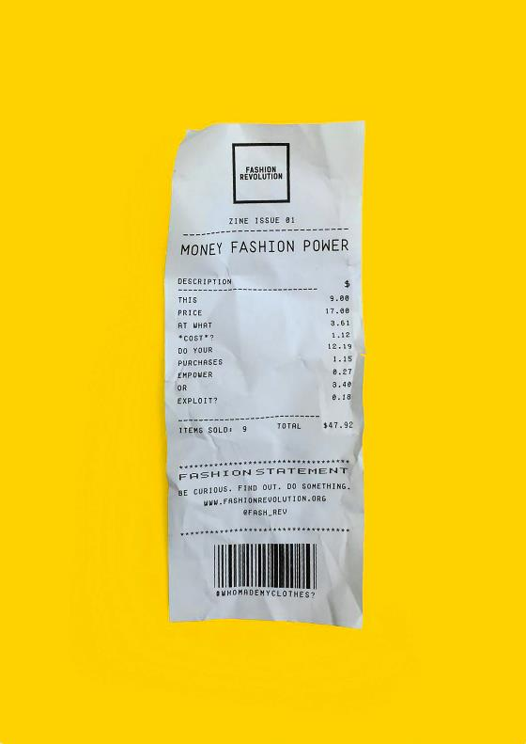
The purchasing power of consumers
All images in this presentation are subject to copyright. Copyright owners are listed in the book. By downloading these presentations you agree that they are for classroom use only.

Slide 4
overconsumption
Overconsumption: The state or an instance of consuming too much food, drink, fuel, clothing, etc. Collins Dictionary

Slide 5
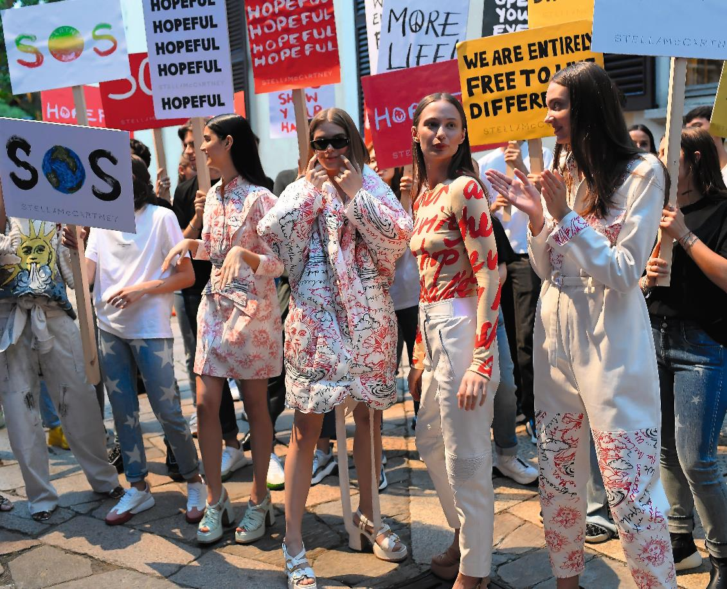
Consumers AND Brands as activists
All images in this presentation are subject to copyright. Copyright owners are listed in the book. By downloading these presentations you agree that they are for classroom use only.

Slide 6
principles of Sustainable consumption
Smart shopping
Clothing care
Wash-less clothing
Clothing repair

Slide 7
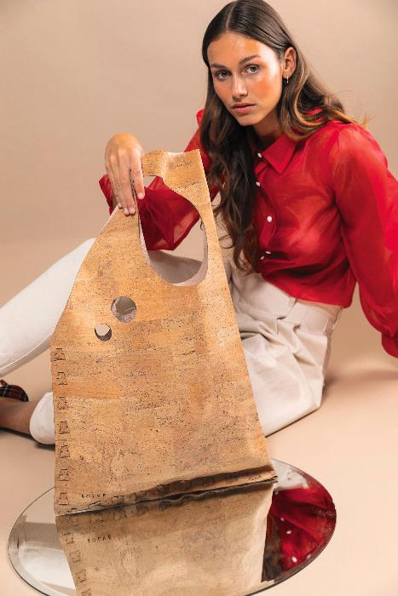
Consumers as co-creators
Sharing economy
Consumer and brand collaboration
Builds trust
Creates greater product value and ownership
Increases product life cycle
Digitizing the process
All images in this presentation are subject to copyright. Copyright owners are listed in the book. By downloading these presentations you agree that they are for classroom use only.

Slide 8
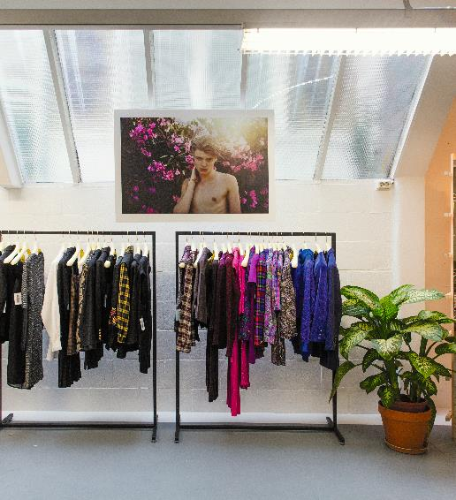
Consumers as users
Access to products versus ownership
Allows for frequent style changes
Increases product life cycle
Creates a positive environmental impact
All images in this presentation are subject to copyright. Copyright owners are listed in the book. By downloading these presentations you agree that they are for classroom use only.

Slide 9
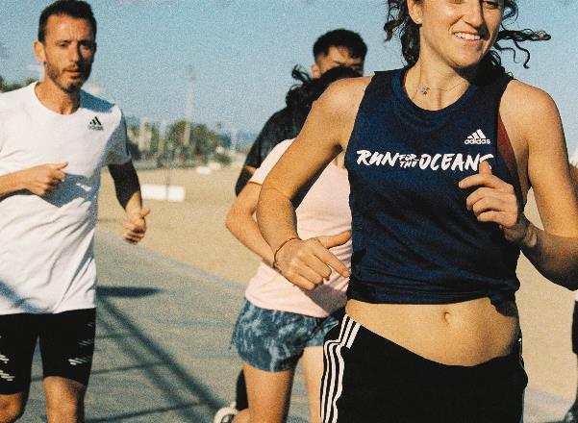
Consumers as local citizens
Builds local economy
Consumer connection to product and community
Ensures better quality control
Reduces carbon footprint
Generates less waste
All images in this presentation are subject to copyright. Copyright owners are listed in the book. By downloading these presentations you agree that they are for classroom use only.

Slide 10
Think Piece
What benefits would drive you to shift from owning your clothing to renting it?

Slide 11

Think Piece
After a proper analysis, determine if your favorite clothing brand is truly a sustainable brand or if it is just greenwashing.
Are you surprised by the results?

