Slide 1
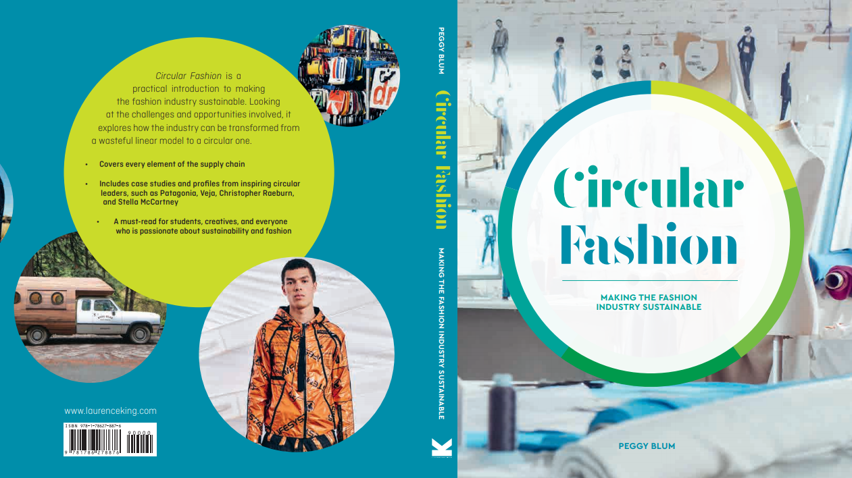

Slide 2

11:
END of use
Circular Fashion: Making the Fashion Industry Sustainable

Slide 3
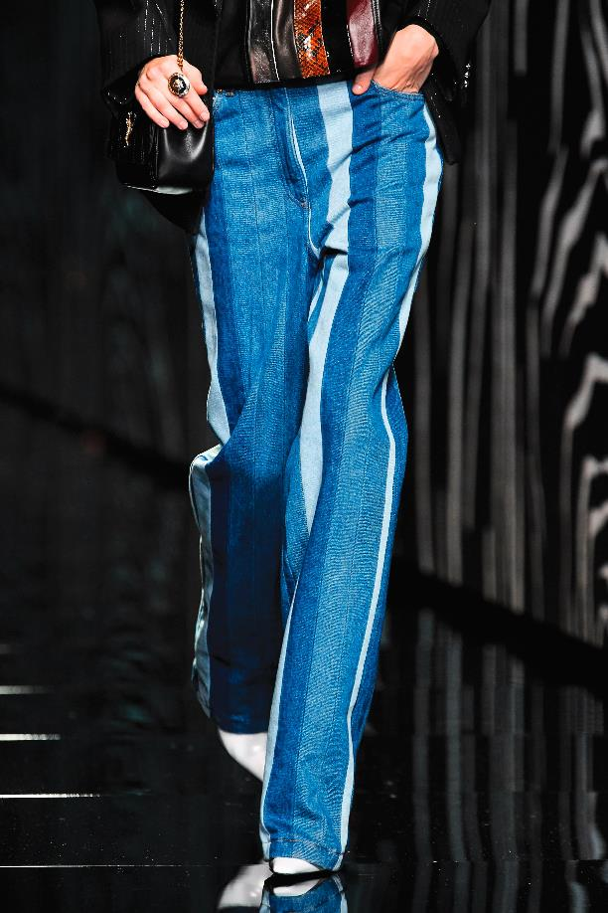
what happens when a piece of clothing is no longer wanted?
All images in this presentation are subject to copyright. Copyright owners are listed in the book. By downloading these presentations you agree that they are for classroom use only.

Slide 4
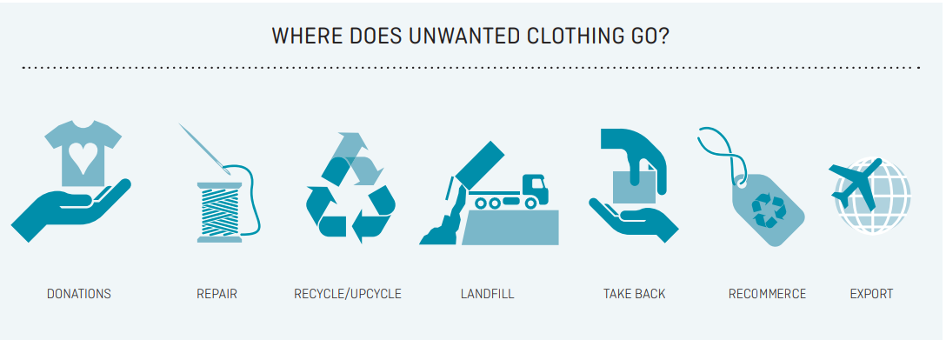
The disposal of unwanted clothing
All images in this presentation are subject to copyright. Copyright owners are listed in the book. By downloading these presentations you agree that they are for classroom use only.

Slide 5
Extended producer responsibility
Extended Producer Responsibility (EPR) is a government policy approach where producers take responsibility for the entire life cycle of the products they produce and sell in the market.

Slide 6
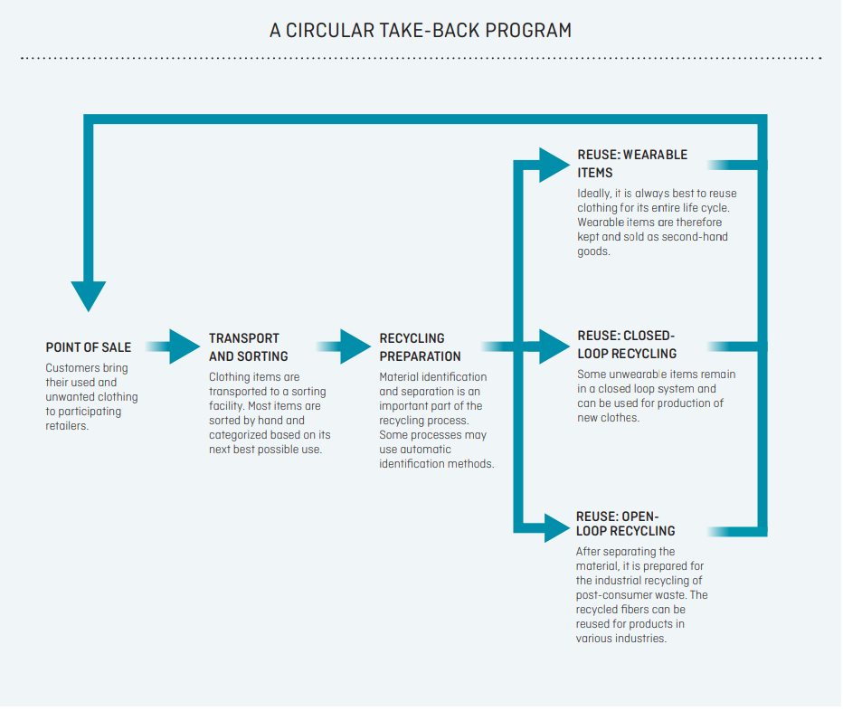
Circular Take-back program
All images in this presentation are subject to copyright. Copyright owners are listed in the book. By downloading these presentations you agree that they are for classroom use only.

Slide 7
Recycling
Closed-loop recycling process
The retailer or manufacturer has an end-of-use process in place and reuses collected items for products within its organization.
Open-loop recycling process
Clothing and textiles are collected, sorted, and processed, ultimately to be reused in various industries.

Slide 8
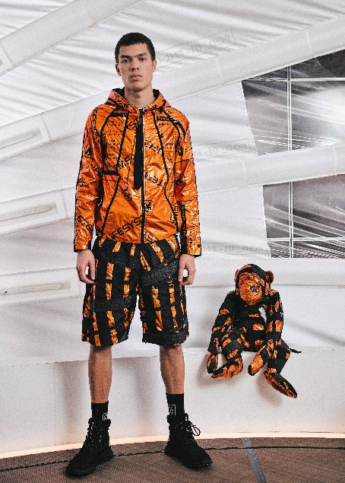
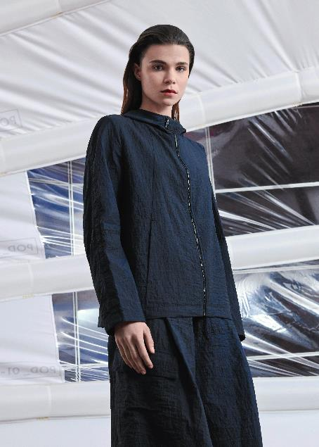
UPCYCLE
Upcycle: Reuse discarded objects or material in such a way as to create a product of higher quality or value than the original. Oxford Dictionary
All images in this presentation are subject to copyright. Copyright owners are listed in the book. By downloading these presentations you agree that they are for classroom use only.

Slide 9

UPMADE
Upmade software enables brands and manufacturers to apply industrial upcycling methods to their production models.
All images in this presentation are subject to copyright. Copyright owners are listed in the book. By downloading these presentations you agree that they are for classroom use only.

Slide 10
Think Piece
The majority of unprecedented growth in textile waste is driven by fast fashion and consumer behavior. In what ways can you properly dispose of your unwanted clothing?

Slide 11

Think Piece
After a proper analysis, determine if your favorite clothing brand is truly a sustainable brand or if it is just greenwashing.
Are you surprised by the results?

