Slide 1
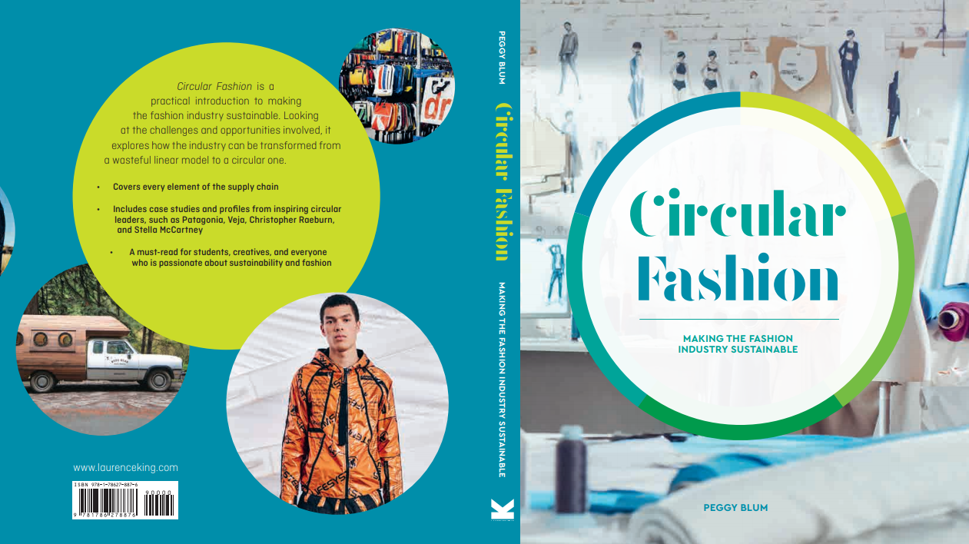

Slide 2

12:
Collaboration
And innovation
Circular Fashion: Making the Fashion Industry Sustainable

Slide 3
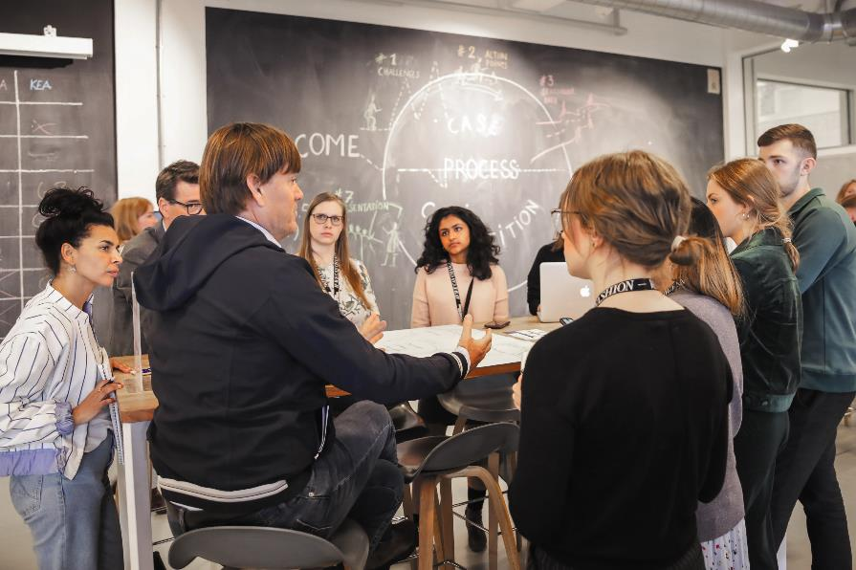
collaboration
All images in this presentation are subject to copyright. Copyright owners are listed in the book. By downloading these presentations you agree that they are for classroom use only.

Slide 4
collaboration
Business
Government
Consumers/users
Educators

Slide 5
Inspirational figures
The Circulars
Global Fashion Agenda
Circular leaders
Fashion for Good

Slide 6
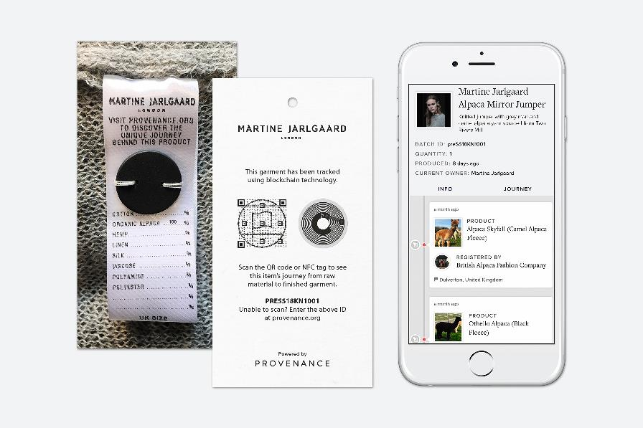
innovation
All images in this presentation are subject to copyright. Copyright owners are listed in the book. By downloading these presentations you agree that they are for classroom use only.

Slide 7
innovation
Sustainable materials
Digital traceability
Recycling technologies

Slide 8
Think Piece
How can individuals, businesses, and educators collaborate to create innovative fashion products and services for the future? How can these products and services respond to the
current challenges the industry faces?

Slide 9

Think Piece
After a proper analysis, determine if your favorite clothing brand is truly a sustainable brand or if it is just greenwashing.
Are you surprised by the results?

